Slide 1


Ryan White Part A & Minority AIDS Initiative Service Utilization in the Indianapolis Transitional Grant Area: FY 2016-2017
June 1, 2017
Tammie L. Nelson, MPH, CPH
TNelson@MarionHealth.org

Slide 2
Objective
To provide the Ryan White Planning Council with information necessary for FY 2018-2019 priority setting and allocation

Slide 3
The Indianapolis Transitional Grant Area (TGA)

Slide 4
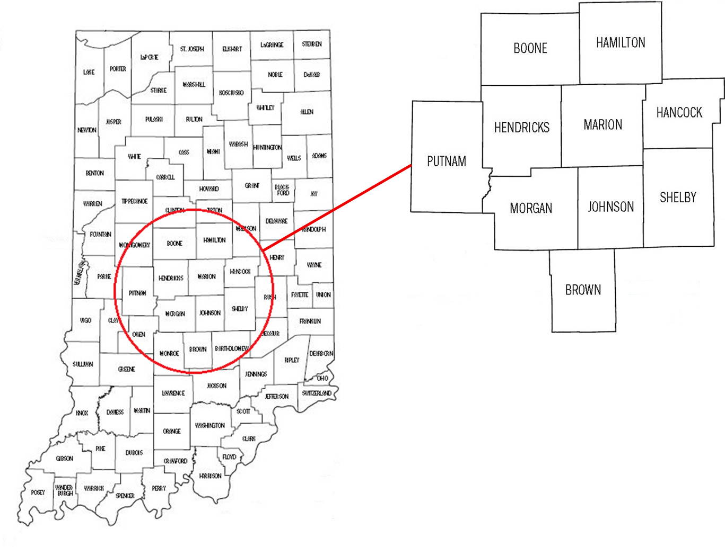
Indianapolis TGA Population
Ten Central Indiana counties with an estimated population of 1.86 million¹ (6% increase since 2010)² ³

Slide 5
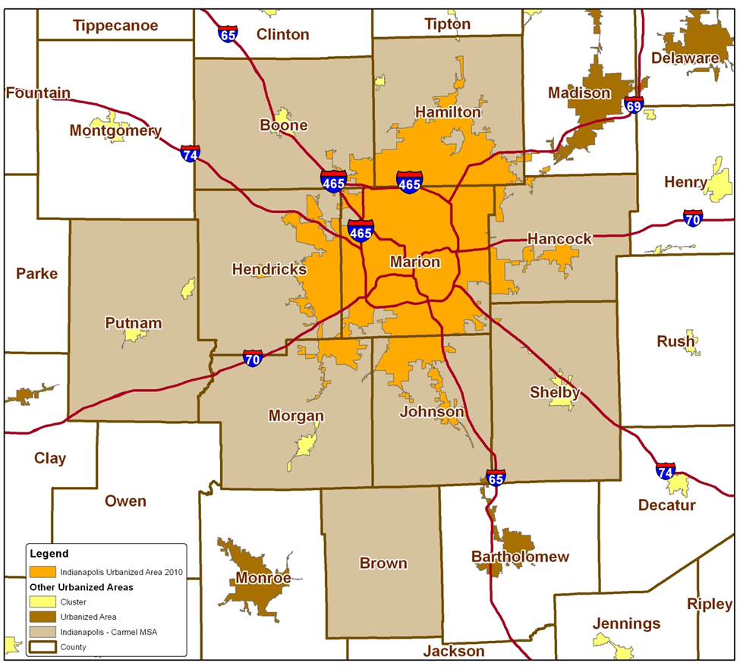
TGA Population Center
88% of the TGA’s population in orange⁴
46% reside inside Indianapolis city limits¹

Slide 6
Overview of Part A and Minority AIDS Initiative (MAI) Funding

Slide 7
Overview of Part A and MAI Funding
Part A Funding = Formula + Supplemental⁵
Formula funds are based on the number of people living with HIV/AIDS (PLWH/A) in the TGA
Supplemental funds are awarded competitively based on demonstrated need and other selective criteria
Includes core medical and support services designed to provide a continuum of care for PLWH/A
Core Medical
Must account for at least 75% of Part A funds allocated for services (without a waiver)
Support Services
Must be linked to the continuum of care and cannot exceed 25% of Part A funds allocated for services unless a waiver is obtained

Slide 8
Overview of Part A and MAI Funding
MAI Funding⁵
Funding based on distribution of PLWH/A among racial/ethnic minorities residing in the TGA
Supports services for minority populations
Data Sources
Utilization data collected using the Ryan White Information Services Enterprise (RISE) database⁶
Clinical and outcomes data collected using RISE, CAREWare, and the Enhanced HIV/AIDS Reporting System (eHARS) database⁷

Slide 9
All Parts Spending in the Indianapolis TGA

Slide 12
Part A and MAI Service Utilization

Slide 13
Part A/MAI Utilization: FY 2016-2017
During FY 2016-2017:
2,690 unique clients utilized 27,952 units of service excluding 7,664 EIS tests administered
Core Medical accounted for 63.9% of Part A/MAI service units and 75.3% of dollars spent at an average cost of $121 per unit
Support Services accounted for 36.1% of Part A/MAI service units and 24.7% of dollars spent at an average cost of $70 per unit

Slide 14
Part A/MAI Utilization: FY 2016-2017 vs. FY 2015-2016
The number of clients and services utilized increased considerably during FY 2016-2017
Number of clients increased 5.5% (2,690 v. 2,549)
Number of EIS tests decreased 2.5% (7,664 v. 7,858)
Units of non-EIS service increased 4.2% (27,952 v. 26,825)
Cost per client decreased 1.7% ($1,354 v. $1,378)

Slide 15
Utilization of Core Medical Services

Slide 16
Utilization in FY 2016-2017 v. FY 2015-2016

Slide 17
Utilization in FY 2016-2017 v. FY 2015-2016

Slide 18
Utilization in FY 2016-2017 v. FY 2015-2016

Slide 19
Utilization in FY 2016-2017 v. FY 2015-2016

Slide 20
Early Intervention Services (EIS)
Accounted for 21.5% of Part A/MAI services utilized and 10.3% of dollars spent
Utilized by 7,568 clients, a decrease of 4% from FY15 (N=7,858)
1.0 service unit per client
Averaged $50 per client, a decrease of 18.8% from FY15 ($61)

Slide 21
Medical Case Management (Including Treatment Adherence)
Accounted for 23.4% of Part A/MAI services utilized and 30.4% of dollars spent
Utilized by 2,225 clients, an increase of 12.4% from FY15 (N=1,980)
Averaged 3.7 service units per client, an increase of 29.5% from FY15 (N=2.9)
Averaged $496.74 per client, an increase of 27.8% from FY15 ($388.77)

Slide 22
Outpatient Ambulatory/Primary Medical Care
Accounted for 10.7% of Part A/MAI services utilized and 18% of dollars spent
Utilized by 531 clients, an increase of 2.5% from FY15 (N=518)
Averaged 7.2 service units per client, a decrease of 25.3% from FY15 (N=9.6)
Averaged $1,234.81 per client, a decrease of 18.1% from FY15 ($1,507.99)

Slide 23
Mental Health Services
Accounted for 5.2% of Part A/MAI services utilized and 6.6% of dollars spent
Utilized by 273 clients, a decrease of 5.9% from FY15 (N=290)
Averaged 6.8 service units per client, an increase of 18.5% from FY15 (N=5.7)
Averaged $880.53 per client, an increase of 86.3% from FY15 ($473)

Slide 24
Oral Health Care
Accounted for 0.9% of Part A/MAI services utilized and 1.5% of dollars spent
Utilized by 102 clients, a decrease of 22.7% from FY15 (N=132)
Averaged 3.0 service units per client, a decrease of 36.9% from FY15 (N=4.8)
Averaged $550.81 per client, a decrease of 17.6% from FY15 ($668)

Slide 25
AIDS Pharmacy Assistance (Local)
Accounted for 0.6% of Part A/MAI services utilized and 3.7% of dollars spent
Utilized by 97 clients, a decrease of 2.0% from FY15 (N=99)
Averaged 2.3 service units per client - no change from FY15
Averaged $1,390.79 per client, a decrease of 0.9% from FY15 ($1,404)

Slide 26
Health Insurance Premium & Cost Sharing Assistance
Accounted for 0.9% of Part A/MAI services utilized and 4.1% of dollars spent
Utilized by 42 clients, an decrease of 12.5% from FY15 (N=48)
Averaged 7.5 service units per client, an increase of 4.3% from FY15 (N=7.1)
Averaged $3,570.93 per client, a decrease of 5.8% from FY15 ($3,792)

Slide 27
Substance Abuse Services
Accounted for 0.3% of Part A/MAI services utilized and 0.4% of dollars spent
Utilized by 33 clients, a decrease of 25.0% from FY15 (N=44)
Averaged 3.3 service units per client, a decrease of 55.4% from FY15 (N=7.5)
Averaged $494.79 per client, a decrease of 54.0% from FY15 ($1,076)

Slide 28
Nutrition Services
Accounted for 0.4% of Part A/MAI services utilized and 0.2% of dollars spent
Utilized by 80 clients, an increase of 515.4% from FY15 (N=13)
Averaged 1.7 service units per client, an increase of 59.0% from FY15 (N=1.1)
Averaged $110.31 per client, an increase of 52.6% from FY15 ($72)

Slide 29
Utilization of Support Services

Slide 30
Utilization in FY 2016-2017 v. FY 2015-2016

Slide 31
Utilization in FY 2016-2017 v. FY 2015-2016

Slide 32
Utilization in FY 2016-2017 v. FY 2015-2016

Slide 33
Utilization in FY 2016-2017 v. FY 2015-2016

Slide 34
Non-Medical Case Management
Accounted for 16.7% of Part A/MAI services utilized and 12.5% of dollars spent
Utilized by 2,225 clients, an increase of 0.1% from FY15 (N=2,223)
Averaged 2.7 service units per client, an increase of 3.5% from FY15 (N=2.6)
Averaged $204.22 per client, an increase of 6.7% from FY15 ($191)

Slide 35
Health Education/Risk Reduction (HE/RR)
Accounted for 4.3% of Part A/MAI services utilized and 2.3% of dollars spent
Utilized by 507 clients, a decrease of 54.3% from FY15 (N=1,110)
Averaged 3.0 service units per client – no change from FY15
Averaged $165.81 per client, an increase of 118.9% from FY15 ($76)

Slide 36
Outreach Services
Accounted for 1.6% of Part A/MAI services utilized and 0.6% of dollars spent
Utilized by 250 clients, a decrease of 44.3% from FY15 (N=449)
Averaged 2.3 service units per client, an increase of 128.8% from FY15 (N=1.0)
Averaged $88.38 per client, a decrease of 44.0% from FY15 ($158)

Slide 37
Emergency Financial: Food
Accounted for 2.5% of Part A/MAI services utilized and 0.8% of dollars spent
Utilized by 406 clients, a decrease of 0.7% from FY15 (N=409)
Averaged 2.2 service units per client – no change from FY15
Averaged $73.92 per client, a decrease of 5.1% from FY15 ($78)

Slide 38
Medical Transportation Services
Accounted for 8.3% of Part A/MAI services utilized and 2.2% of dollars spent
Utilized by 351 clients, an increase of 2.0% from FY15 (N=344)
Averaged 8.4 service units per client, an increase of 87.2% from FY15 (N=4.5)
Averaged $227.26 per client, an increase of 45.2% from FY15 ($157)

Slide 39
Short Term Housing
Accounted for 0.6% of Part A/MAI services utilized and 3.0% of dollars spent
Utilized by 160 clients, a decrease of 1.2% from FY15 (N=162)
Averaged 1.3 service units per client, an increase of 8.8% from FY15 (N=1.2)
Averaged $692.06 per client, an increase of 3.4% from FY15 ($669)

Slide 40
Emergency Financial: Utilities
Accounted for 0.7% of Part A/MAI services utilized and 1.3% of dollars spent
Utilized by 153 clients, an increase of 22.4% from FY15 (N=125)
Averaged 1.5 service units per client, an increase of 4.7% from FY15 (N=1.4)
Averaged $315.35 per client, an increase of 6.3% from FY15 ($297)

Slide 41
Psychosocial Services
Accounted for 0.3% of Part A/MAI services utilized and 0.8% of dollars spent
Utilized by 43 clients, a decrease of 30.6% from FY15 (N=62)
Averaged 2.6 service units per client, a decrease of 31.6% from FY15 (N=3.8)
Averaged $664.91 per client, an increase of 49.5% from FY15 ($445)

Slide 42
Legal Services
Accounted for 0.5% of Part A/MAI services utilized and 0.5% of dollars spent
Utilized by 72 clients, an increase of 18.0% from FY15 (N=61)
Averaged 2.3 service units per client, a decrease of 32.8% from FY15 (N=3.4)
Averaged $248.07 per client, a decrease of 31.6% from FY15 ($362)

Slide 43
Linguistic Services
Accounted for 0.8% of Part A/MAI services utilized and 0.6% of dollars spent
Utilized by 44 clients – no change from FY15
Averaged 6.5 service units per client, an increase of 94.5% from FY15 (N=3.3)
Averaged $488.34 per client, an increase of 90.8% from FY15 ($256)

Slide 44
Part A/MAI Client Profile

Slide 45
Client Status and Time Enrolled
During FY 2016-2017, a total of 2,690 unique clients utilized Part A and/or MAI services, an increase of 5.5% over FY 2015-2016 (N=2,549)
Of clients served, 66.8% (N=1,797) have an active client status, a decrease of 1.6% over FY 2015-2016 (67.9%)
Of unique clients served, 10.9% (N=292) applied for and accessed Ryan White services for the first time – About the same as FY 2015-2016 (11%)
Clients were enrolled from <1 to 52 weeks with an average duration of 35.7 weeks

Slide 46
Part A/MAI Clients by Enrollment Status

Slide 47
Part A/MAI Clients by Gender

Slide 48
Part A/MAI Clients by Current Age

Slide 49
Part A/MAI Clients by Race/Ethnicity

Slide 50
Part A/MAI Clients by HIV Status

Slide 51
Part A/MAI Clients by Exposure Category

Slide 52
Part A/MAI Clients by Poverty Level

Slide 53
Part A/MAI Clients by County of Residence
During FY 2016, 45.5% of PLWH/A in the TGA utilized Part A/MAI services (2,690 of 5,907) – up from 44.9%
49.3% of Marion County PLWH/A accessed services – up from 49.0%
23.8% of PLWH/A in the outlying counties accessed services – up from 20.0%
N missing = 16

Slide 54
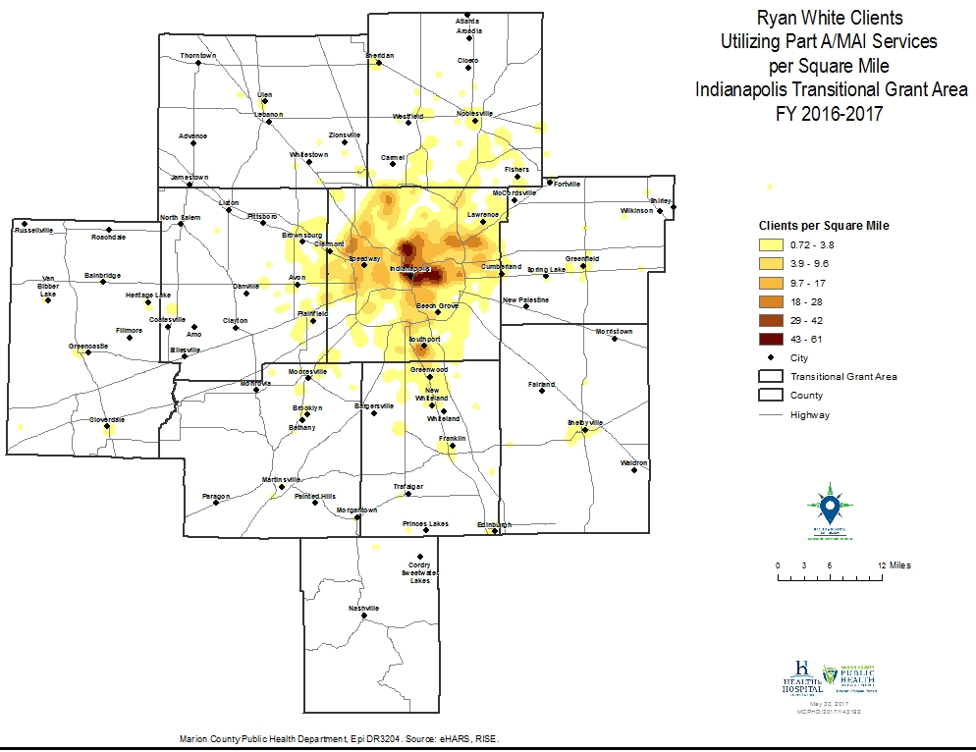

Slide 55
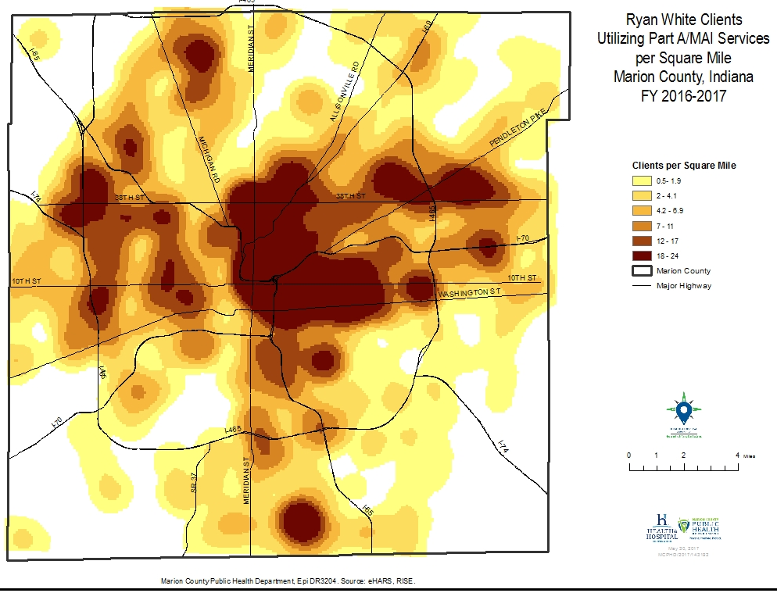

Slide 56

HIV Continuum of Care in the TGA

Slide 57
HIV Care Continuum Definitions
Linked to Care: People newly diagnosed with HIV during FY 2016 who received a CD4/viral load test within 90 days
Retained in Care: Residents living with HIV/AIDS with 2+ CD4/viral load tests performed at least 3 months apart in FY 2016
Antiretroviral Therapy: Residents living with HIV/AIDS who received a prescription for antiretroviral therapy in FY 2016
Viral Load Suppression: Residents living with HIV/AIDS with a FY 2016 viral load result <200 RNA copies/mL

Slide 58
Ryan White Clients v. Non-Client PLWH/A
* The National HIV/AIDS Strategy goal is 30 days until linkage to care. When using that benchmark, only 65.0% of RWSP clients and 67.1% of non-RWSP clients were linked to care.

Slide 59


Slide 60


Slide 61
Michael Wallace
Director
Tammie L. Nelson, MPH, CPH
Epidemiologist
Ryan White HIV Services Program
Health & Hospital Corporation
Marion County Public Health Department
http://RyanWhiteIndy.org

Slide 62
References
¹ U.S. Census Bureau. (2016). Annual estimates of the resident population: April 1, 2010 to July 1, 2015. U.S. Census Bureau, Population Division. Release dates: For the United States, regions, divisions, states, and Puerto Rico Commonwealth, December 2015; For counties and Puerto Rico municipios, March 2016.
² U.S. Census Bureau. (2002). Time series of Indiana intercensal population estimates by county: April 1, 1990 to April 1, 2000. Table CO-EST2001-12-18. Release date April 17, 2002.
³ U.S. Census Bureau. (2011). Intercensal estimates of the resident population for counties of Indiana: April 1, 2000 to July 1, 2010. Table CO-EST00INT-01-18.
⁴ Glenn, R. (2011). Demographics & trends: Indianapolis, Marion County & the Indianapolis region. Department of Metropolitan Development: City of Indianapolis.
⁵ Health Resources and Services Administration. (2014). About the Ryan White HIV/AIDS program – About Part A: Grants to emerging metropolitan & transitional grant areas. Washington D.C.: U.S. Department of Health and Human Services. Available at http://hab.hrsa.gov/abouthab/parta.html
⁶ Ryan White HIV Services Program. (2014). Ryan White Information Services Enterprise (RISE). Indianapolis: Marion County Public Health Department.
⁷ Centers for Disease Control and Prevention. (2014). Enhanced HIV/AIDS Reporting System (eHARS). Indianapolis: Indiana State Department of Health.
⁸ U.S. Department of Health & Human Services. (2015). 2015 poverty guidelines. Retrieved from https://aspe.hhs.gov/2015-poverty-guidelines.

