Slide 1


Epidemiology of HIV in the Indianapolis Transitional Grant Area: 2019
May 07, 2020
Sam Parmar, MPH
SParmar@MarionHealth.org

Slide 2
Objectives
To identify trends in HIV incidence, prevalence, mortality, and health outcomes within the TGA
To provide the Ryan White Planning Council with information necessary for priority setting and allocation
To provide Planning Council subcommittees with relevant information

Slide 3

      Epidemiology

Slide 4
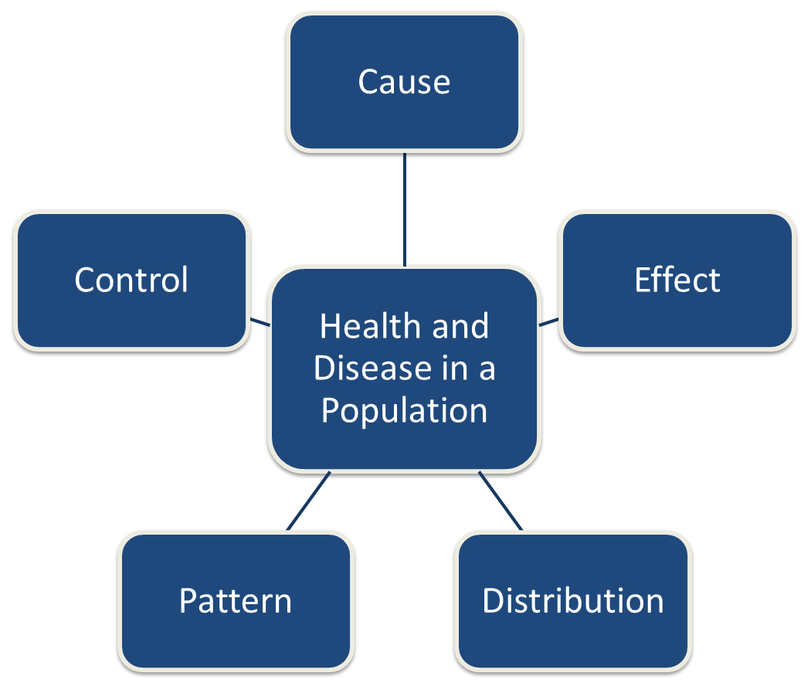
Epidemiology – The study of:

Slide 5
Epidemiology - Terminology
Incidence
  New diagnoses– Annual rate of new diagnoses per 100,000 of those at risk
Prevalence
  Existing diagnoses – The number of previously diagnosed and newly diagnosed people per 100,000 (e.g., number of TGA residents living with HIV on 12/31/2019 who were still living in the TGA on 12/31/2019)
Mortality
  Deaths due to a specific cause – Annual rate of deaths per 100,000
Rate Ratio
  Comparison of rates between two or more groups

Slide 6
      The Indianapolis Transitional Grant Area
      (TGA)

Slide 7
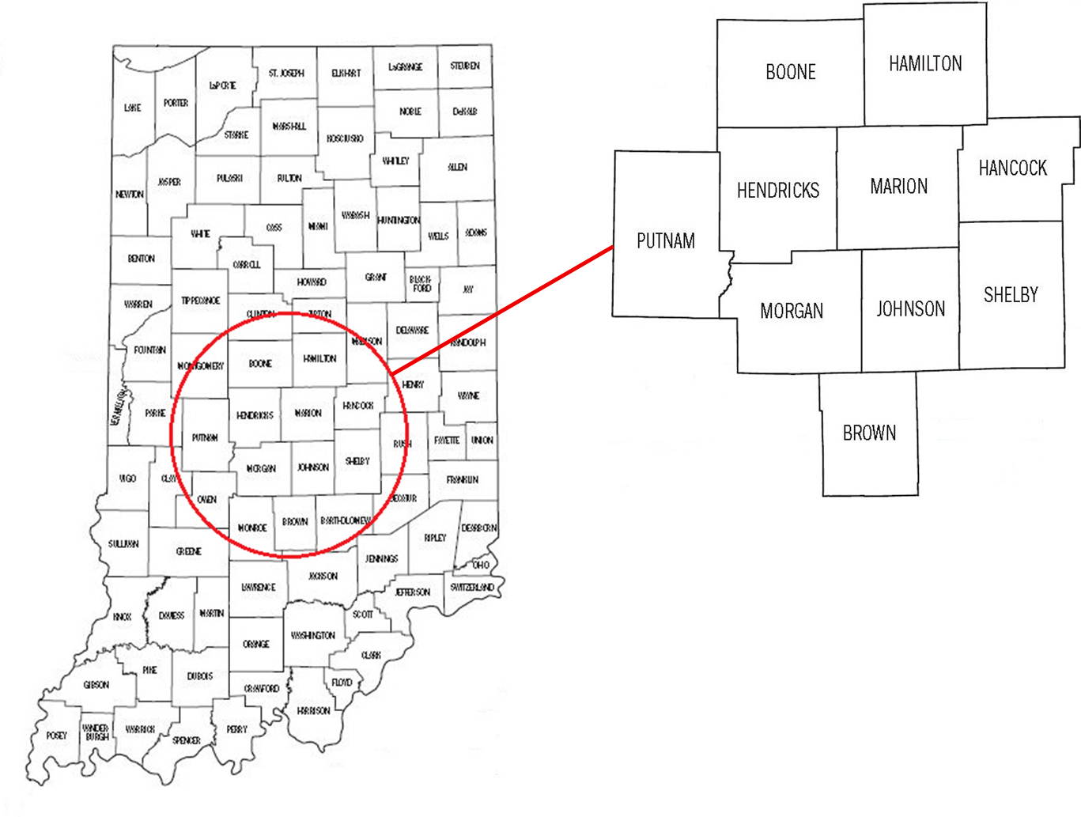
TGA Location & Population
Ten Central Indiana counties with a 2019 estimated population of 1.94 million¹ (10% increase since 2010)^{2, 3}
Notes:
1,760,856 to 1,920,076

Slide 8
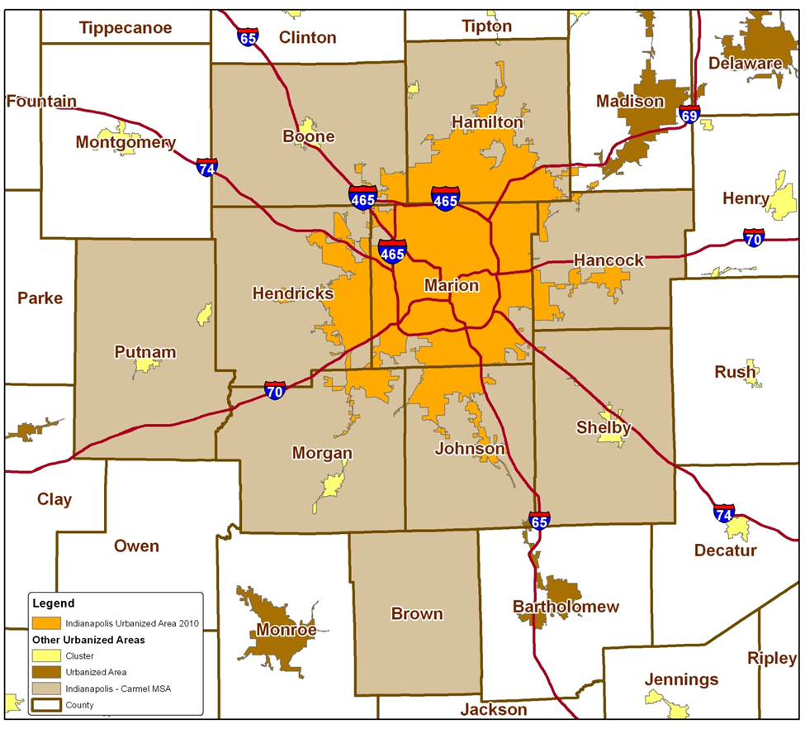
TGA Population Center
84% of the TGA’s population in orange⁴
49% reside inside Indianapolis city limits¹
Notes:
84% of TGA population is most recent estimate (1,604,134/1,920,076)
49% reside inside Indianapolis city limits (955,110/1,920,076)

Slide 9
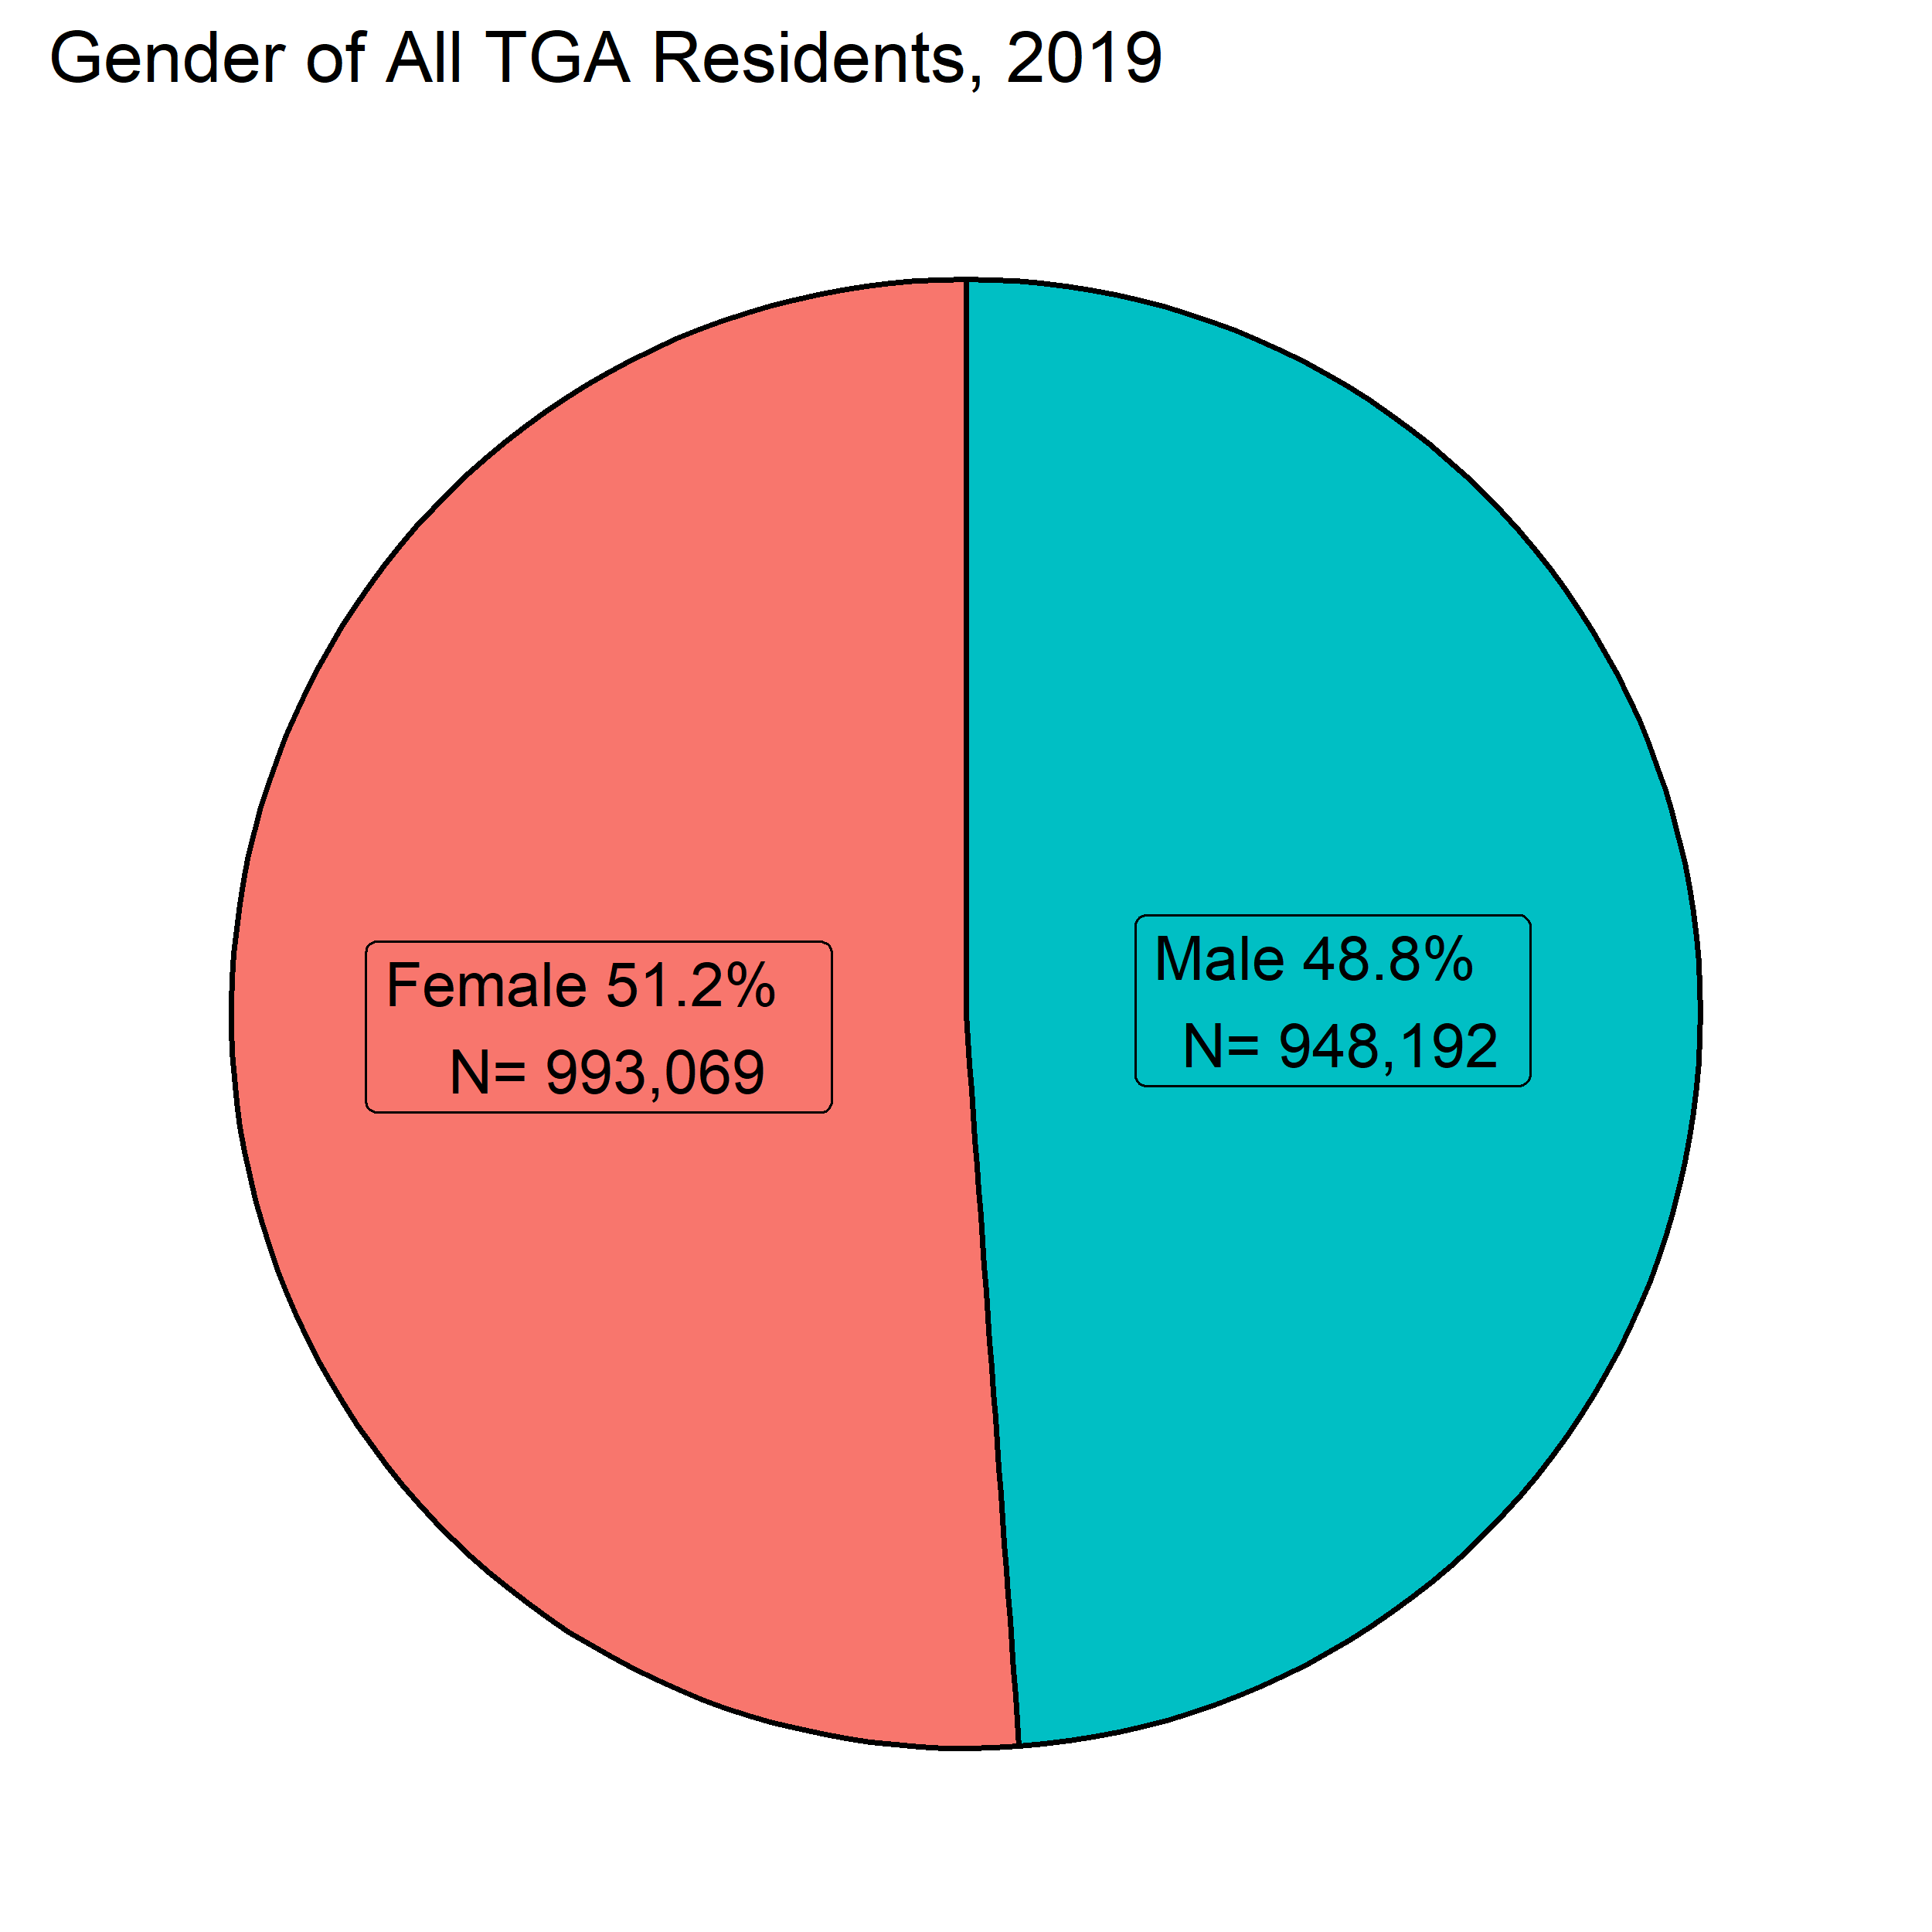
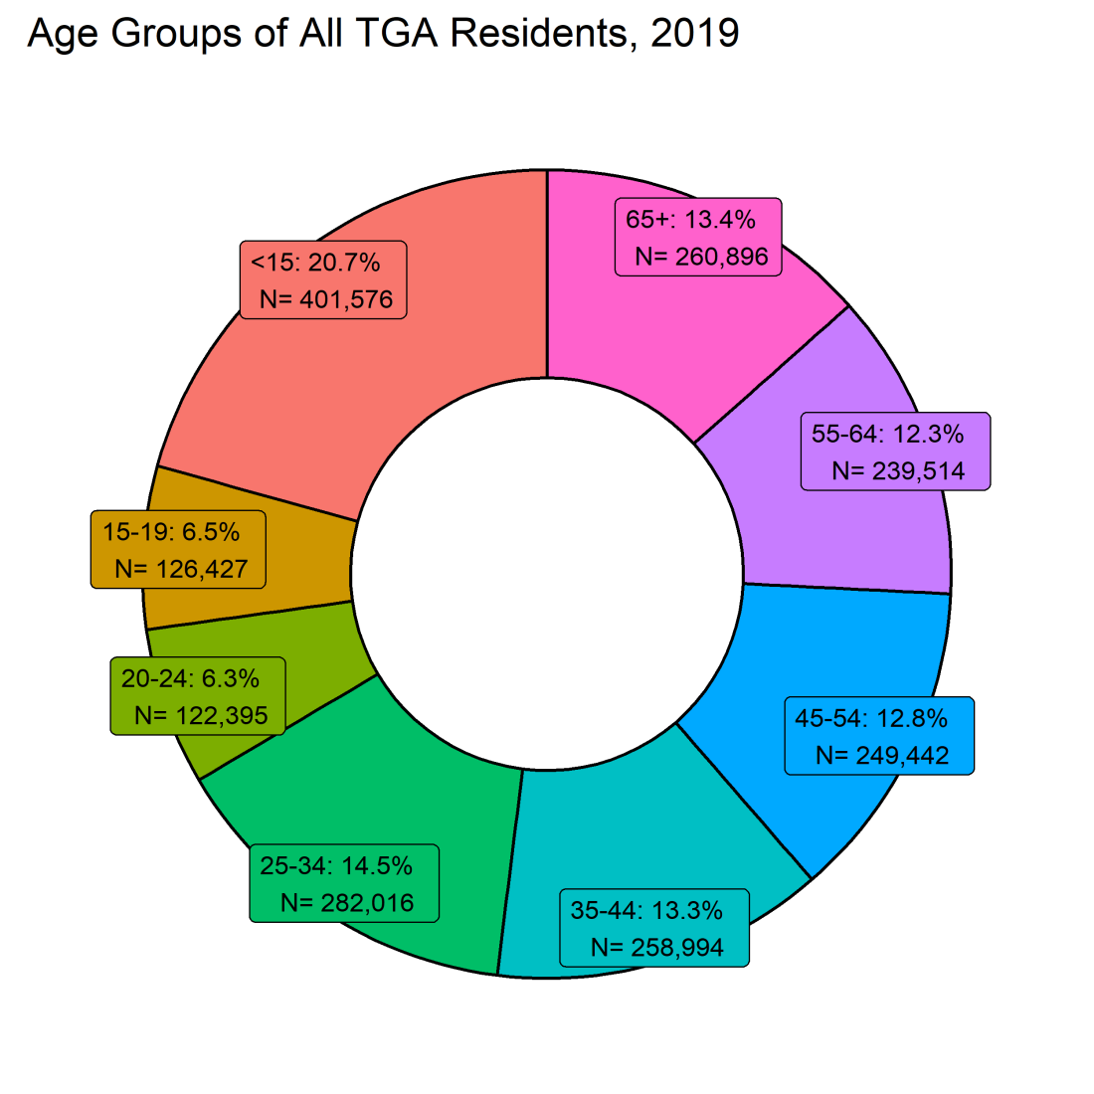
TGA Demographics

Slide 10
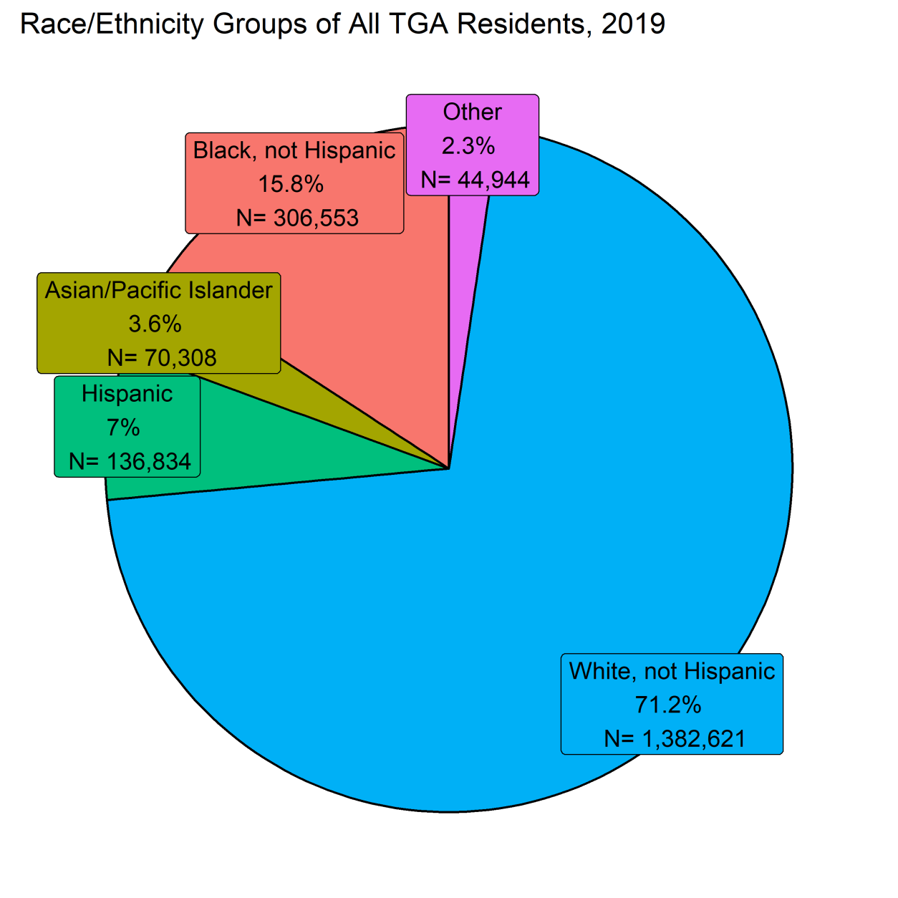
TGA Demographics
The population of Marion County is more diverse than that of the TGA overall, with 28% African American, 11% Hispanic, and nearly 4% each of Asian/PI and 3% Other

Slide 11
      HIV/AIDS Incidence

Slide 12
HIV/AIDS Incidence
New Diagnoses | No. | Rate [95% CI*] | 2018 Rate [95% CI*] | U.S. Rate** (2018)⁵
HIV† | 271 | 14 [12.4-15.8] | 12.7 [11.1-14.4] | 11.4
AIDS | 83 | 4.3 [3.4-5.3] | 6.2 [5.1-7.4] | 5.2
*95% confidence interval **Includes the TGA † New HIV dx and HIV at AIDS dx
No significant change in AIDS incidence from 2018 to 2019
HIV/AIDS incidence in the TGA are on par with national rates
Notes:
Most recent available year-end US Rate is for 2018 preliminary, as of 04/30/2019:
https://www.cdc.gov/hiv/pdf/library/reports/surveillance/cdc-hiv-surveillance-report-2018-vol-30.pdf

Slide 13
HIV/AIDS Incidence
HIV Diagnoses and Population Estimates in the Indianapolis TGA: 2010-2019

Slide 14
HIV/AIDS Incidence
HIV Diagnoses by Time to AIDS in the Indianapolis TGA: 2010-2019*
*Conversion within 91-365 Days masked due to low case counts

Slide 15
HIV Incidence by County
County | No. | % of HIV in TGA | Rate [95% CI*] | RR [95% CI*]: to Others
Marion | 218 | 80.4% | 22.7 [19.8-25.9] | 5.4 [3.8-7.8]
Hendricks | 19 | 7.0% | 11.2 [6.7-17.4] | 2.7 [1.5-4.7]
Others* | 34 | 12.6% | 4.2 [2.9-5.9] | 1.0
* 95% confidence interval
Marion County HIV incidence was at about 5 times that of TGA counties outside of Marion and Hendricks

Slide 16
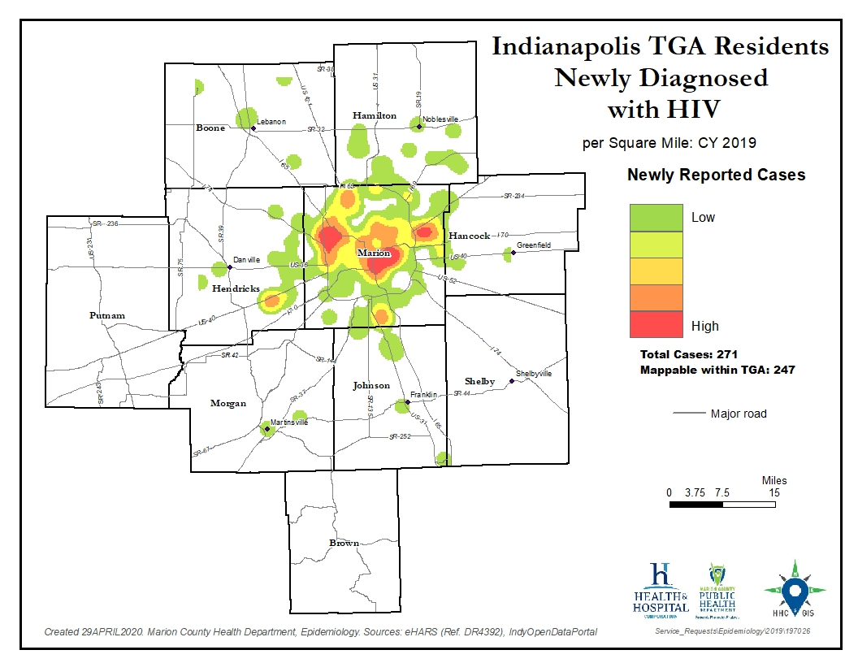
Notes:
MCPHD GIS: The output values represent the predicted amount of the phenomenon within each cell. Better to look at the classes/colors in this graph qualitatively rather quantitatively. This is b/c some areas may have been emphasized due to surrounding cell values or due to points crossing multiple cells (being at an edges or intersections).

Slide 17
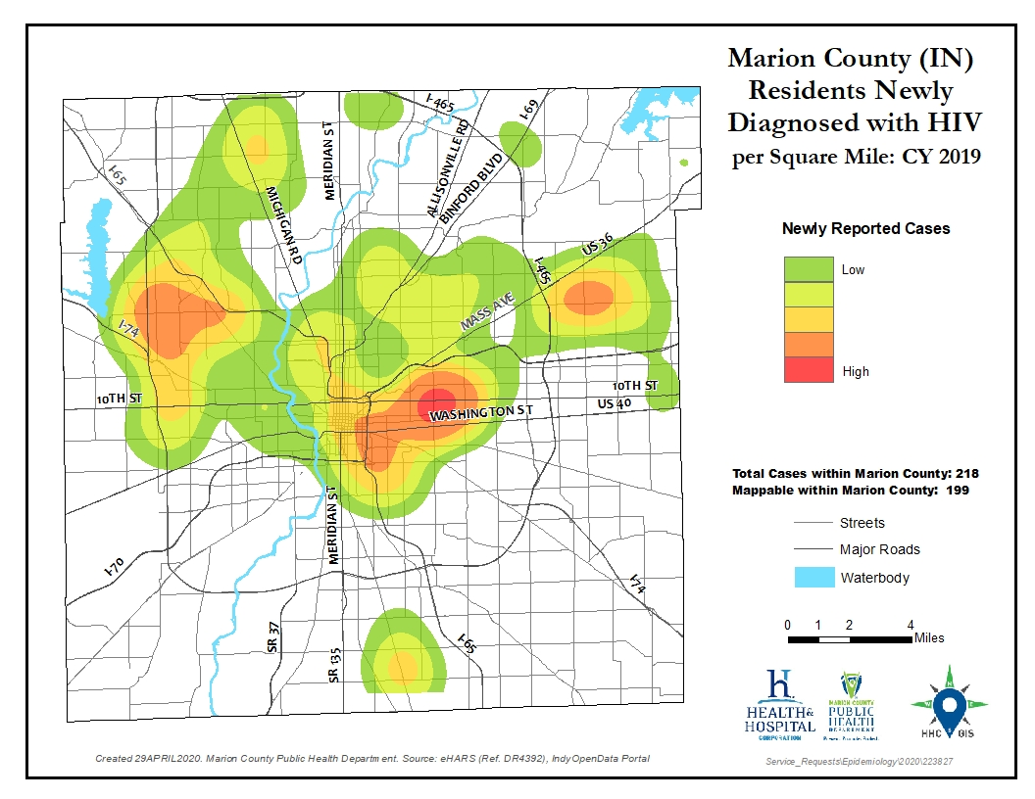

Slide 18
HIV Incidence by Gender
Gender | No. | % of HIV in TGA | Rate [95% CI*] | RR [95% CI*]: to Female
Female | 54 | 19.9% | 5.4 [4.1-7.1] | 1.0
Male | 211 | 77.9% | 22.3 [19.4-25.5] | 4.1 [3.0-5.5]
Transgender | 6 | 2.2% | - | -
*95% confidence interval
No significant change by gender between 2018 to 2019
Men were diagnosed with HIV at a rate of about 4 times that of women

Slide 19
HIV/AIDS Incidence
HIV Diagnoses by Sex at Birth in the Indianapolis TGA: 2010-2019

Slide 20
HIV Incidence by Race/Ethnicity
Race/ Ethnicity | No. | % of HIV in TGA | Rate [95% CI*] | RR [95% CI*]: to White
Asian/PI | <5 | - | NS | NS
Black | 146 | 53.8% | 47.6 [40.2-56] | 9.3 [7.0-12.3]
Hispanic | 44 | 16.2% | 32.2 [23.4-43.2] | 6.3 [4.3-9.1]
Other | 7 | <3.0% | NS | NS
White | 71 | 26.2% | 5.1 [4-6.5] | 1.0
*95% confidence interval NS = Does not meet MCPHD standards for statistical significance
African Americans and residents of Hispanic ethnicity continue to experience increased risk of HIV infection
No significant change by race/ethnicity 2018 to 2019

Slide 21
HIV Incidence by Age
Age (Yrs.) | No. | % of HIV in TGA | Rate [95% CI*]
<15 | <5 | - | NS
15-19 | 11 | 4.0% | 8.7 [4.3-15.6]
20-24 | 44 | 16.2% | 35.9 [26.1-48.3]
25-34 | 105 | 38.8% | 37.2 [30.5-45.1]
35-44 | 68 | 25.1% | 26.3 [20.4-33.3]
45-54 | 27 | 10.0% | 10.8 [7.1-15.7]
55-64 | 12 | 4.4% | 5 [2.6-8.8]
65+ | <5 | - | NS
*95% confidence interval NS = Does not meet MCPHD standards for statistical significance
Young adults 20-34 continue to be at most risk of HIV, with rates at least double those of other age groups
No significant change by age between 2018 and 2019

Slide 22
HIV Incidence by Exposure Category
Exposure | No. | % of HIV in TGA | Rate [95% CI*] | RR [95% CI*]: to Heterosexual
MSM^ | 129 | 47.6% | 255.6 [213.4-303.6] | 72.1 [53.7-96.9]
IDU^ | 23 | 8.5% | 74 [46.9-111.1] | 20.9 [13-33.6]
Heterosex. | 67 | 24.7% | 3.5 [2.7-4.5] | 1.0
Perinatal | <5 | - | - | -
Not Rptd. | 52 | 19.2% | 2.7 [2-3.5] | NA
^MSM=Male-to-male sexual contact (denominator estimated)^{5, 6} and IDU=Injection drug use(denominator estimated)³⁰ Rows may total more than actual incidence due to report of multiple categories *95% confidence interval
The percentage of new HIV without reported risk has increased from 13.6% (N=33)
to 19.2% (N=52)
MSM continue to bear the greatest burden of HIV

Slide 23
HIV Incidence by U.S. Nativity Status
Nativity Status | No. | % of HIV in TGA | Rate [95% CI*] | RR [95% CI*]: to Native Born
Foreign Born** | 35 | 12.9% | 25.2 [17.5-35] | 3.6 [2.5-5.2]
Native Born | 126 | 46.5% | 7.0 [5.8-8.3] | 1.0
Unk/Miss | 110 | 40.6% | - | -
*95% confidence interval, ** TGA foreign born population denominator based on census tract data¹
Foreign-born residents of the TGA account for an estimated 7.2% of the TGA population and experienced HIV incidence about 4x that of native-born residents

Slide 24
      HIV Mortality and Death

Slide 25
HIV Mortality and All Deaths of PLWH/A
Area | No. | Rate [95% CI*] | 2018 Rate [95% CI*] | U.S. Rate^{**7}
Mortality (Marion Only) | 19 | NS | NS | 1.7(2017)
Deaths (TGA) | 55 | 2.8 [2.1-3.7] | 2.4 [1.8-3.3] | 4.9(2017)
*95% confidence interval; NS = Does not meet MCPHD standards for statistical significance
The mortality rate of PLWH/A is roughly on par with the 2018.
No significant change in mortality or deaths from 2018 to 2019
Notes:
Error in printed slides which is correct here. Still similar to year before.
Most recent U.S. data for cause of death related to HIV here: https://www.cdc.gov/nchs/data/nvsr/nvsr68/nvsr68_09-508.pdf
Most recent All cause HIV mortality here: https://www.cdc.gov/hiv/pdf/library/reports/surveillance/cdc-hiv-surveillance-report-2018-vol-30.pdf

Slide 26
Death of PLWH/A (Any Cause)
Deaths of Indianapolis TGA Residents Living with HIV/AIDS, Regardless of Cause of Death, by Year: 2000-2019

Slide 27
HIV Mortality
Deaths of Marion County (IN) Residents with HIV as the Underlying Cause of Death, by Year: 2000-2019

Slide 28
      HIV Prevalence

Slide 29
ISDH Lost to Care Program
Funded by Ryan White Part B funds
Work in Health District 5 started in May 2019
Comprised of lost to care specialists
Looked at individuals without a CD4 or Viral Load test result in the calendar year (2019) and attempted to reengage people into care
Legacy data was updated utilizing address data and death data
The effect on the Indy TGA has been a noticeably decreased HIV prevalence compared to previous years due to improved data quality
Notes:
ISDH Health District 5 massively overlaps with the Indy TGA Jurisdiction, with all of our counties except Putnam and Brown overlapping with Health District 5.
See link for a map of ISDH Health Preparedness Districts: https://www.in.gov/isdh/images/ISDH%20District%20Map%20(Apr%202017).jpg

Slide 30
Estimated Number of Undiagnosed PLWH/A
HIV/AIDS Prevalence | 5,745
HIV Prevalence | 3,009
AIDS Prevalence | 2,736
Undiagnosed/Unaware | 859
Estimated Total PLWH/A | 6,604
Current estimated proportion of PLWH/A while undiagnosed/unaware is 13% of known prevalence²⁷

Slide 31
Prevalence of Diagnosed HIV/AIDS
Status | No. | Rate [95% CI*] | U.S. Rate (2017)⁵
HIV | 3,009 | 155 [149.5-160.6] | 147.3
AIDS | 2,736 | 140.9 [135.7-146.3] | 161.4
Total | 5,745 | 295.9 [288.4-303.7] | 308.7
*95% confidence interval
Significant reduction in HIV and AIDS prevalence 2018 to 2019 (see prior slide)
Notes:
HIV above represents HIV, non-AIDS.
Latest data is 2017 (year-end) for total PLWHA
https://www.cdc.gov/hiv/pdf/library/reports/surveillance/cdc-hiv-surveillance-report-2018-vol-30.pdf

Slide 32
HIV/AIDS Prevalence by County
County | No. | % of HIV in TGA | Rate [95% CI*] | RR [95% CI*]: to Shelby
Marion | 4,844 | 84.3% | 504.6 [490.6-518.9] | 7.0 [3.9-12.7]
Hamilton | 265 | 4.6% | 78.4 [69.2-88.4] | NS
Hendricks | 188 | 3.3% | 110.4 [95.2-127.3] | NS
Johnson | 166 | 2.9% | 104.7 [89.4-121.9] | NS
Putnam | 58 | 1.0% | 153.2 [116.4-198] | 2.1 [1.1-4.1]
Hancock | 67 | 1.2% | 86.2 [66.8-109.4] | NS
Morgan | 53 | 0.9% | 75.4 [56.5-98.6] | NS
Boone | 57 | 1.0% | 83.4 [63.2-108.1] | NS
Shelby | 29 | 0.5% | 64.8 [43.4-93] | NS
Brown | 11 | 0.2% | 71.8 [35.8-128.3] | 1.0
*95% confidence interval

Slide 33
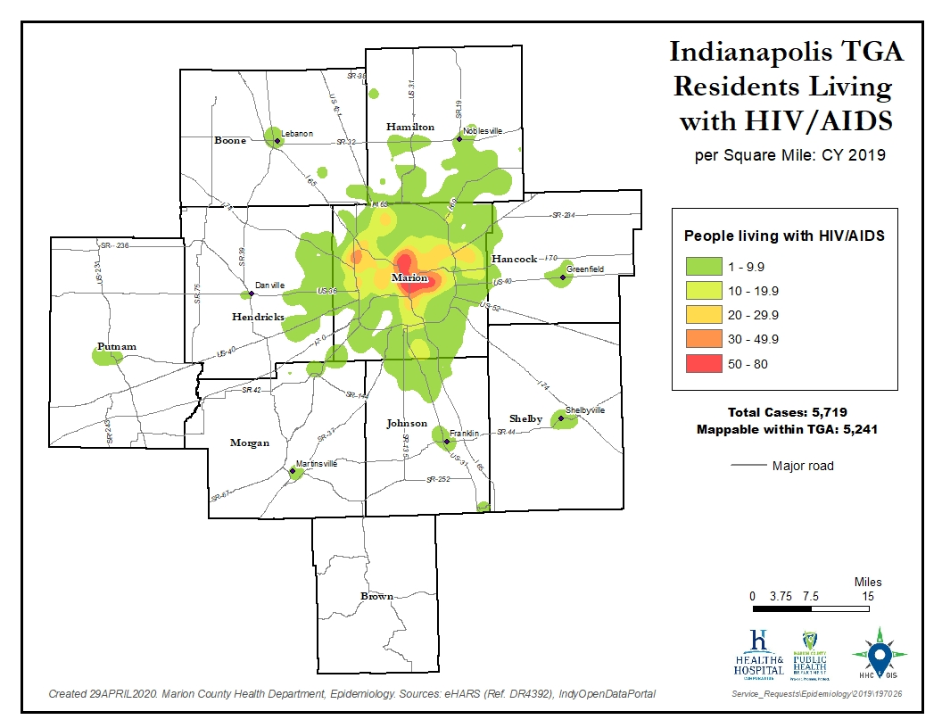

Slide 34
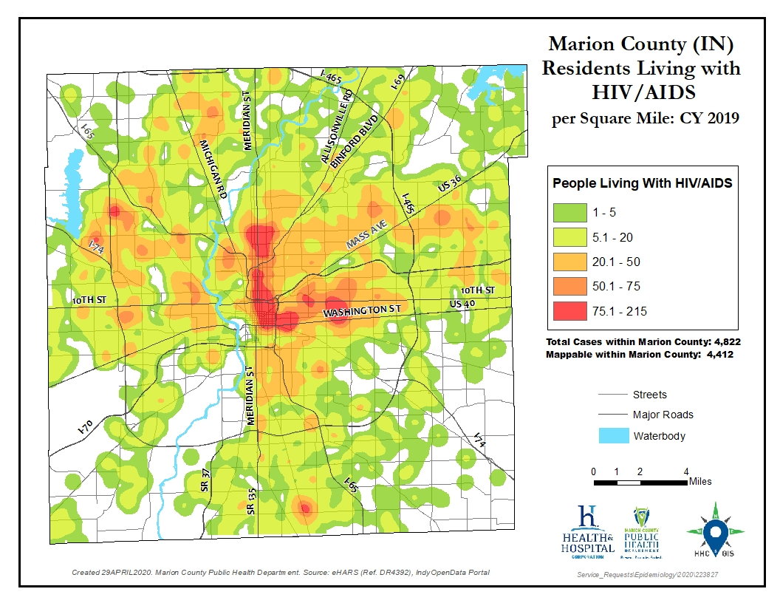

Slide 35
HIV/AIDS Prevalence by Gender
Gender | No. | % of HIV in TGA | Rate [95% CI*] | RR [95% CI*]: to Female
Female | 1,216 | 21.2% | 122.4 [115.7-129.5] | 1.0
Male | 4,442 | 77.3% | 468.5 [454.9-482.4] | 3.8 [3.6-4.0]
MtF | 72 | 1.2% | UNK | UNK
FtM | 15 | 0.3% | UNK | UNK
*95% confidence interval
HIV prevalence among the TGA’s men was about 4 times that found among women

Slide 36
HIV/AIDS Prevalence by Race/Ethnicity
Race/ Ethnicity | No. | % of HIV in TGA | Rate [95% CI*] | RR [95% CI*]: to White
Black | 2,655 | 46.2% | 866.1 [833.7-899.4] | 5.3 [5.1-5.7]
Other | 181 | 3.2% | Approx. 403 | Approx. 2.5
Hispanic | 529 | 9.2% | 386.6 [354.4-420.9] | 2.4 [2.2-2.6]
Asian/PI | 157 | 2.7% | 223.3 [189.8-261] | 1.4 [1.2-1.6]
White | 2,223 | 38.7% | 160.8 [154.2-167.6] | 1.0
*95% confidence interval
HIV prevalence continues to be higher among racial/ethnic minorities than among Caucasians in the TGA

Slide 37
HIV/AIDS Prevalence by Current Age
Age (Yrs.) | No. | % of HIV in TGA | Rate [95% CI*]
<15 | 33 | 0.6% | 8.2 [5.7-11.5]
15-19 | 36 | 0.6% | 28.5 [19.9-39.4]
20-24 | 178 | 3.1% | 145.4 [124.9-168.4]
25-34 | 1,170 | 20.4% | 414.9 [391.5-439.2]
35-44 | 1,219 | 21.2% | 470.7 [444.7-497.7]
45-54 | 1,449 | 25.2% | 580.9 [551.5-611.4]
55-64 | 1,253 | 21.8% | 523.1 [494.7-552.8]
65+ | 400 | 7.0% | 153.3 [138.7-169.1]
*95% confidence interval
Adults over 45 Yrs. of age account for more than 55% of the TGA’s PLWH/A

Slide 38
HIV/AIDS Prevalence by Exposure/Risk
Exposure | No. | % of HIV in TGA | Rate [95% CI*] per 100,000 or per 100(%) | RR [95% CI*]: to Heterosexual
MSM^ | 3,137 | 54.6% | 6.21% [6.0%-6.4%] | 88.2[82.7-94.1]
Heterosex. | 1,332 | 23.2% | 0.07%[0.067%-0.074%] | 1.0
IDU^ | 540 | 9.4% | 1.74% [1.59%-1.89%] | 24.7 [22.3-27.3]
Perinatal | 76 | 1.2% | 0.28%[0.23%-0.36%] | 4.1 [3.2-5.2]
Other | 11 | 0.2% | NS | NS
Not Rptd. | 649 | 11.3% | 0.033%[0.031%-0.036%] | 0.47 [0.43-0.52]
^MSM=Male-to-male sexual contact (denominator estimated)⁵ ⁶ and IDU=Injection drug use (denominator estimated)³⁰ Rows may total more than actual incidence due to report of multiple categories *95% confidence interval
Based on CDC estimates, as many as 34% of HIV-positive MSM are unaware of their status.⁸

Slide 39
HIV/AIDS Prevalence by U.S. Nativity Status
Nativity Status | No. | % of HIV in TGA | Rate [95% CI*] | RR [95% CI*]: to Native Born
Foreign Born | 814 | 14.2% | 585.3 [545.8-626.7] | 2.4 [2.2-2.6]
Native Born | 4,441 | 77.3% | 246.8 [239.7-254.2] | 1.0
Unk/Miss | 490 | 8.5% | - | -
*95% confidence interval
HIV prevalence among foreign-born TGA residents is about two times that of native-born residents

Slide 40
HIV/AIDS Prevalence by Birth Region
Birth Region | No. | % of HIV in TGA
Northern America | 4,441 | 77.3%
Latin America and Caribbean | 320 | 5.6%
Africa | 298 | 5.2%
Asia | 146 | 2.5%
Europe | 17 | 0.3%
Unknown | 490 | 8.5%
United States, Latin America and Africa are the top 3 Birth Regions for PLWHA in our TGA
Notes:
Northern America group here includes USA, Canada, Greenland, etc. It does not include Mexico and Central American countries which are included in Latin America and Caribbean group.

Slide 41
      Co-morbidities

Slide 42

Foreign-Born
With a risk of about 4 times that of native-born residents, foreign-born residents of the TGA accounted for over 1 in 10 newly diagnosed with HIV during 2019
Similarly, over 1 in 10 PLWH/A in the TGA are foreign-born, experiencing a prevalence that is over two times as high as among the native-born
Special considerations
  Linguistic services
  Health insurance
  Social support structure
  Cultural stigma/beliefs
  Fear

Slide 43

Aging
Better therapies → Longer lives
Over 55% of PLWH/A in the TGA are 45+ years of age
Special considerations⁹
  Weakened immune system
  Increased risk of adverse events and drug interactions
  Stigma and depression due to illness, or loss of family and friends
  Increased risk for cardiovascular disease, bone loss, and certain cancers

Slide 44

Homelessness
Among PLWH/A, between 300 and 400 were homeless or insecurely housed at some point during 2018^{10,11,12}
  Research suggests that 10%-16% of all PLWH/A in some communities are homeless at any given time¹³
Special considerations
  Case finding
  Public assistance
  Permanent housing
  Priority of medical care
Photo credit: Jeremy Swain, Ending Homelessness in London
Notes:
Most recent estimate for Indianapolis based on HOPWA report for 2018.

Slide 45

Recent Incarceration
10% of the TGA’s PLWH/A have a history of incarceration
  Special considerations
    Employment and housing
    Retention in care throughout and after the transition
    Substance abuse
    Trouble navigating the health care system
Notes:
Current estimate = 10.4%

Slide 46
Mental Health & Substance Abuse
Approximately 2,873 PLWH/A suffer from mental health issues according to the 50% estimate found in the National HIV/AIDS Strategy¹⁴
40% of PLWH/A are estimated to have substance abuse issues and 13% are thought to experience both substance abuse and mental health issues¹⁴
Special considerations¹⁴
  Sadness or Depression
  Stress, Fear, and Anxiety
  HIV-associated neurocognitive disorders (HAND)
To complicate matters…
  Marion County, home to 86% of the TGA’s PLWH/A, is an underserved area for mental health services (population-to-provider ratio is only about two-thirds the average mental health staffing capacity in the state)¹⁵

Slide 47
Food Insecurity
Nearly 50% of PLWH/A are thought to struggle with food insecurity
  Food insecurity is a risk factor for mortality among people on HAART, especially those who are underweight¹⁶
  Food insecurity associated with prevalent HIV, STI, and illicit drug use among men in the US ¹⁶

Slide 48
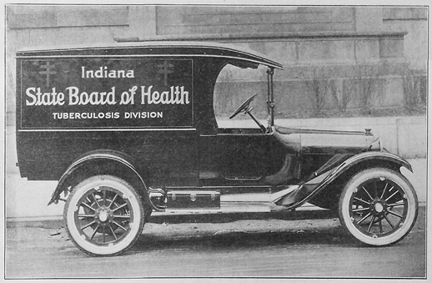
Mycobacterium tuberculosis (TB)
For 2017, 48 TGA residents were diagnosed with active TB, three were HIV-positive. For 2018, 43 TGA residents were diagnosed with active TB, three were HIV-positive. For 2019, 49 TGA residents were diagnosed with active TB, five were HIV-positive.
  6%-10% of active TB diagnoses are among PLWH/A¹⁷
  Conversion from latent to active TB is 10 times more likely in PLWH/A (7%-10% risk each year)¹⁸
  Everyone newly HIV diagnosed should be tested for TB right away, and PLWH/A and at risk for TB should be tested annually.¹⁹
Special considerations
  Screening
  Diagnostic
  HIV-TB synergy
  Treatment complications

Slide 49
Viral Hepatitis
Approximately 575 PLWH/A are thought to be co-infected with hepatitis B based on the 10% estimate of the U.S. Department of Health and Human Services²⁰
Approximately 1,437 PLWH/A are thought to be co-infected with hepatitis C based on the 25% estimate of the National Alliance of State and Territorial AIDS Directors²¹
Special considerations
  HIV co-infection triples the risk for HCV-related liver disease which is the leading cause of non-AIDS related death among PLWH/A²²
Current guidelines call for HCV screening in all PLWH/A (annually for those at increased risk)²³

Slide 50
Chlamydia
12,254 chlamydia diagnoses were reported in the TGA during 2018, at least 326 among PLWH/A²⁴
  The chlamydia rate among PLWH/A was 5,301 per 100,000 [95% CI: 4,754.8-5,891.4], a rate 7-9 times higher than that of HIV-negative residents.
Chlamydia co-infection among PLWH/A is thought to be grossly underestimated – PLEASE screen, diagnose and treat PLWH/A and their partner(s) for chlamydia

Slide 51
Gonorrhea
4,367 gonorrhea diagnoses were reported in the TGA during 2018, at least 236 among PLWH/A²⁴
  The gonorrhea rate among PLWH/A was 3,838 per 100,000 [95% CI: 3,371.7-4,348.7], a rate 14-19 times higher than that of HIV-negative residents
Gonorrhea co-infection among PLWH/A is thought to be grossly underestimated – PLEASE screen, diagnose and treat PLWH/A and their partner(s) for gonorrhea.

Slide 52
Early Syphilis
363 early syphilis (primary, secondary, and early latent) diagnoses were reported in the TGA during 2018, at least 110 among PLWH/A²⁴
  The rate of early syphilis among PLWH/A was 1,789 per 100,000 [95% CI: 1,472-2,152], a rate at about 76 times higher [95% CI: 76.2-116.7] than that of HIV-negative residents.
HIV co-infection among new syphilis cases is very common– PLEASE screen, diagnose and treat PLWH/A and their partner(s) for syphilis.

Slide 53
More on Sexually-Transmitted Infections
HIV and STIs are commonly co-morbid conditions
Special concerns
  STDs can increase the likelihood of contracting HIV
As providers to residents with the highest risk, you can:
  Include routine screening as a function of HIV primary care
  Perform risk analyses – Assess risk behaviors of your patients
  Perform risk reduction - Alert your patients to the risks of STDs, especially when comorbid to HIV/AIDS, and offer periodic STD testing for each of your patients
  Treat - Diagnose and treat patients and their partner(s)
  Report – Provide thorough and accurate case reporting for better modeling of risk factors

Slide 54

      Measures of HIV Health Outcomes

Slide 55
HIV Treatment Cascade (AKA: Continuum of Care
Developed by Dr. Edward Gardner and colleagues²⁵ in March 2011
Model for use in identifying unmet needs, as well as discovery of where, across the continuum of care, clients are lost to follow-up
“Improving control of HIV begins with enhanced detection and linkage to care” – Gardner, et al., 2011 ²⁵
“HIV screening without linkage to care “confers little or no benefit to the patient” – Branson, et al., 2006 ²⁶

Slide 56
Benefits of Improving Linkage Into and Retention in Care
Delayed linkage and poor engagement in care are associated with:²⁵ ²⁶
  Delayed/no receipt of anti-retroviral therapy (ART)
  Quicker progression to AIDS
  Drug resistance
  Increased morbidity (hospitalizations, opportunistic infections, emergency department visits, etc.)
  Increased mortality
  Increased risk of HIV transmission

Slide 57
National HIV/AIDS Progress Indicators
90% of HIV-positive residents aware of their status
85% of those newly diagnosed linked to care within 30 days
90% retained in care
80% suppressed viral load

Slide 58
HIV Care Continuum Definitions
Linked to Care: People newly diagnosed with HIV during CY 2019 who received a CD4/viral load test within 90 days unless otherwise specified
Retained in Care: Residents living with HIV/AIDS with 2+ CD4/viral load tests performed at least 3 months apart in CY 2019
Antiretroviral Therapy: Residents living with HIV/AIDS who received a prescription for antiretroviral therapy in CY 2019
Viral Load Suppression: Residents living with HIV/AIDS with a CY 2019 viral load result <200 RNA copies/mL

Slide 59
HIV Care Continuum of the TGA
*Linkage to care within 90 days shown above
Note: There was 48% linkage to care within 30 days

Slide 60
Ryan White Clients v. Non-Client PLWH/A
*Linkage to care within 90 days shown above.
Current HRSA measure is 30 days until linkage to care. When using that benchmark, only 50% of RWSP clients and 48% of non-RWSP clients were linked to care.

Slide 61
Community Viral Load
Geometric means were used for comparisons of viral load
  Geometric means are always smaller than arithmetic means because the effect of very large values is diminished
  Geometric means are more stable from year to year
All results are based on the last reported viral load test during 2019 for all residents with ≥1 viral load test
Results were standardized such that:
  Results reported as 0 or <20 were set to half the lower limit of detection possible for the assay used according to CDC recommendations²⁸

Slide 62
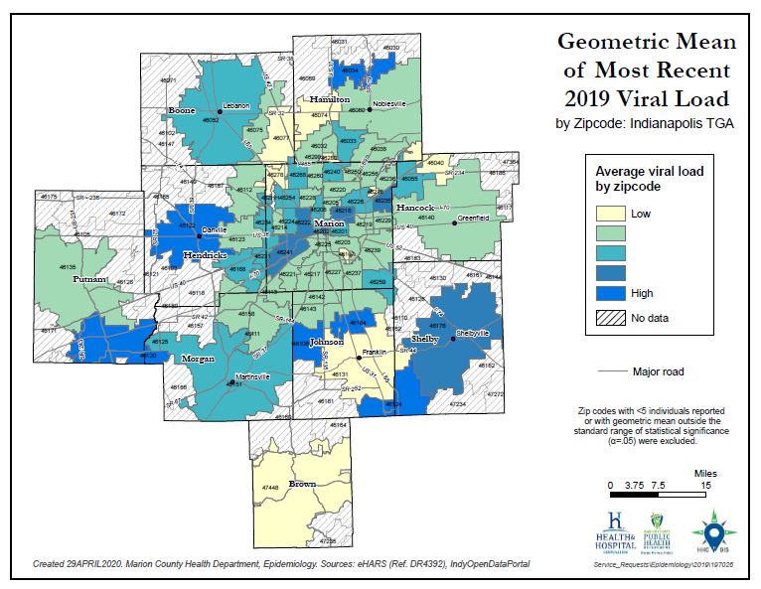

Slide 63
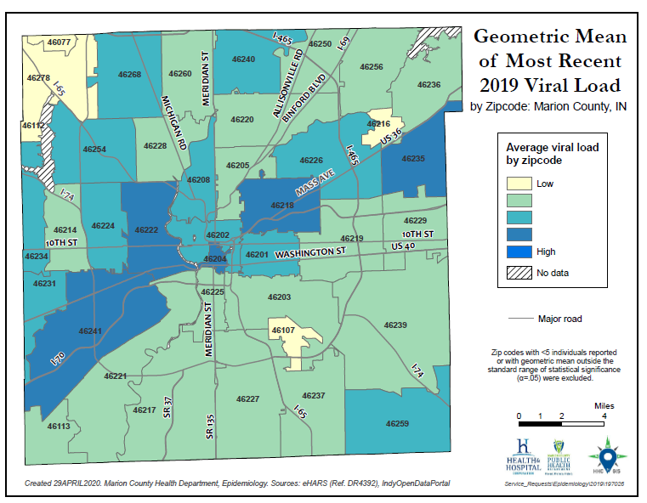

Slide 64
Community Viral Load by Gender
Number and percent with suppressed viral load (<200 copies/mL) at last CY 2019 test, by gender
Gender | N | % at <200 copies/mL** | Geometric Mean Viral Load | 95% Confidence Interval (GM)
Male | 2977 | 58.8 | 50 | 46-54
Female | 738 | 53.3 | 48 | 41-56
MtF Transgender | 44 | 50 | * | 36-229
FtM Transgender | 8 | 53.3 | * | 12-45
*Point estimate suppressed due to wide confidence interval **Percentage includes unknown/missing viral loads in denominator

Slide 65
Community Viral Load by Race/Ethnicity
Number and percent with suppressed viral load (<200 copies/mL) at last CY 2019 test, by race/ethnicity
Race/Ethnicity | N | % at <200 copies/mL** | Geometric Mean Viral Load | 95% Confidence Interval (GM)
White | 1,689 | 69.9 | 37 | 34-40
Black | 1,583 | 50.0 | 64 | 56-72
Hispanic | 256 | 39.7 | * | 55-107
Asian/PI | 111 | 65.6 | 35 | 25-47
Other | 128 | 58.4 | * | 43-100
*Point estimate suppressed due to wide confidence interval **Percentage includes unknown/missing viral loads in denominator

Slide 66
Community Viral Load by Age
Number and percent with suppressed viral load (<200 copies/mL) at last CY 2019 test, by current age (Yrs.)
Current Age (Yrs.) | N | % at <200 copies/mL** | Geometric Mean Viral Load | 95% Confidence Interval (GM)
<15 | 29 | 82 | * | 22.4-159
15-19 | 25 | 50 | * | 42-939
20-24 | 99 | 40.4 | * | 67-213
25-34 | 699 | 46.6 | * | 87-135
35-44 | 756 | 54.1 | 57 | 48-67
45-54 | 961 | 60.4 | 40 | 36-45
55-64 | 878 | 66.9 | 31 | 28-34
65+ | 283 | 68 | 29 | 24-34
Unk/Miss | 37 | 46.8 | * | 35-227
*Point estimate suppressed due to wide confidence interval **Percentage includes unknown/missing viral loads in denominator

Slide 67
Community Viral Load by County
Number and percent with suppressed viral load (<200 copies/mL) at last CY 2019 test, by county of residence
County of Residence | N | % at <200 copies/mL** | Geometric Mean Viral Load | 95% Confidence Interval (GM)
Boone | 40 | 65.9 | * | 24-67
Brown | 9 | 81.8 | 23 | 19-28
Hamilton | 204 | 72.4 | * | 28-46
Hancock | 59 | 79.1 | * | 24-72
Hendricks | 139 | 64.3 | * | 39-91
Johnson | 120 | 65.7 | * | 31-61
Marion | 3061 | 55.7 | 51 | 47-55
Morgan | 35 | 62.3 | * | 19-77
Putnam | 39 | 60.3 | * | 27-121
Shelby | 24 | 65.5 | * | 28-356
*Point estimate suppressed due to wide confidence interval **Percentage includes unknown/missing viral loads in denominator

Slide 68
Community Viral Load by RWSP Status
Number and percent with suppressed viral load (<200 copies/mL) at last CY 2019 test, by Ryan White HIV Services Program enrollment status
RWSP Enrollment Status: CY 2019 | N | % at <200 copies/mL** | Geometric Mean Viral Load | 95% Confidence Interval (GM)
Not Enrolled | 1283 | 56.0 | 54 | 48-62
Enrolled Part of the Year | 1911 | 56.6 | 50 | 45-55
Enrolled All Year^ | 573 | 64.5 | 41 | 35-48
* Point estimate suppressed due to wide confidence interval
**Percentage includes unknown/missing viral loads in denominator ^ Experienced <30 day enrollment lapse during the year of interest

Slide 69
Improving Retention in Care
Guidelines for Improving Entry Into and Retention in Care and Antiretroviral Adherence for Persons With HIV: Evidence-Based Recommendations From an International Association of Physicians in AIDS Care Panel²⁹
Close monitoring and individualized care
  Systematic monitoring of retention in care for all PLWH/A
  Intensive outreach for PLWH/A who are not engaged in care within six months
  Use of peer or paraprofessional patient navigators
  Summary of recommendations included. See appendix.
  Full published article at: http://annals.org/article.aspx?articleid=1170890
Notes:
International Association of Physicians in AIDS Care convened a panel to develop evidence-based recommendations
to optimize entry into and retention in care and ART adherence for people with HIV

Slide 70
Vision for the National HIV/AIDS Strategy
“The United States will become a place where new HIV infections are rare and when they do occur, every person, regardless of age, gender, race/ethnicity, sexual orientation, gender identity or socio-economic circumstance, will have unfettered access to high quality, life-extending care, free from stigma and discrimination.” ¹⁴

Slide 71
Undetectable = Untransmittable (U=U)
“Getting and keeping an undetectable viral load* is the best thing people with HIV can do to stay healthy” ³²⁻³³
CDC: Risk of HIV Transmission With Undetectable Viral Load by Transmission Category ³²
Transmission Category | Risk for People Who Keep an Undetectable Viral Load
Sex (oral, anal, or vaginal) | Effectively no risk
Pregnancy, labor, and delivery | 1% or less†
Sharing syringes or other drug injection equipment | Unknown, but likely reduced risk
Breastfeeding | Substantially reduces, but does not eliminate risk. Current recommendation in the United States is that mothers with HIV should not breastfeed their infants.
Notes:
https://www.cdc.gov/hiv/risk/art/index.html
https://www.cdc.gov/hiv/pdf/risk/art/cdc-hiv-tasp-101.pdf
† The risk of transmitting HIV to the baby can be 1% or less if the mother takes HIV medicine daily as prescribed throughout pregnancy, labor, and delivery and gives HIV medicine to her baby for 4-6 weeks after giving birth.

Slide 72


Slide 73


Slide 74
Sam Parmar, MPH
Epidemiologist
Health & Hospital Corporation
Marion County Public Health Department
3901 Meadows Drive, H116
Indianapolis, IN 46205
Office: 317-221-3556
Fax: 317-221-4404
SParmar@MarionHealth.org

Slide 75
References
¹ U.S. Census Bureau and Marion County Public Health Department. (2017). Marion County Public Health Department estimates based on ARIMA projections calculated using U.S. Census Bureau data.
² U.S. Census Bureau. (2002). Time series of Indiana intercensal population estimates by county: April 1, 1990 to April 1, 2000. Table CO-EST2001-12-18. Release date April 17, 2002.
³ U.S. Census Bureau. (2011). Intercensal estimates of the resident population for counties of Indiana: April 1, 2000 to July 1, 2010. Table CO-EST00INT-01-18.
⁴ Glenn, R. (2011). Demographics & trends: Indianapolis, Marion County & the Indianapolis region. Department of Metropolitan Development: City of Indianapolis.
⁵ Centers for Disease Control and Prevention. (2019). HIV surveillance report, 2018 Vol. 30. Retrieved from https://www.cdc.gov/hiv/pdf/library/reports/surveillance/cdc-hiv-surveillance-report-2018-vol-30.pdf
⁶ Purcell et al. (2012). Estimating the population size of MSM in the U.S. to obtain HIV and syphilis rates. Open AIDS Journal; 6(S1: M6) 98-107.
⁷ Centers for Disease Control and Prevention. (2018). Deaths: Final data for 2017. National Vital Statistics Report, 66(6). Retrieved from https://www.cdc.gov/nchs/data/nvsr/nvsr68/nvsr68_09-508.pdf and https://www.cdc.gov/hiv/pdf/library/reports/surveillance/cdc-hiv-surveillance-report-2018-vol-30.pdf
⁸ Centers for Disease Control and Prevention. (2016). HIV Testing in the United States: Fact sheet. Retrieved from https://www.cdc.gov/nchhstp/newsroom/docs/factsheets/hiv-testing-us-508.pdf
⁹ Centers for Disease Control and Prevention. (2013). HIV Among People Aged 50 and Older. Retrieved from https://www.cdc.gov/hiv/group/age/olderamericans/index.html
¹⁰ Indiana University Public Policy Institute. (2015). 2015 Point-in-time count: Many families in Indianapolis not able to find shelter. Retrieved from http://www.chipindy.org/wp-content/uploads/2013/07/HomelessCount_2015_
Web.pdf

Slide 76
References
¹¹ U.S. Department of Housing and Urban Development. (2018). HOPWA performance profile - Formula grantee: City of Indianapolis. Retrieved from https://files.hudexchange.info/reports/published/HOPWA_Perf_GranteeForm_00_INDI-IN_IN_2018.pdf
¹² Health & Hospital Corporation. (2017). Ryan White information services enterprise (RISE). Indianapolis: Ryan White HIV Services Program, Marion County Public Health Department.
¹³ Shubert, G. (2012). Mobilizing knowledge: Housing is HIV prevention and care. Available from https://shnny.org/uploads/Housing_is_HIV_Prevention_and_Health_Care.pdf
¹⁴ The White House Office of National AIDS Policy. (2010). National HIV/AIDS strategy for the United States. Retrieved from http://www.cdc.gov/hiv/strategy/pdf/nhas.pdf and https://www.hiv.va.gov/patient/daily/mental/single-page.asp
¹⁵ Marion County Public Health Department. (2014). Community health assessment of Marion County: 2014. Retrieved from http://www.hhcorp.org/hhc/index.php/newsroom/2014-press-releases/645-marion-county-releases-2014-community-health-assessment
¹⁶ Weiser, S. D., Fernandes, K. A., Brandson, E. K., Lima, V. D., Anema, A., Bangsberg, D. R., . . . Hogg, R. S. (2009). The association between food insecurity and mortality among HIV-infected individuals on HAART. J Acquir Immune Defic Syndr, 52(3): 342-349. doi: 10.1097/QAI.0b013e3181b627c2. Retrieved from http://www.ncbi.nlm.nih.gov/pmc/articles/PMC3740738/ and Palar, K., Laraia, B., Tsai, A. C., Johnson, M., & Weiser, S. D. (2016). Food insecurity is associated with HIV, sexually transmitted infections and drug use among men in the United States. AIDS (London, England), 30(9), 1457–1465. http://doi.org/10.1097/QAD.0000000000001095
¹⁷ Centers for Disease Control and Prevention. (2013). Staying healthy with HIV/AIDS: Potential related health problems: Tuberculosis. Retrieved from https://www.aids.gov/hiv-aids-basics/staying-healthy-with-hiv-aids/potential-related-health-problems/tuberculosis/
¹⁸ Centers for Disease Control and Prevention. (2013). Latent tuberculosis infection: A guide for primary health care providers. Retrieved from https://www.cdc.gov/tb/publications/ltbi/pdf/targetedltbi.pdf

Slide 77
References
¹⁹ Centers for Disease Control and Prevention. (2016). HIV and tuberculosis. Retrieved from http://www.cdc.gov/hiv/pdf/library/factsheets/hiv-tb.pdf
²⁰ U.S. Department of Health and Human Services. (2014). Staying healthy with HIV/AIDS: Potential related health problems: Hepatitis. Retrieved from http://www.aids.gov/hiv-aids-basics/staying-healthy-with-hiv-aids/potential-related-health-problems/hepatitis/
²¹ National Alliance of State and Territorial AIDS Directors. (2011). HIV and viral hepatitis co-infection. Retrieved from http://www.nastad.org/Docs/031236_HIV%20VH%20CoInfection%20Final.pdf
²² Centers for Disease Control and Prevention. (2014). HIV and viral hepatitis. Retrieved from http://www.cdc.gov/hiv/pdf/library_factsheets_hiv_and_viral_hepatitis.pdf
²³ U.S. Department of Health & Human Services. (2015). Guidelines for the use of antiretroviral agents in HIV-1-infected adults and adolescents: Considerations for antiretroviral use in patients with coinfections. Retrieved from https://aidsinfo.nih.gov/guidelines/html/1/adult-and-adolescent-arv-guidelines/26/hiv-hcv
²⁴ Indiana State Department of Health. (2015). Statewide investigation, monitoring and surveillance system (SWIMSS).
²⁵ Gardner, E.M., McLees, M.P., Steiner, J.F., del Rio, C., and Burman, W.J. (2011). The spectrum of engagement in HIV care and its relevance to test-and-treat strategies for prevention of HIV infection. Clin Infect Dis. 2011;52(6): 793-800. doi: 10.1093/cid/ciq243
²⁶ Branson, B.M., Handsfield, H.H., Lampe, M.A., Janssen, R.S., Taylor, A.W., Lyss, S.B., and Clark, J.E. (2006). Revised recommendations for HIV testing of adults, adolescents, and pregnant women in health-care settings. Centers for Disease Control and Prevention: Atlanta. MMWR. 2006; 55(RR14): 1-17. Retrieved from http://www.cdc.gov/mmwr/preview/mmwrhtml/rr5514a1.htm
²⁷ Centers for Disease Control and Prevention. (2016). Monitoring selected national HIV prevention and care objectives by using HIV surveillance data - United States and 6 dependent areas - 2014. HIV Surveillance Supplemental Report, 21(4). Retrieved from https://www.cdc.gov/hiv/pdf/library/reports/surveillance/cdc-hiv-surveillance-supplemental-report-vol-21-4.pdf
²⁸ Centers for Disease Control and Prevention. (2011). Guidance on community viral load: A family of measures, definitions, and method for calculation. Retrieved from https://stacks.cdc.gov/view/cdc/28147

Slide 78
References
²⁹ Thompson, M. A., Mugavero, M. J., Amico, K. R., Cargill, V. A., Chang, L. W., Gross, R., . . . Nachega, J. B. (2012). Guidelines for improving entry into and retention in care and antiretroviral adherence for persons with HIV: Evidence-based recommendations from an international association of physicians in AIDS care panel. Ann Intern Med. 2012;156(11): 817-833. doi: 10.7326/0003-4819-156-11-201206050-00419
³⁰ Kooreman& Greene. (2016). Injection drug us in Indiana: A major risk factor for HIV transmission.
https://www.healthpolicy.iupui.edu/PubsPDFs/Injection%20Drug%20Use%20in%20Indiana.pdf
³¹ CDC. (2018). HIV treatment Can Prevent Sexual Transmission. https://www.cdc.gov/hiv/pdf/risk/art/cdc-hiv-tasp-101.pdf
³² CDC. (2018). HIV Treatment as Prevention. https://www.cdc.gov/hiv/risk/art/index.html

