Slide 1


Ryan White Part A & Minority AIDS Initiative Service Utilization in the Indianapolis Transitional Grant Area: FY 2019-2020
June 4, 2020
Sam Parmar, MPH
SParmar@MarionHealth.org

Slide 2
Objective
To provide the Ryan White Planning Council with information necessary for FY 2020-2021 priority setting and allocation

Slide 3
      The Indianapolis Transitional Grant Area (TGA)

Slide 4
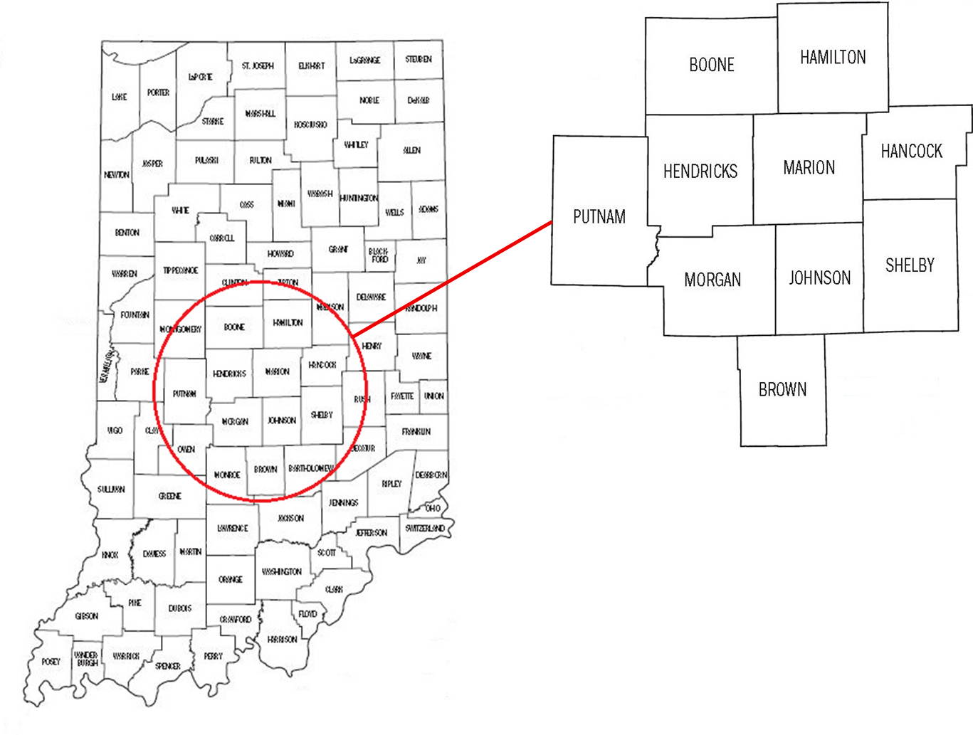
TGA Location & Population
Ten Central Indiana counties with a 2019 estimated population of 1.94 million¹ (10% increase since 2010)^{2, 3}

Slide 5
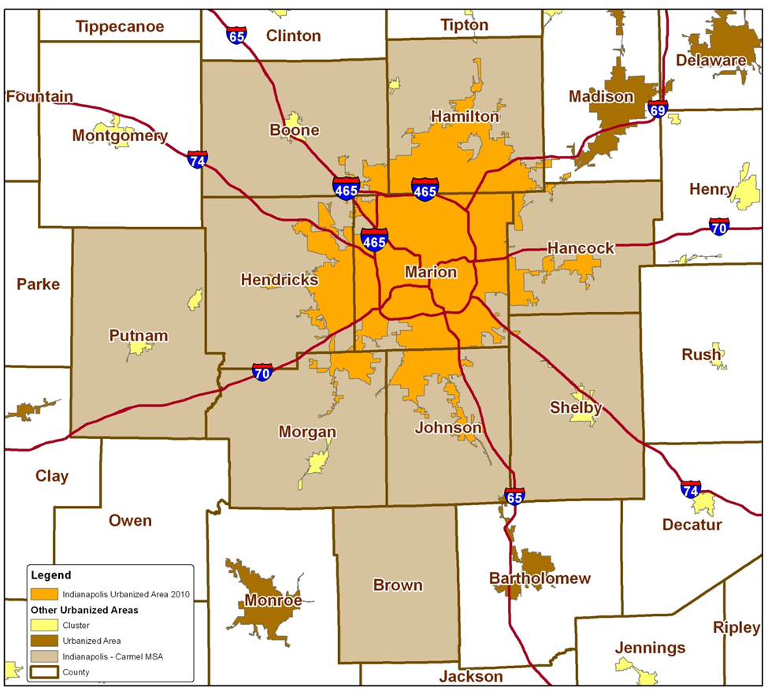
TGA Population Center
84% of the TGA’s population in orange⁴
49% reside inside Indianapolis city limits¹
Notes:
84% of TGA population is most recent estimate (1,604,134/1,920,076)
49% reside inside Indianapolis city limits (955,110/1,920,076)

Slide 6
      Overview of Part A and Minority AIDS Initiative (MAI) Funding

Slide 7
Overview of Part A and MAI Funding
Part A Funding = Formula + Supplemental⁵
    Formula funds are based on the number of people living with HIV/AIDS (PLWH/A) in the TGA
    Supplemental funds are awarded competitively based on demonstrated need and other selective criteria
    Includes core medical and support services designed to improve access and reduce disparities in health outcomes for PLWH/A
  Core Medical
    Must account for at least 75% of Part A funds allocated for services (without a waiver)
  Support Services
    Must be linked to the continuum of care and cannot exceed 25% of Part A funds allocated for services unless a waiver is obtained

Slide 8
Overview of Part A and MAI Funding
MAI Funding⁵
  Funding based on distribution of PLWH/A among racial/ethnic minorities residing in the TGA
  Supports services for minority populations
Data Sources
  Utilization data collected using the Ryan White Information Services Enterprise (RISE) ⁶ database and CAREWare
  Clinical and outcomes data collected using RISE, CAREWare, and the Enhanced HIV/AIDS Reporting System (eHARS) database⁷

Slide 9
      All Parts Spending in the Indianapolis TGA

Slide 11
Notes:
Need for Part C
Outpatient Ambulatory category above includes Outpatient Ambulatory - Vision

Slide 13
Part A/MAI Service Units/Clients Comparison: FY 2019-2020 vs. 2018-2019
Service Type | FY 2019-2020 |  | FY 2018-2019
 | # of Clients | # of Services | # of Clients | # of Services
EIS | 7,399 | 8,103 | 6,791 | 7,129
Medical Case Mgt | 2,347 | 9,159 | 2,344 | 7,813
Amb/Pri Medical Care | 317 | 2,834 | 423 | 1,611
Mental Health Care | 1 | 2 | 17 | 61
Oral Health Care | 92 | 178 | 80 | 139
Local AIDS Rx Assist. | 17 | 20 | 13 | 17
Health Insurance | 5 | 5 | 16 | 16
Substance Abuse - Outpatient | 0 | 0 | 1 | 1
Nutrition | 215 | 1,608 | 204 | 509
Non-Med Case Mgt | 2,196 | 10,653 | 2,157 | 9,619
HE/RR | 356 | 356 | 152 | 152
Emergency $ Food | 545 | 1,402 | 519 | 1,185
Medical Transport | 319 | 3,058 | 294 | 1,231
Outreach | 90 | 98 | 39 | 40
Short Term Housing | 135 | 174 | 133 | 156
Emergency $ Utilities | 126 | 185 | 94 | 132
Legal | 28 | 124 | 12 | 23
Linguistic | 35 | 131 | 44 | 156
Psycho- social | 0 | 0 | 0 | 0
Emergency Pharmacy | 24 | 37 | 21 | 22
Substance Abuse - Residential | 16 | 1,193 | 24 | 1142
Food bank/home-delivered meals | 0 | 0 | 53 | 6086
Summary | 2,834 | 39,320 | 2,715 | 37,240
Notes:
This slide has been added by request
Core services in red tone and supportive services in blue tone

Slide 14
      Part A and MAI Service Utilization

Slide 15
Part A/MAI Utilization: FY 2019-2020
During FY 2019-2020:
  2,834 unique clients utilized 31,217 units of service excluding 8,103 EIS tests administered
  Core Medical accounted for 55.7% of Part A/MAI service units and 70.7% of dollars spent at an average cost of $117.18 per unit
  Support Services accounted for 43.9% of Part A/MAI service units and 29.3% of dollars spent at an average cost of $68.45 per unit

Slide 16
Part A/MAI Utilization: FY 2019-2020 vs. FY 2018-2019
The number of clients and services utilized increased considerably during FY 2019-2020
  Number of clients increased 4.4% (2,834 v. 2,715)
  Number of EIS tests increased 13.7% (8,103 v. 7,129)
  Units of non-EIS service increased 3.7% (31,217 v. 30,111)
  Cost per client increased 4.7% ($1,326 v. $1,266)

Slide 17
      Utilization of Core Medical Services

Slide 18
Utilization in FY 2019-2020 v. FY 2018-2019

Slide 19
Utilization in FY 2019-2020 v. FY 2018-2019
Notes:
Graphs updated to reflect correct MCM service units

Slide 20
Utilization in FY 2019-2020 v. FY 2018-2019

Slide 21
Utilization in FY 2019-2020 v. FY 2018-2019

Slide 22
Early Intervention Services (EIS)
Accounted for 21% of Part A/MAI services utilized and 19.4% of dollars spent
Utilized by 7,399 clients, an increase of 9% from FY18 (N=6,791)
Average 1.0 service unit per client
Averaged $98 per client, an increase of 46% from FY18 ($67)
Notes:
Proportion of services utilized updated

Slide 23
Medical Case Management (Including Treatment Adherence)
Accounted for 23% of Part A/MAI services utilized and 30% of dollars spent
Utilized by 2,347 clients, an increase of 0.1% from FY18 (N=2,344)
Averaged 3.9 service units per client, an increase of 18% from FY18 (N=3.3)
Averaged $473.4 per client, a decrease of 9% from FY18 ($520.2)
Notes:
Proportion of services utilized updated and service units per client updated

Slide 24
Outpatient Ambulatory/Primary Medical Care
Accounted for 7.2% of Part A/MAI services utilized and 14.4% of dollars spent
Utilized by 317 clients, a decrease of 25% from FY18 (N=423)
Averaged 8.9 service units per client, an increase of 134% from FY18 (N=3.8)
Averaged $1,707.03 per client, an increase of 42% from FY18 ($1,200.17)
Notes:
Proportion of services utilized updated

Slide 25
Mental Health Services
Accounted for 0.01% of Part A/MAI services utilized and 0.01% of dollars spent
Utilized by 1 clients, a decrease of 94% from FY18 (N=17)
Averaged 2 service units per client, a decrease of 44% from FY18 (N=3.6)
Averaged $388 per client, a decrease of 33% from FY18 ($ 579.94)
Notes:
Proportion of services utilized updated

Slide 26
Oral Health Care
Accounted for 0.45% of Part A/MAI services utilized and 1.6% of dollars spent
Utilized by 92 clients, an increase of 15% from FY18 (N=80)
Averaged 1.9 service units per client, a increase of 12% from FY18 (N=1.7)
Averaged $656.8 per client, a decrease of 4.8% from FY18 ($690.10)
Notes:
Proportion of services utilized updated

Slide 27
AIDS Pharmacy Assistance (Local)
Accounted for 0.05% of Part A/MAI services utilized and 1.8% of dollars spent
Utilized by 17 clients, a increase of 31% from FY18 (N=13)
Averaged 1.8 service units per client, a increase of 38.5% from FY18 (N=1.3)
Averaged $4,088.3 per client, a increase of 18.4% from FY18 ($3,454.23)
Notes:
Proportion of services utilized updated

Slide 28
Health Insurance Premium & Cost Sharing Assistance
Accounted for 0.01% of Part A/MAI services utilized and 0.3% of dollars spent
Utilized by 5 clients, a decrease of 69% from FY18 (N=16)
Averaged 1.0 service units per client, no change from FY18 (N=1)
Averaged $2,077.2 per client, an increase of 109% from FY18 ($ 993.19)
Notes:
Proportion of services utilized updated

Slide 29
Substance Abuse Services - Outpatient
Accounted for 0% of Part A/MAI services utilized and 0% of dollars spent
Utilized by 0 clients, a 100% decrease from FY18 (N=1)
Averaged 0 service units per client, a decrease of 100% from FY17 (N=1)
Averaged $0 per client, a decrease of 100% from FY18 ($138)
Notes:
Proportion of services utilized updated

Slide 30
Medical Nutrition Therapy
Accounted for 4.1% of Part A/MAI services utilized and 1.2% of dollars spent
Utilized by 215 clients, an increase of 5.4% from FY18 (N=204)
Averaged 7.5 service units per client, a 257% increase from FY18 (N=2.1)
Averaged $200.4 per client, an increase of 100% from FY18 ($98.7)
Notes:
Proportion of services utilized updated

Slide 31
      Utilization of Support Services

Slide 32
Utilization in FY 2019-2020 v. FY 2018-2019

Slide 33
Utilization in FY 2019-2020 v. FY 2018-2019
Notes:
Graphs updated to reflect correct NMCM service units

Slide 34
Utilization in FY 2019-2020 v. FY 2018-2019

Slide 35
Utilization in FY 2019-2020 v. FY 2018-2019

Slide 36
Utilization in FY 2019-2020 v. FY 2018-2019

Slide 37
Utilization in FY 2019-2020 v. FY 2018-2019

Slide 38
Non-Medical Case Management
Accounted for 27.1% of Part A/MAI services utilized and 20.8% of dollars spent
Utilized by 2,196 clients, an increase of 1.8% from FY18 (N=2,157)
Averaged 4.9 service units per client, an increase of 8.8% from FY18 (N=4.5)
Averaged $355.6 per client, an increase of 2.3% from FY18 ($347.5)
Notes:
Proportion of services utilized updated and service units per client updated

Slide 39
Health Education/Risk Reduction (HE/RR)
Accounted for 0.9% of Part A/MAI services utilized and 2.5% of dollars spent
Utilized by 356 clients, an increase of 134% from FY18 (N=152)
Averaged 1 service units per client, no change from FY18 (N=1)
Averaged $258.2 per client, a decrease of 34% from FY18 ($393.19)
Notes:
Proportion of services utilized updated

Slide 40
Emergency Financial: Food
Accounted for 3.6% of Part A/MAI services utilized and 1.3% of dollars spent
Utilized by 545 clients, a increase of 5% from FY18 (N=519)
Averaged 2.6 service units per client, an increase of 13% from FY18 (2.3)
Averaged $89.7 per client, a increase of 47.5% from FY18 ($60.8)
Notes:
Proportion of services utilized updated

Slide 41
Medical Transportation Services
Accounted for 7.8% of Part A/MAI services utilized and 0.6% of dollars spent
Utilized by 319 clients, an increase of 9% from FY18 (N=294)
Averaged 9.6 service units per client, a increase of 128% from FY18 (N=4.2)
Averaged $65.2 per client, an decrease of 66.4% from FY18 ($194.1)
Notes:
Proportion of services utilized updated

Slide 42
Outreach Services
Accounted for 0.25% of Part A/MAI services utilized and 0.09% of dollars spent
Utilized by 90 clients, an increase of 131% from FY17 (N=39)
Averaged 1.1 service units per client, an increase of 10% from FY18 (N=1.0)
Averaged $37.8 per client, an increase of 57% from FY18 ($24.05)
Notes:
Proportion of services utilized updated

Slide 43
Short Term Housing
Accounted for 0.44% of Part A/MAI services utilized and 3.1% of dollars spent
Utilized by 135 clients, an increase of 1.5% from FY18 (N=133)
Averaged 1.3 service units per client, a 8.3% increase from FY18 (N=1.2)
Averaged $850.7 per client, a increase of 33% from FY18 ($637.4)
Notes:
Proportion of services utilized updated

Slide 44
Emergency Financial: Utilities
Accounted for 0.47% of Part A/MAI services utilized and 1.4% of dollars spent
Utilized by 126 clients, an increase of 34% from FY18 (N=94)
Averaged 1.5 service units per client, 7% increase from FY18 (N=1.4)
Averaged $431 per client, an decrease of 2.9% from FY18 ($443.9)
Notes:
Proportion of services utilized updated

Slide 45
Legal Services
Accounted for 0.32% of Part A/MAI services utilized and 0.5% of dollars spent
Utilized by 28 clients, an increase of 133% from FY18 (N=12)
Averaged 4.4 service units per client, an increase of 131% from FY18 (N=1.9)
Averaged $729.2 per client, an increase of 91% from FY18 ($381.25)
Notes:
Proportion of services utilized updated

Slide 46
Linguistic Services
Accounted for 0.3% of Part A/MAI services utilized and 0.3% of dollars spent
Utilized by 35 clients, an decrease of 21% from FY18 (N=44)
Averaged 3.7 service units per client, a increase of 5.7% from FY18 (N=3.5)
Averaged $337 per client, an decrease of 20.1% from FY18 ($422.6)
Notes:
Proportion of services utilized updated

Slide 47
Emergency Financial: Pharmacy
Accounted for 0.4% of Part A/MAI services utilized and 0.09% of dollars spent
Utilized by 24 clients, an increase of 14.3% from FY18 (N=21)
Averaged 1.5 service units per client, an increase of 50% from FY18 (N=1.0)
Averaged $665.4 per client, an decrease of 66.5% from FY18 ($1987.08)
Notes:
Proportion of services utilized updated

Slide 48
Substance Abuse Services – Residential
Accounted for 3% of Part A/MAI services utilized and 0.8% of dollars spent
Utilized by 16 clients, a decrease of 33% from FY18 (N=24)
Averaged 75 service units per client, 368% increase from FY18 (N=16)
Averaged $1,786 per client, an increase of 60.1% from FY18 ($1,115.00)
Notes:
Proportion of services utilized updated

Slide 49
Food Bank/Home delivered Meals
Accounted for 0% of Part A/MAI services utilized and 0% of dollars spent
Utilized by 0 clients, a decrease of 100% from FY18 (N=53)
Averaged 0 service units per client, a decrease of 100% from FY17 (N=115)
Averaged $0 per client, a decrease of 100% from FY18 ($1,162.26)
Notes:
Proportion of services utilized updated

Slide 50
      Part A/MAI Client Profile

Slide 51
Client Status and Time Enrolled
During FY 2019-2020, a total of 2,834 unique clients utilized Part A and/or MAI services, an increase of 4.4% over FY 2018-2019 (N=2,715)
Of unique clients served, 5.9% (N=168) applied for and accessed Ryan White services for the first time, nearly the same as FY 2018-2019 (6.2%, 167)
Notes:
How many have an active client status?

Slide 52
Part A/MAI Clients by Gender

Slide 53
Part A/MAI Clients by Current Age

Slide 54
Part A/MAI Clients by Race/Ethnicity

Slide 55
Part A/MAI Clients by County of Residence
During FY 2019, 49.3% of PLWH/A in the TGA utilized Part A/MAI services (2,834 of 5,745)
  50.2% of Marion County PLWH/A accessed services
  17.7% of PLWH/A in the outlying counties accessed services
N missing = 254
Notes:
Migrating to new data t

Slide 56


Slide 57


Slide 58
Michael Butler
Director
Sam Parmar, MPH
Epidemiologist
Ryan White HIV Services Program
Health & Hospital Corporation
Marion County Public Health Department
http://RyanWhiteIndy.org

Slide 59
References
¹ U.S. Census Bureau and Marion County Public Health Department. (2017). Marion County Public Health Department estimates based on ARIMA projections calculated using U.S. Census Bureau data
² U.S. Census Bureau. (2002). Time series of Indiana intercensal population estimates by county: April 1, 1990 to April 1, 2000. Table CO-EST2001-12-18. Release date April 17, 2002.
³ U.S. Census Bureau. (2011). Intercensal estimates of the resident population for counties of Indiana: April 1, 2000 to July 1, 2010. Table CO-EST00INT-01-18.
⁴ Glenn, R. (2011). Demographics & trends: Indianapolis, Marion County & the Indianapolis region. Department of Metropolitan Development: City of Indianapolis.
⁵ Health Resources and Services Administration. (2014). About the Ryan White HIV/AIDS program – About Part A: Grants to emerging metropolitan & transitional grant areas. Washington D.C.: U.S. Department of Health and Human Services. Available at http://hab.hrsa.gov/abouthab/parta.html
⁶ Ryan White HIV Services Program. (2014). Ryan White Information Services Enterprise (RISE). Indianapolis: Marion County Public Health Department.
⁷ Centers for Disease Control and Prevention. (2014). Enhanced HIV/AIDS Reporting System (eHARS). Indianapolis: Indiana State Department of Health.
⁸ U.S. Department of Health & Human Services. (2015). 2015 poverty guidelines. Retrieved from https://aspe.hhs.gov/2015-poverty-guidelines.

