Slide 1


Ryan White Part A & Minority AIDS Initiative Service Utilization in the Indianapolis Transitional Grant Area: FY 2021-2022
June 2, 2022
Maguette Diop, MD-MPH
MDiop@MarionHealth.org

Slide 2
Objective
To provide the Ryan White Planning Council with information necessary for FY 2023-2024 priority setting and allocation

Slide 3
The Indianapolis Transitional Grant Area (TGA)

Slide 4
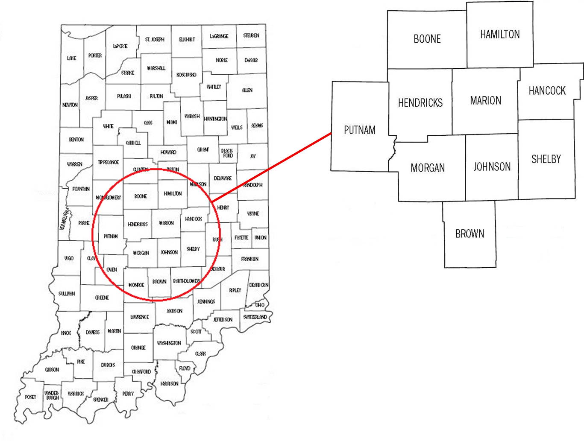
TGA Location & Population
Ten Central Indiana counties with a 2021 estimated population of 1.97 million¹ (12.4% increase since 2010)^{2, 3}
Notes:
1,761,042 to 1,979,981

Slide 5
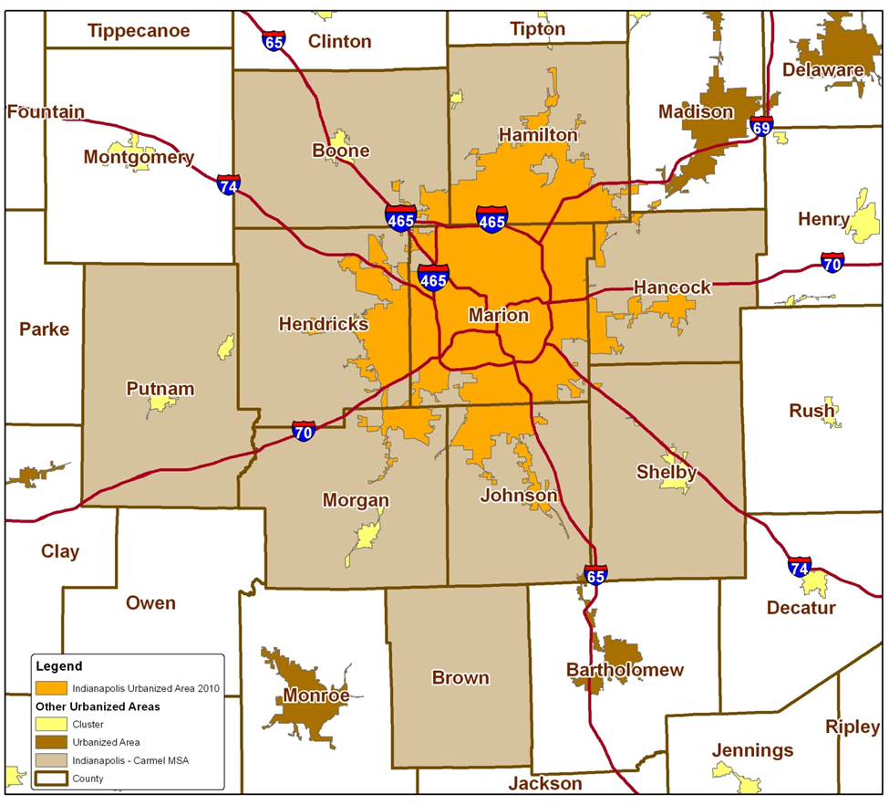
TGA Population Center
82% of the TGA’s population in orange⁴
49% reside inside Indianapolis city limits¹
Notes:
82% of TGA population is most recent estimate (1,623,354/1,979,981)
49% reside inside Indianapolis city limits (969,462/1,979,981)

Slide 6
Overview of Part A and Minority AIDS Initiative (MAI) Funding

Slide 7
Overview of Part A and MAI Funding
Part A Funding = Formula + Supplemental⁵
Formula funds are based on the number of people living with HIV/AIDS (PLWH/A) in the TGA
Supplemental funds are awarded competitively based on demonstrated need and other selective criteria
Includes core medical and support services designed to improve access and reduce disparities in health outcomes for PLWH/A
Core Medical
Must account for at least 75% of Part A funds allocated for services (without a waiver)
Support Services
Must be linked to the continuum of care and cannot exceed 25% of Part A funds allocated for services unless a waiver is obtained

Slide 8
Overview of Part A and MAI Funding
MAI Funding⁵
Funding based on distribution of PLWH/A among racial/ethnic minorities residing in the TGA
Supports services for minority populations
Data Sources
Utilization data collected using CAREWare
Clinical and outcomes data collected using CAREWare, and the Enhanced HIV/AIDS Reporting System (eHARS) database⁷

Slide 9
All Parts Spending in the Indianapolis TGA

Slide 11
Notes:
Need for Part C
Outpatient Ambulatory category above includes Outpatient Ambulatory - Vision

Slide 12
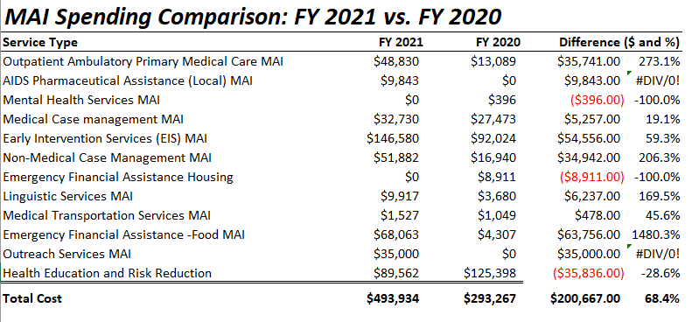

Slide 13
Part A/MAI Service Units/Clients Comparison: FY 2021-2022 vs. 2020-2021
Service Type | FY 2021-2022 |  | FY 2020-2021
 | # of Clients | # of Services | # of Clients | # of Services
EIS | 15,147 | 17,159 | 9,555 | 11,023
Medical Case Mgt | 2,486 | 6,640 | 2,368 | 8,644
Out/Amb/Health Services | 160 | 2,030 | 136 | 595
Mental Health Services | 3 | 3 | 3 | 7
Oral Health Care | 67 | 189 | 47 | 113
AIDS Pharmaceutical Assistance (Local) | 10 | 9 | 6 | 9
Health Insurance | 6 | 9 | 12 | 19
Substance Abuse - Outpatient | 0 | 0 | 0 | 0
Medical Nutrition Therapy | 238 | 2,248 | 196 | 1,083
Non-Med Case Mgt | 2,183 | 9,248 | 2,179 | 10,382
HE/RR | 499 | 499 | 218 | 218
Emergency $ Food | 959 | 2,620 | 630 | 1,792
Medical Transport | 425 | 2,312 | 323 | 1,400
Outreach Services | 261 | 300 | 144 | 182
Emergency $ Housing | 128 | 181 | 89 | 109
Emergency $ Utilities | 143 | 229 | 67 | 93
Legal | 1 | 1 | 0 | 0
Linguistic | 37 | 126 | 35 | 69
Psycho- social | 88 | 88 | 0 | 0
Emergency $ Pharmacy | 8 | 11 | 11 | 13
Substance Abuse - Residential | 10 | 332 | 9 | 840
Food bank/home-delivered meals | 0 | 0 | 0 | 0
Summary | 2,805 | 44,234 | 2,908 | 36,591
Notes:
This slide has been added by request
Core services in red tone and supportive services in blue tone

Slide 14
Part A and MAI Service Utilization

Slide 15
Part A/MAI Utilization: FY 2021-2022
During FY 2021-2022:
2,805 unique Ryan White enrolled clients utilized 26,576 units of service
The number of clients above does not include individuals receiving testing or HE/RR services
The number of services above exclude 17,159 EIS tests administered, and 499 HE/RR services delivered
Core Medical accounted for 64% of Part A/MAI service units and 65.9% of dollars spent at an average cost of $94.9 per unit
Support Services accounted for 36% of Part A/MAI service units and 34.1% of dollars spent at an average cost of $87.3 per unit

Slide 16
Part A/MAI Utilization: FY 2021-2022 vs. FY 2020-2021
The number of clients decreased during FY 2021-2022
The number of services utilized increased during FY 2021-2022
The number of non-EIS services utilized and the cost per client increased during FY 2021-2022
Number of clients decreased by 3.5% (2,805 v. 2,908)
Number of EIS tests increased by 55.7% (17,159 v. 11,023)
Units of non-EIS service increased by 3.9% (26,576 v. 25,567)
Cost per client increased by 15.9% ($1,454 v. $1,254)

Slide 17
Utilization of Core Medical Services

Slide 18
Utilization in FY 2021-2022 v. FY 2020-2021

Slide 19
Utilization in FY 2021-2022 v. FY 2020-2021
Notes:
Graphs updated to reflect correct MCM service units

Slide 20
Utilization in FY 2021-2022 v. FY 2020-2021

Slide 21
Utilization in FY 2020-2021 v. FY 2019-2020

Slide 22
Early Intervention Services (EIS)
Accounted for 38.8% of Part A/MAI services utilized and 30.1% of dollars spent
Utilized by 15,147 clients, an increase of 58.5% from FY20 (N=9,555)
Average 1.0 service unit per client
Averaged $81 per client, a decrease of 22.9% from FY20 ($105)
Notes:
Proportion of services utilized updated

Slide 23
Medical Case Management (Including Treatment Adherence)
Accounted for 15% of Part A/MAI services utilized and 23.4% of dollars spent
Utilized by 2,486 clients, an increase of 5% from FY20 (N=2,368)
Averaged 2.7 service units per client, a decrease of 27% from FY20 (N=3.7)
Averaged $383.9 per client, a decrease of 27.5% from FY20 ($529.4)
Notes:
Proportion of services utilized updated and service units per client updated

Slide 24
Outpatient /Ambulatory Health Services
Accounted for 4.6% of Part A/MAI services utilized and 9.5% of dollars spent
Utilized by 160 clients, an increase of 17.6% from FY20 (N=136)
Averaged 12.7 service units per client, an increase of 188.6% from FY20 (N=4.4)
Averaged $2,406.9 per client, an increase of 148.4% from FY20 ($969.1)
Notes:
Proportion of services utilized updated

Slide 25
Mental Health Services
Accounted for 0.01% of Part A/MAI services utilized and 0.01% of dollars spent
Utilized by 3 clients, the same as for FY20 (N=3)
Averaged 1 service unit per client, a decrease of 50% from FY20 (N=2)
Averaged $200 per client, a decrease of 53.5% from FY20 ($430.33)
Notes:
Proportion of services utilized updated

Slide 26
Oral Health Care
Accounted for 0.43% of Part A/MAI services utilized and 0.8% of dollars spent
Utilized by 67 clients, an increase of 42.6% from FY20 (N=47)
Averaged 2.8 service units per client, an increase of 16.7% from FY20 (N=2.4)
Averaged $496.8 per client, a decrease of 11% from FY20 ($558)
Notes:
Proportion of services utilized updated

Slide 27
AIDS Pharmaceutical Assistance (Local)
Accounted for 0.02% of Part A/MAI services utilized and 0.53% of dollars spent
Utilized by 10 clients, an increase of 66.7% from FY20 (N=6)
Averaged 0.9 service units per client, a decrease of 40% from FY20 (N=1.5)
Averaged $2,152.7 per client, a decrease of 41.5% from FY20 ($3,682)
Notes:
Proportion of services utilized updated

Slide 28
Health Insurance Premium & Cost Sharing Assistance
Accounted for 0.02% of Part A/MAI services utilized and 0.54% of dollars spent
Utilized by 6 clients, a decrease of 50% from FY20 (N=12)
Averaged 1.5 service units per client, a decrease of 6.3% of from FY20 (N=1.6)
Averaged $3640 per client, a decrease of 4.5% from FY20 ($3,810)
Notes:
Proportion of services utilized updated

Slide 29
Medical Nutrition Therapy
Accounted for 5.1% of Part A/MAI services utilized and 1.02% of dollars spent
Utilized by 238 clients, an increase of 21.4% from FY20 (N=196)
Averaged 9.4 service units per client, an increase of 70.9% from FY20 (N=5.5)
Averaged $175.3 per client, an increase of 2.2% from FY20 ($171.6)
Notes:
Proportion of services utilized updated

Slide 30
Utilization of Support Services

Slide 31
Utilization in FY 2021-2022 v. FY 2020-2021

Slide 32
Utilization in FY 2021-2022 v. FY 2020-2021
Notes:
Graphs updated to reflect correct NMCM service units

Slide 33
Utilization in FY 2021-2022 v. FY 2020-2021

Slide 34
Utilization in FY 2021-2022 v. FY 2020-2021

Slide 35
Utilization in FY 2021-2022 v. FY 2020-2021

Slide 36
Utilization in FY 2020-2021 v. FY 2019-2020

Slide 37
Non-Medical Case Management
Accounted for 20.9% of Part A/MAI services utilized and 19.8% of dollars spent
Utilized by 2,183 clients, an increase of 0.2% from FY20 (N=2,179)
Averaged 4.2 service units per client, a decrease of 12.5% from FY20 (N=4.8)
Averaged $369.3 per client, a decrease of 2.2% from FY20 ($377.5)
Notes:
Proportion of services utilized updated and service units per client updated

Slide 38
Health Education/Risk Reduction (HE/RR)
Accounted for 1.13% of Part A/MAI services utilized and 2.2% of dollars spent
Utilized by 499 clients, an increase of 128.9% from FY20 (N=218)
Averaged 1 service unit per client, the same as for FY20 (N=1)
Averaged $179.5 per client, a decrease of 70.3% from FY20 ($604.2)
Notes:
Proportion of services utilized updated

Slide 39
Emergency Financial: Food
Accounted for 5.9% of Part A/MAI services utilized and 3.4% of dollars spent
Utilized by 959 clients, an increase of 52.2% from FY20 (N=630)
Averaged 2.7 service units per client, a decrease of 3.6% from FY20 (2.8)
Averaged $146.2 per client, an increase of 78.3% from FY20 ($82)
Notes:
Proportion of services utilized updated

Slide 40
Medical Transportation Services
Accounted for 5.2% of Part A/MAI services utilized and 0.92% of dollars spent
Utilized by 425 clients, an increase of 31.6% from FY20 (N=323)
Averaged 5.4 service units per client, an increase of 25.6% from FY20 (N=4.3)
Averaged $88.6 per client, an increase of 72.7% from FY20 ($51.3)
Notes:
Proportion of services utilized updated

Slide 41
Outreach Services
Accounted for 0.7% of Part A/MAI services utilized and 1.2% of dollars spent
Utilized by 261 clients, an increase of 81.3% from FY20 (N=144)
Averaged 1.1 service units per client, a decrease of 15.4% from FY20 (N=1.3)
Averaged $181 per client, an increase of 211.5% from FY20 ($58.1)
Notes:
Proportion of services utilized updated

Slide 42
Emergency Financial Housing
Accounted for 0.4% of Part A/MAI services utilized and 3.3% of dollars spent
Utilized by 128 clients, an increase of 43.8% from FY20 (N=89)
Averaged 1.4 service units per client, a 16.7% increase from FY20 (N=1.2)
Averaged $1,041.6 per client, an increase of 70.5% from FY20 ($610.9)
Notes:
Proportion of services utilized updated

Slide 43
Emergency Financial: Utilities
Accounted for 0.52% of Part A/MAI services utilized and 1.99% of dollars spent
Utilized by 143 clients, an increase of 113.4% from FY20 (N=67)
Averaged 1.6 service units per client, 14.3% increase from FY20 (N=1.4)
Averaged $566.3 per client, an increase of 95.6% from FY20 ($289.5)
Notes:
Proportion of services utilized updated

Slide 44
Legal Services
Accounted for 0.002% of Part A/MAI services utilized and 0.003% of dollars spent
Utilized by 1 client compared to N=0 for FY20
Averaged 0.75 service unit per client compared to N=0 for FY20
Averaged $124 per client compared to $0 for FY20
Notes:
Proportion of services utilized updated

Slide 45
Linguistic Services
Accounted for 0.28% of Part A/MAI services utilized and 0.24% of dollars spent
Utilized by 37 clients, an increase of 5.7% from FY20 (N=35)
Averaged 3.4 service units per client, an increase of 70% from FY20 (N=2)
Averaged $268 per client, an increase of 140.6% from FY20 ($111.4)
Notes:
Proportion of services utilized updated

Slide 46
Psycho-social Services
Accounted for 0.2% of Part A/MAI services utilized and 0.7% of dollars spent
Utilized by 88 clients compared to N=0 for FY20
Averaged 1 service unit per client compared to N=0 for FY20
Averaged $317 per client compared to $0 for FY20
Notes:
Proportion of services utilized updated

Slide 47
Emergency Financial: Pharmacy
Accounted for 0.02% of Part A/MAI services utilized and 0.25% of dollars spent
Utilized by 8 clients, a decrease of 27.3% from FY20 (N=11)
Averaged 1.4 service units per client, an increase of 16.7% from FY20 (N=1.2)
Averaged $1,275 per client, an increase of 241.2% from FY20 ($373.7)
Notes:
Proportion of services utilized updated

Slide 48
Substance Abuse Services – Residential
Accounted for 0.75% of Part A/MAI services utilized and 0.2% of dollars spent
Utilized by 10 clients, an increase of 11.1% from FY20 (N=9)
Averaged 33.2 service units per client, 64.3% decrease from FY20 (N=93)
Averaged $851.6 per client, a decrease of 62% from FY20 ($2,243)
Notes:
Proportion of services utilized updated

Slide 49
Part A/MAI Client Profile

Slide 50
Client Status and Time Enrolled
During FY 2021-2022, a total of 2,805 unique clients utilized Part A and/or MAI services, a decrease of 3.5% compared to FY 2020-2021 (N=2,908)
Of unique clients served, 11.7% (N=329) applied for and accessed Ryan White services for the first time
Notes:
How many have an active client status?

Slide 51
Part A/MAI Clients by Gender

Slide 52
Part A/MAI Clients by Current Age

Slide 53
Part A/MAI Clients by Race/Ethnicity

Slide 54
Part A/MAI Clients by Exposure Category

Slide 55
Part A/MAI Clients by County of Residence
Marion | 2,518 | 89.8%
Hamilton | 73 | 2.6%
Johnson | 43 | 1.5%
Hendricks | 57 | 2.0%
Hancock | 28 | 1.0%
Morgan | 13 | 0.5%
Putnam | 10 | 0.4%
Boone | 13 | 0.5%
Shelby | 8 | 0.3%
Brown | 3 | 0.1%
Other | 39 | 1.4%
During FY 2021, 45.4% of PLWH/A in the TGA utilized Part A/MAI services (2,805 of 6,174)
48.2% of Marion County PLWH/A accessed services
30.3% of PLWH/A in the outlying counties accessed services
Notes:
Migrating to new data t

Slide 56


Slide 57


Slide 58
Maguette Diop, MD-MPH
Epidemiologist
Ryan White HIV Services Program
Health & Hospital Corporation
Marion County Public Health Department
http://RyanWhiteIndy.org

Slide 59
References
¹ U.S. Census Bureau and Marion County Public Health Department. (2021). Marion County Public Health Department estimates based on ARIMA projections calculated using U.S. Census Bureau data
² U.S. Census Bureau. (2002). Time series of Indiana intercensal population estimates by county: April 1, 1990 to April 1, 2000. Table CO-EST2001-12-18. Release date April 17, 2002.
³ U.S. Census Bureau. (2011). Intercensal estimates of the resident population for counties of Indiana: April 1, 2000 to July 1, 2010. Table CO-EST00INT-01-18.
⁴ Glenn, R. (2011). Demographics & trends: Indianapolis, Marion County & the Indianapolis region. Department of Metropolitan Development: City of Indianapolis.
⁵ Health Resources and Services Administration. (2022). About the Ryan White HIV/AIDS program – About Part A: Grants to emerging metropolitan & transitional grant areas. Washington D.C.: U.S. Department of Health and Human Services. Available at http://hab.hrsa.gov/abouthab/parta.html
⁶ Ryan White HIV Services Program. (2022).CAREWare. Indianapolis: Marion County Public Health Department.
⁷ Centers for Disease Control and Prevention. (2022). Enhanced HIV/AIDS Reporting System (eHARS). Indianapolis: Indiana State Department of Health.

