Slide 1


Ryan White Part A & Minority AIDS Initiative Service Utilization in the Indianapolis Transitional Grant Area: FY 2022-2023
June 1, 2023
Maguette Diop, MD-MPH
MDiop@MarionHealth.org

Slide 2
Objective
To provide the Ryan White Planning Council with information necessary for FY 2024-2025 priority setting and allocation

Slide 3
The Indianapolis Transitional Grant Area (TGA)

Slide 4
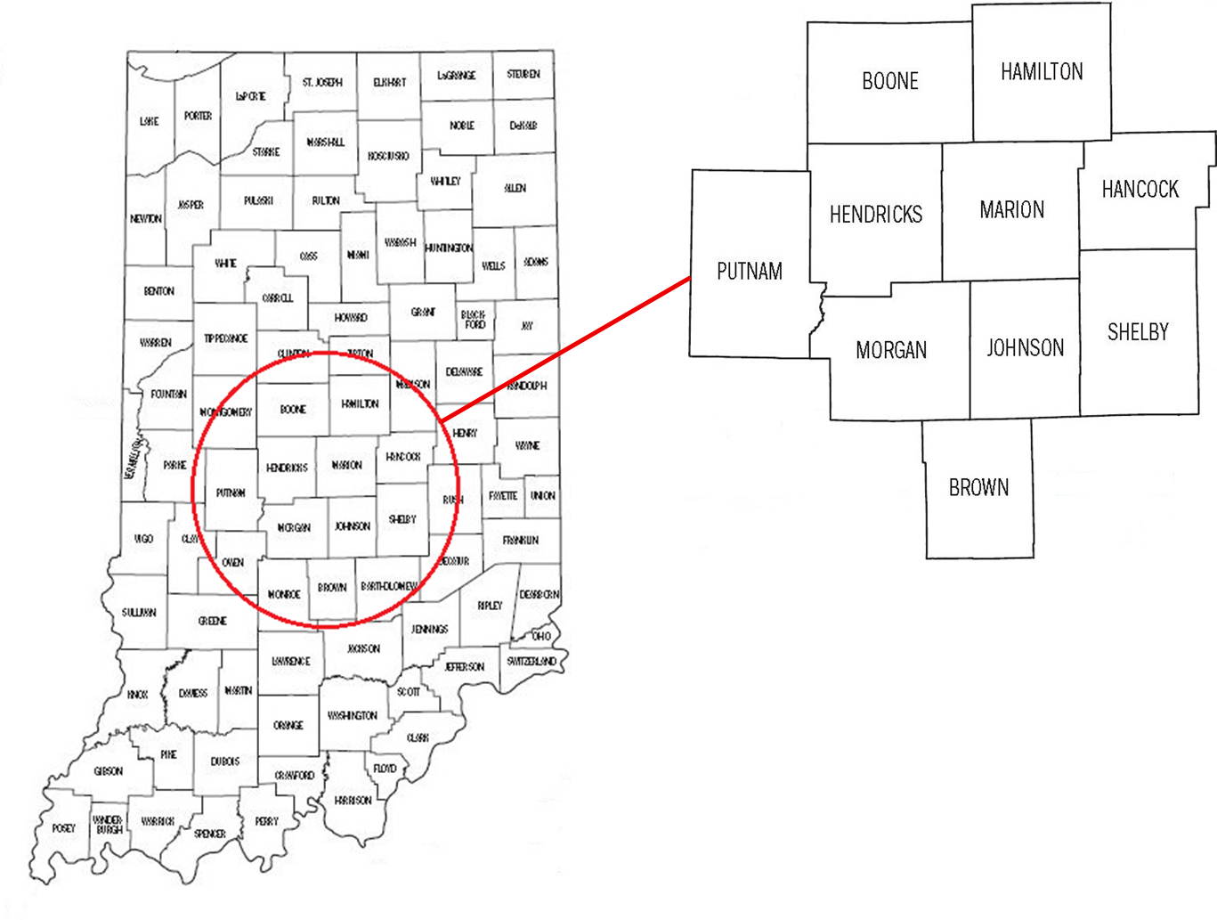
TGA Location & Population
Ten Central Indiana counties with a 2022 estimated population of 2.02 million¹ (14.9% increase since 2010 and 3% since 2020)^{2, 3}
Notes:
1,761,042 to 1,979,981

Slide 5
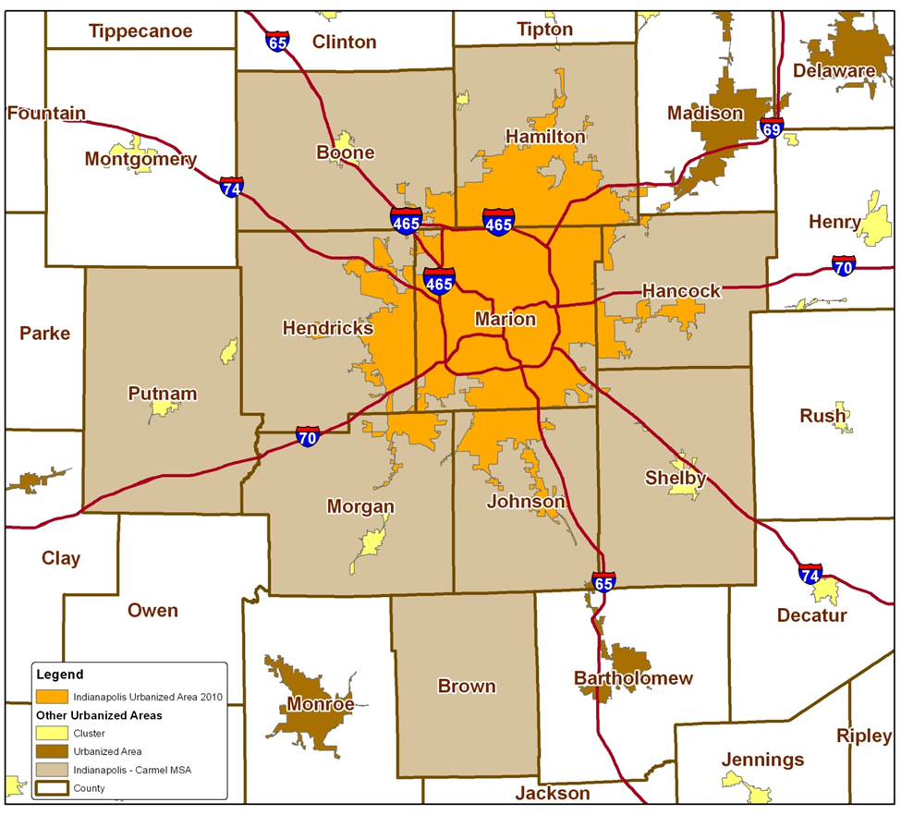
TGA Population Center
83% of the TGA’s population in orange⁴
48% reside inside Indianapolis city limits¹
Notes:
82% of TGA population is most recent estimate (1,623,354/1,979,981)
49% reside inside Indianapolis city limits (969,462/1,979,981)

Slide 6
Overview of Part A and Minority AIDS Initiative (MAI) Funding

Slide 7
Overview of Part A and MAI Funding
Part A Funding = Formula + Supplemental⁵
Formula funds are based on the number of people living with HIV/AIDS (PLWH/A) in the TGA
Supplemental funds are awarded competitively based on demonstrated need and other selective criteria
Includes core medical and support services designed to improve access and reduce disparities in health outcomes for PLWH/A
Core Medical
Must account for at least 75% of Part A funds allocated for services (without a waiver)
Support Services
Must be linked to the continuum of care and cannot exceed 25% of Part A funds allocated for services unless a waiver is obtained

Slide 8
Overview of Part A and MAI Funding
MAI Funding⁵
Funding based on distribution of PLWH/A among racial/ethnic minorities residing in the TGA
Supports services for minority populations
Data Sources
Utilization data collected using CAREWare in addition to other sources for a small number of services
Clinical and outcomes data collected using CAREWare, and the Enhanced HIV/AIDS Reporting System (eHARS) database⁷ in addition to other sources for a small number of service

Slide 9
All Parts Spending in the Indianapolis TGA

Slide 10
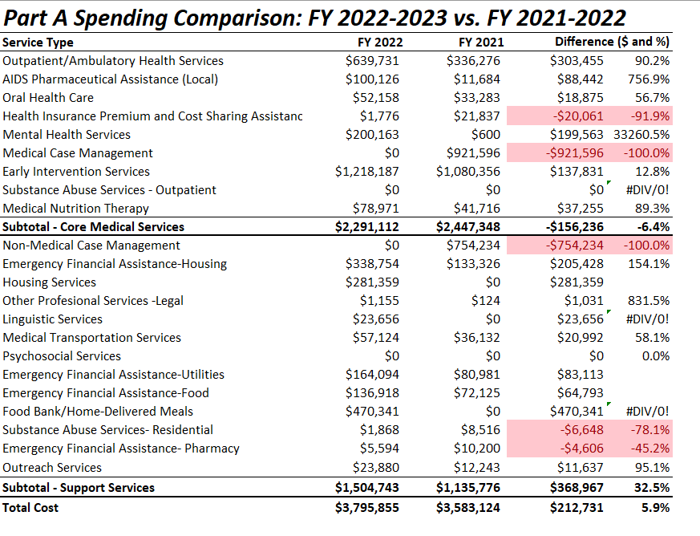

Slide 11
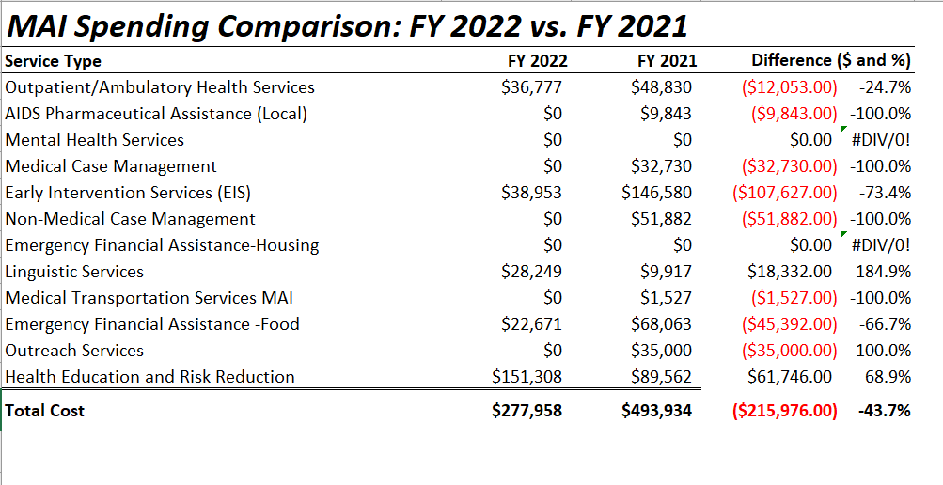

Slide 12
Part A/MAI Service Units/Clients Comparison: FY 2022-2023 vs. 2021-2022
Service Type | FY 2022-2023 |  | FY 2021-2022
 | # of Clients | # of Services | # of Clients | # of Services
EIS | 12,439 | 14,529 | 15,133 | 16,802
Medical Case Mgt | Part B | Part B | 2,132 | 6,239
Out/Amb/Health Services | 548 | 2,632 | 154 | 2,031
Mental Health Services | 72 | 830 | 3 | 3
Oral Health Care | 103 | 284 | 68 | 191
AIDS Pharmaceutical Assistance (Local) | 45 | 66 | 7 | 9
Health Insurance | 1 | 1 | 6 | 9
Medical Nutrition Therapy | 370 | 898 | 238 | 2,248
Non-Med Case Mgt | Part B | Part B | 2,030 | 9,249
HE/RR | 18 | 29 | 8 | 38
Emergency $ Food | 1,080 | 3,350 | 726 | 2,620
Medical Transport | 673 | 2,661 | 403 | 2,312
Outreach Services | 175 | 139 | 171 | 210
Emergency $ Housing | 254 | 381 | 128 | 181
Housing | 605 | 2,586 | 0 | 0
Food Bank/Home Delivered Meals | 1,163 | 7,440 | 0 | 0
Emergency $ Utilities | 242 | 434 | 143 | 229
Legal | 1 | 7 | 1 | 1
Linguistic | 237 | 1,070 | 37 | 126
Psycho- social | 0 | 0 | 0 | 0
Emergency $ Pharmacy | 2 | 4 | 8 | 11
Substance Abuse - Residential | 4 | 88 | 10 | 332
Notes:
This slide has been added by request
Core services in red tone and supportive services in blue tone

Slide 13
Part A and MAI Service Utilization

Slide 14
Part A/MAI Utilization: FY 2022-2023
During FY 2022-2023:
2,116 unique Ryan White enrolled clients utilized 22,759 units of Part A/MAI services
The number of clients above does not include individuals receiving only testing and/or outreach services
The number of services above excludes 14,529 EIS tests administered and 175 outreach services delivered
Core Medical accounted for 51% of Part A/MAI service units and 65% of dollars spent at an average cost of $137.6 per unit
Support Services accounted for 49% of Part A/MAI service units and 35% of dollars spent at an average cost of $78.4 per unit

Slide 15
Part A/MAI Utilization: FY 2022-2023 vs. FY 2021-2022
The number of clients decreased during FY 2022-2023
The number of services utilized decreased during FY 2022-2023
The number of non-EIS services utilized decreased during FY 2022-2023
The cost per client increased during FY 2022-2023
Number of clients decreased by 24.6% (2,116 v. 2,805)
Number of EIS tests decreased by 13.5% (14,529 v. 16,802)
Units of non-EIS service decreased by 12% (22,900 v. 26,039)
Cost per client increased by 32.4% ($1,925 v. $1,454)

Slide 16
Utilization of Core Medical Services

Slide 17
Utilization in FY 2022-2023 v. FY 2021-2022

Slide 18
Utilization in FY 2022-2023 v. FY 2021-2022
Notes:
Graphs updated to reflect correct MCM service units

Slide 19
Utilization in FY 2022-2023 v. FY 2021-2022

Slide 20
Utilization in FY 2022-2023 v. FY 2021-2022

Slide 21
Early Intervention Services (EIS)
Accounted for 38.8% of Part A/MAI services utilized and 30.9% of dollars spent
Utilized by 12,439 clients, a decrease of 17.8% from FY21 (N=15,133)
Average 1.0 service unit per client
Averaged $101 per client, an increase of 24.7% from FY21 ($81)
Notes:
Proportion of services utilized updated

Slide 22
Medical Case Management (Including Treatment Adherence)
Part B during FY 2022-2023
Notes:
Proportion of services utilized updated and service units per client updated

Slide 23
Outpatient /Ambulatory Health Services
Accounted for 7% of Part A/MAI services utilized and 16.6% of dollars spent
Utilized by 548 clients, an increase of 255.8% from FY21 (N=154)
Averaged 4.8 service units per client, a decrease of 63.6% from FY21 (N=13.2)
Averaged $1,235 per client, a decrease of 50.6% from FY21 ($2,500.7)
Notes:
Proportion of services utilized updated

Slide 24
Mental Health Services
Accounted for 2.2% of Part A/MAI services utilized and 4.9% of dollars spent
Utilized by 72 clients, an increase of 2300% from FY21 (N=3)
Averaged 12 service unit per client, an increase of 1100% from FY21 (N=1)
Averaged $2,780 per client, an increase of 1,290% from FY21 ($200)
Notes:
Proportion of services utilized updated

Slide 25
Oral Health Care
Accounted for 0.76% of Part A/MAI services utilized and 1.3% of dollars spent
Utilized by 103 clients, an increase of 51.5% from FY21 (N=68)
Averaged 2.8 service units per client, the same as for FY21 (N=2.8)
Averaged $506.4 per client, an increase of 3.5% from FY21 ($489.5)
Notes:
Proportion of services utilized updated

Slide 26
AIDS Pharmaceutical Assistance (Local)
Accounted for 0.18% of Part A/MAI services utilized and 2.46% of dollars spent
Utilized by 45 clients, an increase of 542.9% from FY21 (N=7)
Averaged 1.5 service units per client, an increase of 15.4% from FY21 (N=1.3)
Averaged $2,225 per client, a decrease of 27.7% from FY21 ($3,075.3)
Notes:
Proportion of services utilized updated

Slide 27
Health Insurance Premium & Cost Sharing Assistance
Accounted for 0.0027% of Part A/MAI services utilized and 0.04% of dollars spent
Utilized by 1 client, a decrease of 83.3% from FY21 (N=6)
Averaged 1 service unit per client, a decrease of 33.3% from FY21 (N=1.5)
Averaged $1,776 per client, a decrease of 51.2% from FY21 ($3,639.5)
Notes:
Proportion of services utilized updated

Slide 28
Medical Nutrition Therapy
Accounted for 2.4% of Part A/MAI services utilized and 1.9% of dollars spent
Utilized by 370 clients, an increase of 55.5% from FY21 (N=238)
Averaged 2.4 service units per client, a decrease of 74.5% from FY21 (N=9.4)
Averaged $213.4 per client, an increase of 21.7% from FY21 ($175.3)
Notes:
Proportion of services utilized updated

Slide 29
Utilization of Support Services

Slide 30
Utilization in FY 2022-2023 v. FY 2021-2022

Slide 31
Utilization in FY 2022-2023 v. FY 202-2022
Notes:
Graphs updated to reflect correct NMCM service units

Slide 32
Utilization in FY 2022-2023 v. FY 2021-2022

Slide 33
Utilization in FY 2022-2023 v. FY 2021-2022

Slide 34
Utilization in FY 2022-2023 v. FY 2021-2022

Slide 35
Utilization in FY 2022-2023 v. FY 2021-2022

Slide 36
Non-Medical Case Management
Part B during FY 2022-2023
Notes:
Proportion of services utilized updated and service units per client updated

Slide 37
Health Education/Risk Reduction (HE/RR)
Accounted for 0.08% of Part A/MAI services utilized and 3.7% of dollars spent
Utilized by 18 clients, an increase of 125% from FY21 (N=8)
Averaged 1.6 service unit per client, a decrease of 66.3% from FY21 (N=4.75)
Averaged $8,406 per client, a decrease of 24.9% from FY21 ($11,195)
Notes:
Proportion of services utilized updated

Slide 38
Emergency Financial Assistance-Food
Accounted for 9% of Part A/MAI services utilized and 3.9% of dollars spent
Utilized by 1,080 clients, an increase of 48.8% from FY21 (N=726)
Averaged 3.1 service units per client, a decrease of 13.9% from FY21 (3.6)
Averaged $147.8 per client, an increase of 23.5% from FY21 ($193.1)
Notes:
Proportion of services utilized updated

Slide 39
Medical Transportation Services
Accounted for 7.1% of Part A/MAI services utilized and 1.4% of dollars spent
Utilized by 673 clients, an increase of 67% from FY21 (N=403)
Averaged 3.95 service units per client, a decrease of 30.7% from FY21 (N=5.7)
Averaged $84.9 per client, a decrease of 9.2% from FY21 ($93.5)
Notes:
Proportion of services utilized updated

Slide 40
Outreach Services
Accounted for 0.4% of Part A/MAI services utilized and 0.6% of dollars spent
Utilized by 175 clients, an increase of 2.3% from FY21 (N=171)
Averaged 0.8 service unit per client, a decrease of 33.3% from FY21 (N=1.2)
Averaged $136.5 per client, a decrease of 50.6% from FY21 ($276.3)
Notes:
Proportion of services utilized updated

Slide 41
Emergency Financial Assistance-Housing
Accounted for 1.02% of Part A/MAI services utilized and 8.3% of dollars spent
Utilized by 254 clients, an increase of 98.4% from FY21 (N=128)
Averaged 1.5 service units per client, a 7.1% increase from FY21 (N=1.4)
Averaged $1,334 per client, an increase of 28.1% from FY21 ($1,041.6)
Notes:
Proportion of services utilized updated

Slide 42
Emergency Financial Assistance-Utilities
Accounted for 1.2% of Part A/MAI services utilized and 4% of dollars spent
Utilized by 242 clients, an increase of 69.2% from FY21 (N=143)
Averaged 1.8 service units per client, a12.5% increase from FY21 (N=1.6)
Averaged $678.1 per client, an increase of 19.7% from FY21 ($566.3)
Notes:
Proportion of services utilized updated

Slide 43
Other Professional Services-Legal
Accounted for 0.02% of Part A/MAI services utilized and 0.03% of dollars spent
Utilized by 1 client the same as for FY21 (N=1)
Averaged 7 service units per client an increase of 833.3% from FY21 (N=0.75)
Averaged $1,155 per client an increase of 831.5% from FY21 ($124)
Notes:
Proportion of services utilized updated

Slide 44
Linguistic Services
Accounted for 2.9% of Part A/MAI services utilized and 1.3% of dollars spent
Utilized by 237 clients, an increase of 540.5% from FY21 (N=37)
Averaged 4.5 service units per client, an increase of 32.4% from FY21 (N=3.4)
Averaged $219 per client, a decrease of 18.3% from FY21 ($268)
Notes:
Proportion of services utilized updated

Slide 45
Emergency Financial Assistance-Pharmacy
Accounted for 0.01% of Part A/MAI services utilized and 0.14% of dollars spent
Utilized by 2 clients, a decrease of 75% from FY21 (N=8)
Averaged 2 service units per client, an increase of 42.9% from FY21 (N=1.4)
Averaged $2,797 per client, an increase of 119.4% from FY21 ($1,275)
Notes:
Proportion of services utilized updated

Slide 46
Substance Abuse Services – Residential
Accounted for 0.24% of Part A/MAI services utilized and 0.05% of dollars spent
Utilized by 4 clients, a decrease of 60% from FY21 (N=10)
Averaged 22 service units per client, 33.7% decrease from FY21 (N=33.2)
Averaged $467 per client, a decrease of 45.2% from FY21 ($851.6)
Notes:
Proportion of services utilized updated

Slide 47
Housing Services
Accounted for 6.9% of Part A/MAI services utilized and 6.9% of dollars spent
Utilized by 605 clients
Averaged 4.3 service unit per client
Averaged $465 per client
Notes:
Proportion of services utilized updated

Slide 48
Food Bank/ Home Delivered Meals
Accounted for 19.9% of Part A/MAI services utilized and 11.6% of dollars spent
Utilized by 1,163 clients
Averaged 6.4 service unit per client
Averaged $404 per client
Notes:
Proportion of services utilized updated

Slide 49
Part A/MAI Client Profile

Slide 50
Client Status and Time Enrolled
During FY 2022-2023, a total of 2,116 unique enrolled clients utilized Part A and/or MAI services, a decrease of 24.6% compared to FY 2021-2022 (N=2,805). This number does not include individuals receiving only- testing and/or outreach services
During this grant period, 378 initial applications were processed through RWISE, representing clients enrolled in the RWSP for the first time.
Notes:
How many have an active client status?

Slide 51
Part A/MAI Enrolled Clients by Gender

Slide 52
Part A/MAI Enrolled Clients by Current Age

Slide 53
Part A/MAI Enrolled Clients by Race/Ethnicity

Slide 54
Part A/MAI Enrolled Clients by Exposure Category

Slide 55
Part A/MAI Enrolled Clients by County of Residence
Marion | 1,938 | 91.6%
Hamilton | 40 | 1.9%
Johnson | 29 | 1.4%
Hendricks | 42 | 2.0%
Hancock | 14 | 0.7%
Morgan | 9 | 0.4%
Putnam | 4 | 0.2%
Boone | 8 | 0.4%
Shelby | 4 | 0.2%
Brown | 0 | 0%
Other | 28 | 1.3%
During FY 2022, 32.8% of PLWH/A in the TGA utilized Part A/MAI services (2,116 of 6,447)
35.8% of Marion County PLWH/A accessed services
17.3% of PLWH/A in the outlying counties accessed services
Notes:
Migrating to new data t

Slide 56


Slide 57


Slide 58
Maguette Diop, MD-MPH
Epidemiologist
Ryan White HIV Services Program
Health & Hospital Corporation
Marion County Public Health Department
http://RyanWhiteIndy.org

Slide 59
References
¹ U.S. Census Bureau and Marion County Public Health Department. (2021). Marion County Public Health Department estimates based on ARIMA projections calculated using U.S. Census Bureau data
² U.S. Census Bureau. (2002). Time series of Indiana intercensal population estimates by county: April 1, 1990 to April 1, 2000. Table CO-EST2001-12-18. Release date April 17, 2002.
³ U.S. Census Bureau. (2011). Intercensal estimates of the resident population for counties of Indiana: April 1, 2000 to July 1, 2010. Table CO-EST00INT-01-18.
⁴ Glenn, R. (2011). Demographics & trends: Indianapolis, Marion County & the Indianapolis region. Department of Metropolitan Development: City of Indianapolis.
⁵ Health Resources and Services Administration. (2022). About the Ryan White HIV/AIDS program – About Part A: Grants to emerging metropolitan & transitional grant areas. Washington D.C.: U.S. Department of Health and Human Services. Available at http://hab.hrsa.gov/abouthab/parta.html
⁶ Ryan White HIV Services Program. (2022).CAREWare. Indianapolis: Marion County Public Health Department.
⁷ Centers for Disease Control and Prevention. (2022). Enhanced HIV/AIDS Reporting System (eHARS). Indianapolis: Indiana State Department of Health.

