Slide 1
Hepatitis C Epidemiology: Marion County (IN)
Tammie Nelson, MPH, CPH
November 23, 2015

Slide 2
Hepatitis C Infection in the U.S.
The CDC estimates 29,718 acute (first 6-months after infection) HCV virus infections occurred during 2013 in the U.S.
The number reported was 2,138 but is adjusted for asymptomatic infection and underreporting
Only 20%-30% experience symptoms during acute infection
Approximately 2.7 million people were living with chronic HCV infection at year-end 2014 in the U.S.
Source: Centers for Disease Control and Prevention. (2015). Hepatitis C facts for health professionals. Retrieved from http://www.cdc.gov/hepatitis/hcv/hcvfaq.htm

Slide 3
Increasing HCV Mortality in the U.S.
Age-adjusted HCV mortality increased significantly in the U.S. between 1999 and 2007
HCV mortality surpassed that of HIV beginning in 2007 causing at least 15,106 U.S. deaths (vs. 12,734 caused by HIV)
HCV caused at least 15,106 deaths among U.S. residents in 2007
Sources: Centers for Disease Control and Prevention. (2015). Hepatitis C facts for health professionals. Retrieved from http://www.cdc.gov/hepatitis/hcv/hcvfaq.htm
Ly, K. N., Xing, J., Klevens, M., Jiles, R. B., Ward, J. W., and Holmberg, S. D. (2012). The increasing burden of mortality from viral hepatitis in the United States between 1999 and 2007. Annals of Internal Medicine, 156(4): 271-278. Retrieved from http://www.annals.org/content/156/4/271.full

Slide 4
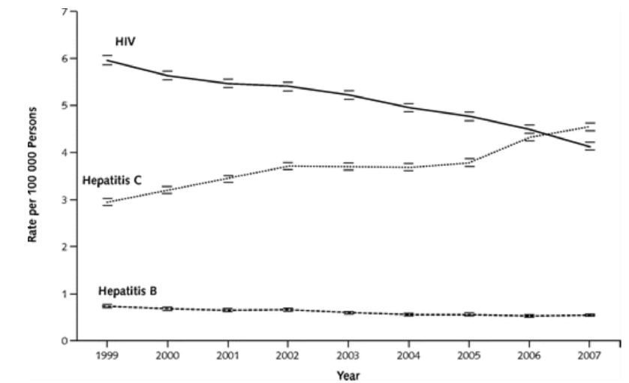
Annual Age-Adjusted HBV, HCV, and HIV Mortality Rates in the United States: 1999-2007
Footnote: In cases of co-infected decedents more than one type of infection was counted.
Source: Ly, K. N., Xing, J., Klevens, M., Jiles, R. B., Ward, J. W., and Holmberg, S. D. (2012). The increasing burden of mortality from viral hepatitis in the United States between 1999 and 2007. Annals of Internal Medicine, 156(4): 271-278. Retrieved from http://www.annals.org/content/156/4/271.full

Slide 5
Modes of HCV Transmission
Transmission occurs primarily by percutaneous exposure to infectious blood (e.g., needle puncture)
Predominate modes of transmission:
Intravenous drug use (currently the most common mode of transmission in the U.S.)
Needle-stick injuries in health care settings
Perinatal transmission (mother-to-child)
Receipt of donated blood/blood products and organs (once common but rare since July 1992)
Receipt of clotting factor concentrates pre-1987
Source: Centers for Disease Control and Prevention. (2015). Hepatitis C facts for health professionals. Retrieved from http://www.cdc.gov/hepatitis/hcv/hcvfaq.htm

Slide 6
Modes of HCV Transmission
Though considered inefficient methods of HCV transmission, infection is possible via:
Sex with an HCV-infected person
Sharing contaminated personal items (i.e., razor or toothbrush)
Invasive health care procedures such as injections or chronic hemodialysis (usually recognized in the context of outbreaks)
Very limited data suggest a risk by non-injection cocaine use
Source: Centers for Disease Control and Prevention. (2015). Hepatitis C facts for health professionals. Retrieved from http://www.cdc.gov/hepatitis/hcv/hcvfaq.htm

Slide 7
Protection Against HCV
No current vaccine
No effective pre- or post-exposure prophylaxis
Prior infection offers no protection
May later be infected with the same or different HCV genotype(s)
Six genotypes (1–6) and 50+ subtypes have been identified to date
Genotype 1 is most common in the U.S.
Source: Centers for Disease Control and Prevention. (2015). Hepatitis C facts for health professionals. Retrieved from http://www.cdc.gov/hepatitis/hcv/hcvfaq.htm

Slide 8
Outcomes of Chronic HCV
Of every 100 persons infected with HCV, approximately:
15–25 clear the virus
75–85 go on to develop chronic HCV infection
60–70 develop chronic liver disease
5–20 develop cirrhosis over a period of 20–30 years
1–5 die from liver-related complications (e.g., liver cancer, cirrhosis)
HCV is the number one cause of liver transplants in the U.S.
Source: Centers for Disease Control and Prevention. (2015). Hepatitis C facts for health professionals. Retrieved from http://www.cdc.gov/hepatitis/hcv/hcvfaq.htm

Slide 9
Outcomes of Chronic HCV
Hepatocellular carcinoma (HCC)
Late complication of chronic progressive liver disease
Sixth most common cancer worldwide
One of the most lethal cancers - Third most common cause of cancer-related deaths worldwide
Chronic HCV increases risk for HCC 20-fold
Sources: International Agency for Research on Cancer. (2013). EPIC study: The liver cancer working group. Retrieved from http://epic.iarc.fr/research/cancerworkinggroups/livercancer.php
International Agency for Research on Cancer. (2010). IARC monographs on the evaluation of carcinogenic risks to humans. Retrieved from http://monographs.iarc.fr/ENG/Monographs/vol96/mono96-6B-05.pdf

Slide 10
Common Co-Infections
Hepatitis B virus (HBV)
9%-30% of people with chronic HBV are co-infected with HCV
HBV/HCV co-infection increases risk for severe liver disease and progression to HCC
HIV
25% of people living with HIV (PLWH) are HCV co-infected
HIV co-infection triples risk for HCV-related liver disease, the leading cause of non-AIDS related death among PLWH
Current guidelines call for HCV screening in all PLWH (annually for those at increased risk)
Sources: Hepatitis B Foundation. (2014). HBV/HCV co-infection. Retrieved from http://www.hepb.org/hepb/hbv_hcv_co-infection.htm
National Alliance of State & Territorial AIDS Directors. (2011). HIV and viral hepatitis co-infection. Retrieved from https://www.nastad.org/Docs/031236_HIV%20VH%20CoInfection%20Final.pdf
Centers for Disease Control and Prevention. (2014). HIV and viral hepatitis. Retrieved from http://www.cdc.gov/hiv/pdf/library_factsheets_hiv_and_viral_hepatitis.pdf
U.S. Department of Health & Human Services. (2015). Guidelines for the use of antiretroviral agents in HIV-1-infected adults and adolescents: Considerations for antiretroviral use in patients with coinfections. https://aidsinfo.nih.gov/guidelines/html/1/adult-and-adolescent-arv-guidelines/26/hiv-hcv

Slide 11
Groups Most at Risk
Prevalence of HCV among various risk groups
1.3% to 1.62% of the U.S. general population 18+ years of age
Most are ‘Baby Boomers’ (born 1945-1965) who were likely infected during the 1970s and 1980s
20% of the those with severe mental illness
29% of those incarcerated
19% to 69% of the homeless
33% to 90% of intravenous drug users (IDU) (see next slide)
Sources: National Viral Hepatitis Round Table. (2014). NVHR hepatitis C state specific resources pages: Indiana. Retrieved from NVHR hepatitis C state specific resources pages: Indiana
Weiss, J. J., Parrella, K., and Perumalswami, P. V.. (2015, October). HepCure: An innovative web-based toolkit to support the treatment of hepatitis C at community health centers in New York state. Presented October 19, 2015 at the Statewide Conference & Clinical Forum of the Community Health Care Association of New York State. Retreived from http://www.chcanys.org/clientuploads/2015_PDFs/Conference%20&%20Trainings/2015%20Conference/Presentations/Monday/HepCure_CHCANYS%20Oct%2019%202015%20Final.pdf
Centers for Disease Control and Prevention. (2015). Hepatitis C facts for health professionals. Retrieved from http://www.cdc.gov/hepatitis/hcv/hcvfaq.htm

Slide 12
HCV Prevalence among IDU
Risk of HCV among IDU
IDU ≤ 30 years old and < 9 yrs use = 1 of 3
IDU > 30 years old and < 9 yrs use = 2 of 3
IDU > 10 yrs use = 9 of 10
IDU and living with HIV = About 8 of 10
Sources: Weiss, J. J., Parrella, K., and Perumalswami, P. V.. (2015, October). HepCure: An innovative web-based toolkit to support the treatment of hepatitis C at community health centers in New York state. Presented October 19, 2015 at the Statewide Conference & Clinical Forum of the Community Health Care Association of New York State. Retreived from http://www.chcanys.org/clientuploads/2015_PDFs/Conference%20&%20Trainings/2015%20Conference/Presentations/Monday/HepCure_CHCANYS%20Oct%2019%202015%20Final.pdf
Centers for Disease Control and Prevention. (2014). HIV and viral hepatitis. Retrieved from http://www.cdc.gov/hiv/pdf/library_factsheets_hiv_and_viral_hepatitis.pdf
Centers for Disease Control and Prevention. (2015). Hepatitis C facts for health professionals. Retrieved from http://www.cdc.gov/hepatitis/hcv/hcvfaq.htm

Slide 13
Marion County HCV

Slide 14
HCV Prevalence in Marion County
An estimated 10,425 to 12,651 residents were living with chronic HCV at EOY 2014
9,045-11,271 HIV-negative residents 18+ years of age (rate 95% CI: 1,273.7-1,650.0 per 100,000)
1,380 HIV-positive residents (rate 95% CI: 23,884.1-26,168.8)
Sources: U.S. Census Bureau. (2015). Annual Estimates of the Resident Population for Selected Age Groups by Sex for the United States, States, Counties, and Puerto Rico Commonwealth and Municipios: April 1, 2010 to July 1, 2014.
National Viral Hepatitis Round Table. (2014). NVHR hepatitis C state specific resources pages: Indiana. Retrieved from NVHR hepatitis C state specific resources pages: Indiana
National Alliance of State & Territorial AIDS Directors. (2011). HIV and viral hepatitis co-infection. Retrieved from https://www.nastad.org/Docs/031236_HIV%20VH%20CoInfection%20Final.pdf

Slide 15
HCV Incidence in Marion County
Most HCV diagnosed in Marion County is among residents with chronic infection; however, the percentage diagnosed at acute vs. chronic increased during 2014 and 2015
2.1% tentatively reported for 2015
Sources: Marion County Public Health Department. (2015). Insight (Internal database).

Slide 16
Acute HCV Incidence in Marion County
Acute HCV diagnoses have been increasing since 2002 (r=0.75, P=0.002)
21 cases tentatively reported for 2015
Sources: Marion County Public Health Department. (2015). Insight (Internal database).

Slide 17
Acute HCV Incidence in Marion County
The rate in 2014 (95% CI: 1.5-3.4 per 100,000) was at least 1.4 times that of 2013 (RR 95% CI: 1.4-8.6) and the 2012 U.S. rate
Sources: Marion County Public Health Department. (2015). Insight (Internal database).

Slide 18
Chronic HCV Incidence in Marion County
No change in the trend of chronic HCV diagnoses during the 2000s (r=-0.07, P=0.83)
985 cases tentatively reported for 2015
Sources: Marion County Public Health Department. (2015). Insight (Internal database).

Slide 19
Chronic HCV Incidence in Marion County
The rate of newly diagnosed chronic HCV in 2014 was 95.1 (95% CI: 89.0-101.5) which was not significantly different than during 2013 and was not significantly different than the 2012 U.S. rate
Sources: Marion County Public Health Department. (2015). Insight (Internal database).

Slide 20
Demographics of HCV in Marion County
Females are more often diagnosed during acute infection; whereas, males tend to be diagnosed more often during the chronic stage of disease
Both genders realized an increase in acute diagnoses; though the largest increase in 2014 was among females
Sources: Marion County Public Health Department. (2015). Insight (Internal database).

Slide 21
Demographics of HCV in Marion County
80% of acute HCV diagnosed 2010-2014 was among White residents
Averaged risk for chronic HCV diagnoses was slightly higher among African Americans than their White peers with a relative risk of 1.37 (95% CI: 1.29-1.46)
Sources: Marion County Public Health Department. (2015). Insight (Internal database).

Slide 22
Demographics of HCV in Marion County
Age was the most significant demographical difference in HCV diagnoses
Ages 25-44 accounted for most acute HCV diagnoses during 2014
Sources: Marion County Public Health Department. (2015). Insight (Internal database).

Slide 23
Demographics of HCV in Marion County
When combining incidence by race/ethnicity and age, differences are more pronounced

Slide 24
Demographics of HCV in Marion County
Among 15-24 year old county residents, there is a significant increasing trend in new HCV diagnoses (any stage) among White residents, though this trend is not found among 15-24 year olds of other racial/ethnic groups
Sources: Marion County Public Health Department. (2015). Insight (Internal database).

Slide 25
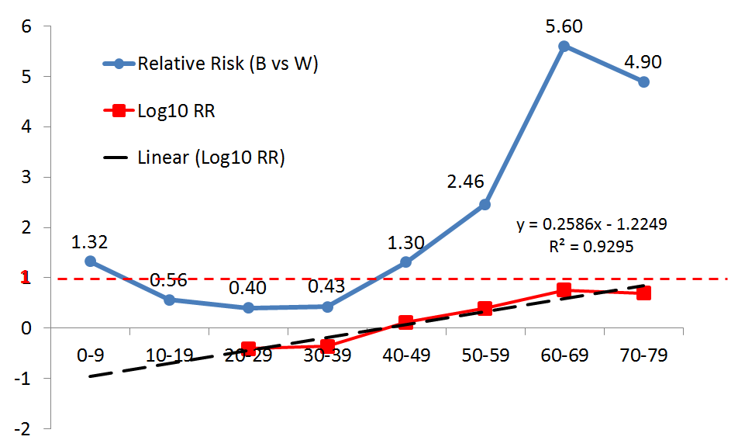
Demographics of HCV in Marion County
It also became clear - assuming similar age at diagnosis - that African American residents are being diagnosed later in the disease stage than their White peers at all ages over 39
Source and graphic: Kirbiyik, U., Nelson, T., Mulanya, K., Dixon, B. (2015). Racial differences in age at Hepatitis C diagnosis in Marion County, Indiana: 2009-2013. Presented November 2, 2015 at the annual meeting of the American Public Health Association: Chicago. Available at https://apha.confex.com/apha/143am/webprogram/Paper330708.html

Slide 26
Risk Factors for HCV in Marion County
Residents newly diagnosed with chronic HCV are not interviewed
Risk factors for residents diagnosed with acute HCV were captured and have been reported statewide by ISDH
Risk(s) Reported by Indiana Residents Diagnosed with Acute HCV: 2014
Non-injection use of street drugs | 43.4%
Injection of non-prescribed medications and/or street drugs | 49.2%
Sexual contact with a confirmed or suspected case of HCV | 20.5%
Note: More than one risk factor can be reported resulting in a total greater than 100%
Sources: Indiana State Department of Helath. (2015). Annual report of infectious diseases: 2014. Retrieved from http://www.in.gov/isdh/files/2014_ISDH_Annual_Report_of_Infectious_Diseases_Final.pdf

Slide 27
Discussion
Two factors may be contributing to the increasing trends noted:
1. Risk awareness is assumed to have increased due to media coverage of the southeast Indiana outbreak
2. Testing may have increased due to the availability of new medication that is considered to be a ‘cure’ for HCV

Slide 28
Discussion
The combination of high prevalence of substance use and increasing HCV incidence among young adults in Marion County is worrisome
Evidence suggests that secondary transmission of HCV is more likely to occur during the first three years after infection
Injection drug users are thought to infect about 20 others, on average, during the initial three-year period following infection
Sources: National Institute on Drug Abuse. (2013). Viral hepatitis - A very real consequence of substance use. Retrieved from http://www.drugabuse.gov/related-topics/viral-hepatitis-very-real-consequence-substance-use
Magiorkinis, G., Sypsa, V., Magiorkinis, E., Paraskevis, D., Katsoulidou, A., Belshaw, R. ... Hatzakis, A. (2013). Integrating phylodynamics and epidemiology to estimate transmission diversity in viral epidemics. PLoS Comput Biol, 9(1), e1002876. doi: 10.1371/journal.pcbi.1002876. Retrieved from http://www.ncbi.nlm.nih.gov/pmc/articles/PMC3561042/

Slide 29
Discussion
Outreach and prevention programs should target HCV among all Marion County residents, especially young adult injection drug users
HCV screening and early initiation of HCV treatment should be undertaken in order to safeguard the health of those affected and to prevent secondary transmission of the virus

Slide 32
Tammie Nelson, MPH, CPH
Epidemiologist
Marion County Public Health Department
3901 Meadows Drive, H108
Indianapolis, IN 46205
Office: 317-221-3556
TNelson@MarionHealth.org

