Slide 1
Opiate Use in the U.S., Indiana, and Marion County
Tammie Nelson, MPH, CPH
November 23, 2015

Slide 2
U.S.

Slide 3
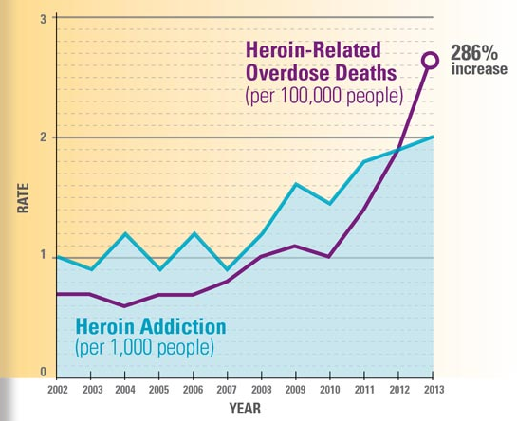
National Statistics
Heroin use doubled between 2002 and 2013 (from 1 to 2 users per 1,000 residents)
Subsequently, the rate of fatal heroin overdose (OD) during the same time period increased by 286% (from 0.7 to 2.7 deaths per 100,000 residents)
Illustration and data source: Centers for Disease Control and Prevention. (2015). Today’s heroin epidemic: More people at risk, multiple drugs abused. Retrieved from http://www.cdc.gov/vitalsigns/heroin/index.html

Slide 4
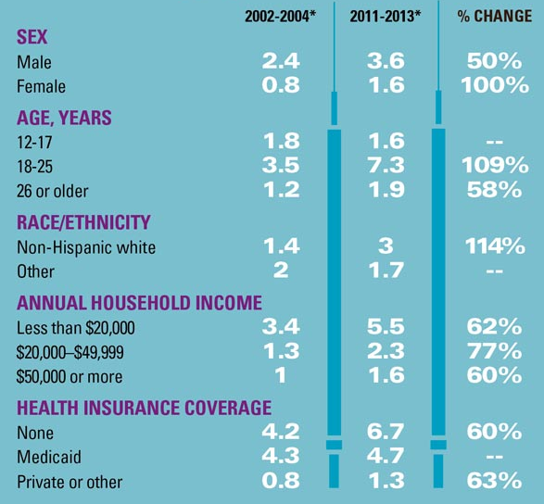
National Statistics
The largest increases in heroin use were seen among:
Females
18-25 year olds
Non-Hispanic Whites
Illustration and data source: Centers for Disease Control and Prevention. (2015). Today’s heroin epidemic: More people at risk, multiple drugs abused. Retrieved from http://www.cdc.gov/vitalsigns/heroin/index.html

Slide 5
National Statistics
Those at greatest risk are:
Male
18-25 years old
Non-Hispanic White
Earn less than $20K/Yr
Either lack health insurance or have only Medicaid coverage
Residing in large metropolitan areas (not shown in table)
Illustration and data source: Centers for Disease Control and Prevention. (2015). Today’s heroin epidemic: More people at risk, multiple drugs abused. Retrieved from http://www.cdc.gov/vitalsigns/heroin/index.html

Slide 6
National Statistics
The most significant risk factor for heroin addiction is addiction to other drugs including:
Alcohol (2x more likely)
Marijuana (3x more likely)
Cocaine (15x more likely)
Prescription (Rx) opioid painkillers (40x more likely)
Centers for Disease Control and Prevention. (2015). Today’s heroin epidemic: More people at risk, multiple drugs abused. Retrieved from http://www.cdc.gov/vitalsigns/heroin/index.html

Slide 7
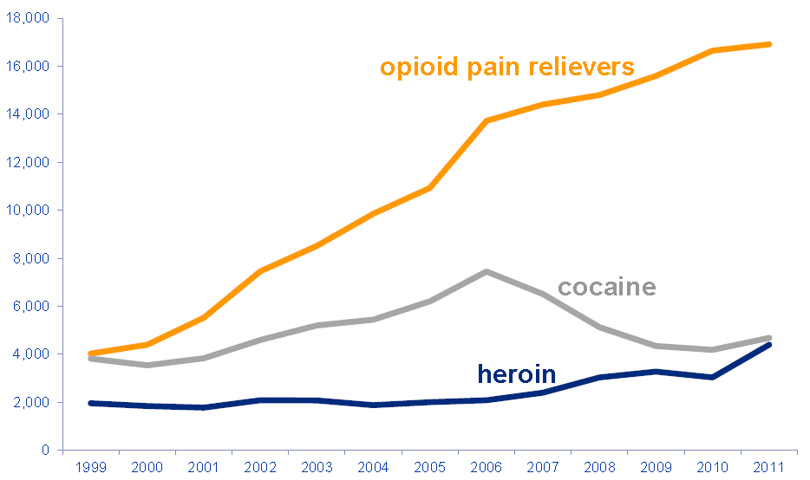
National Statistics
Rx opioid OD deaths outnumbered those of heroin and cocaine combined beginning in 2002
Illustration and data source: National Center for Injury Prevention and Control. (2014). The prescription drug overdose epidemic. Centers for Disease Control and Prevention, http://www.nga.org/files/live/sites/NGA/files/pdf/2014/1409ReducingPrescriptionDrugAbuseDrugOverdoseEpidemic_Noonan.pdf

Slide 8
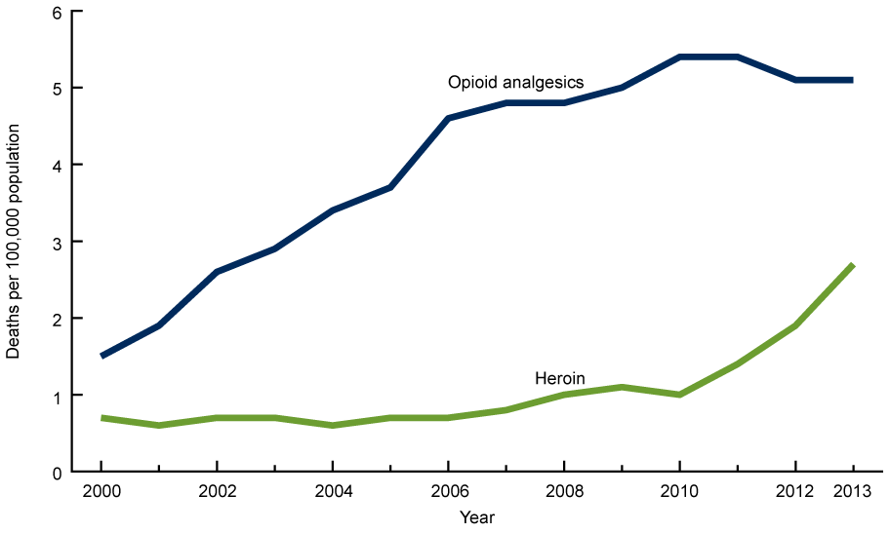
National Statistics
In 2013, the age-adjusted death rate for Rx opioid ODs (5.1 per 100,000) was nearly twice that of heroin (2.7)
Illustration and data source: Hedegaard, H., Chen, L., & Warner, M. (2015). Drug-poisoning deaths involving heroin: United States, 2000-2013. NCHS Data Brief, 190. National Center for Health Statistics, http://www.cdc.gov/nchs/data/databriefs/db190.htm

Slide 9
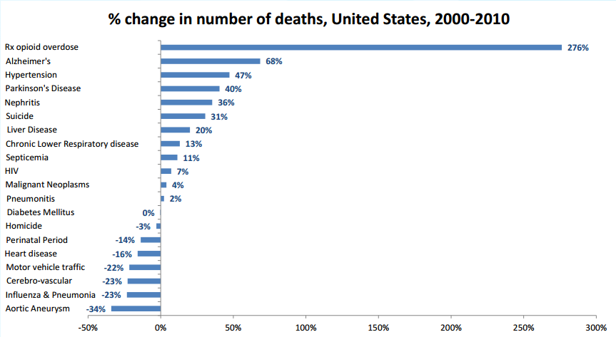
National Statistics
Deaths from Rx opioid ODs have increased more since 2000 than deaths from any other major cause in the U.S.
Illustration and data source: National Center for Injury Prevention and Control. (2014). The prescription drug overdose epidemic. Centers for Disease Control and Prevention, http://www.nga.org/files/live/sites/NGA/files/pdf/2014/1409ReducingPrescriptionDrugAbuseDrugOverdoseEpidemic_Noonan.pdf

Slide 10
National Statistics
Fatal overdoses of Rx opioids reveal only the tip of the iceberg where risk is concerned
For each fatality in 2011, 801 others were at risk for opioid dependence or overdose
1 fatal Rx opioid overdose
12 Rx opioid Tx admissions
25 Rx opioid emergency department visits
105 abusing or dependent on Rx opioids
659 non-medical Rx opioid users
National Center for Injury Prevention and Control. (2014). The prescription drug overdose epidemic. Centers for Disease Control and Prevention, http://www.nga.org/files/live/sites/NGA/files/pdf/2014/1409ReducingPrescriptionDrugAbuseDrugOverdoseEpidemic_Noonan.pdf

Slide 11
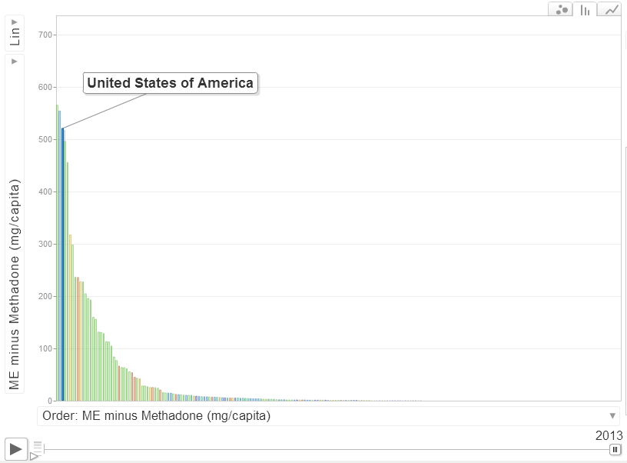
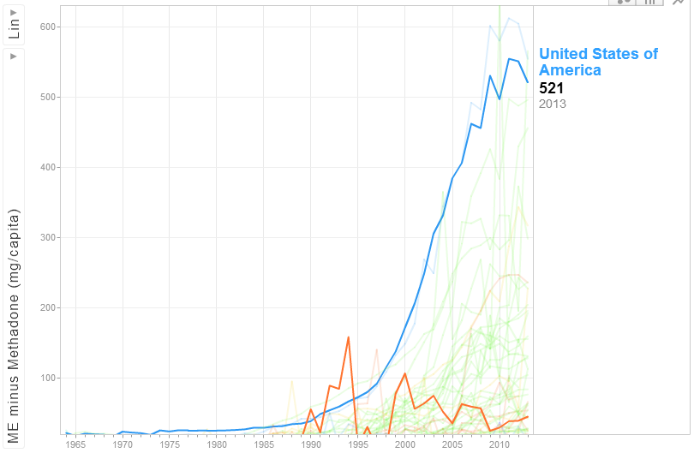
National Statistics
The U.S. ranked third among countries for aggregate consumption of non-methadone Rx opioids in 2013
https://ppsg.medicine.wisc.edu/chart
Illustration and data source: International Narcotics Control Board and University of Wisconsin. (2015). Opioid consumption motion chart. Retrieved from https://ppsg.medicine.wisc.edu/chart

Slide 12
National Statistics
Despite a growing epidemic, U.S. health care providers wrote 259 million painkiller Rxs in 2012
That’s one painkiller Rx for every adult resident of the U.S.
Or, 121 painkiller Rxs per 100 people
National Center for Injury Prevention and Control. (2014). Opioid painkiller prescribing infographic. Centers for Disease Control and Prevention, http://www.cdc.gov/vitalsigns/opioid-prescribing/infographic.html#map

Slide 13
Indiana

Slide 14
Indiana Statistics
Notes:
Sometimes more than one drug type is reported in a drug OD death
Most Indiana OD deaths are reported as ‘Other & Unspecified Drugs’. Still others are reported as ‘Other & Unspecified narcotics’ (illicit drugs). These reports greatly reduce reporting accuracy
With increasing awareness of this issue throughout the state and nation, it is hoped that providers will make an attempt to more accurately report the drug(s) involved

Slide 15
Indiana Statistics
Poisoning is the leading cause of injury death in Indiana and drugs cause 9 of every 10 poisoning deaths
In 2012, the age-adjusted drug OD death rate was 15.8 per 100,000, a 5-fold increase since 1999
Illustration and data source: Indiana State Department of Health and Centers for Disease Control and Prevention. (2014). Indiana - Special emphasis report: Drug overdose deaths, 1999-2012. Retrieved from http://www.in.gov/isdh/files/SER_Drug_Deaths_Indiana.pdf

Slide 16
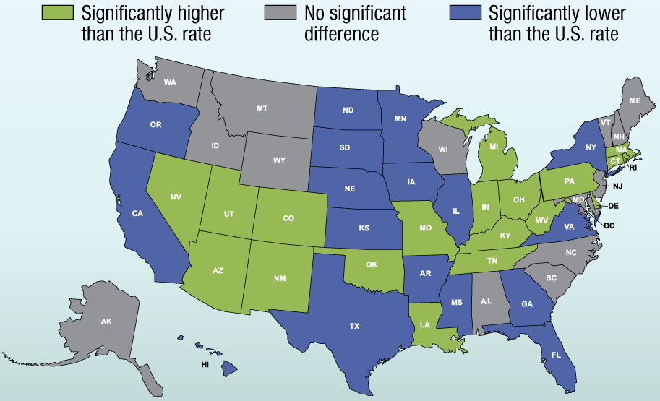
Indiana Statistics
Indiana ranked among U.S. states with 2013 age-adjusted drug OD death rates significantly higher than the U.S. rate of 13.8 per 100,000
Illustration and data source: Centers for Disease Control and Prevention. (2015). NCHS data on drug poisoning deaths. NCHS Fact Sheet. Retrieved from http://www.cdc.gov/nchs/data/factsheets/factsheet_drug_poisoning.htm

Slide 17
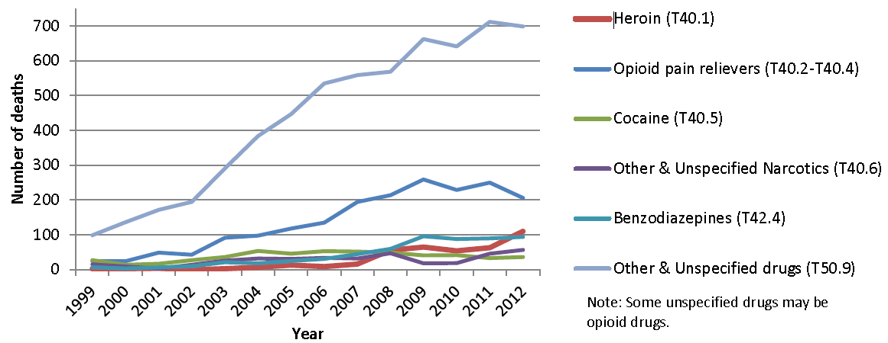
Indiana Statistics
OD deaths from ‘Other/Unspecified’ drugs and narcotics increased rapidly and far outnumber all others; many are assumed to have been attributable to heroin or Rx opioids
Note that reports of ‘Other/Unspecified’ began increasing before reports of specific drug types
Illustration and data source: Indiana State Department of Health and Centers for Disease Control and Prevention. (2014). Indiana - Special emphasis report: Drug overdose deaths, 1999-2012. Retrieved from http://www.in.gov/isdh/files/SER_Drug_Deaths_Indiana.pdf

Slide 18
Indiana Statistics
Reports of heroin OD deaths began steadily increasing in 2007, about one year after a strong increase in reports of Rx opioid OD deaths
Illustration and data source: Indiana State Department of Health and Centers for Disease Control and Prevention. (2014). Indiana - Special emphasis report: Drug overdose deaths, 1999-2012. Retrieved from http://www.in.gov/isdh/files/SER_Drug_Deaths_Indiana.pdf

Slide 19
Indiana Statistics
Rx opioid OD deaths numbered <50 in 1999
Since 2008, Indiana has lost >200 residents per year to Rx opioid OD
Illustration and data source: Indiana State Department of Health and Centers for Disease Control and Prevention. (2014). Indiana - Special emphasis report: Drug overdose deaths, 1999-2012. Retrieved from http://www.in.gov/isdh/files/SER_Drug_Deaths_Indiana.pdf

Slide 20
Indiana Statistics
Despite increasing opiate use and overdoses and evidence that Rx opioid abuse increases risk of heroin addiction, Indiana health care providers continue to prescribe large numbers of opioid pain killers
Example: From 1997 to 2005, OxyContin sales increased 500% in Indiana
Data source: Indiana Prevention Resource Center. (n.d.). OxyContin. Retrieved from http://www.drugs.indiana.edu/publications/factline/oxycontin.pdf

Slide 21
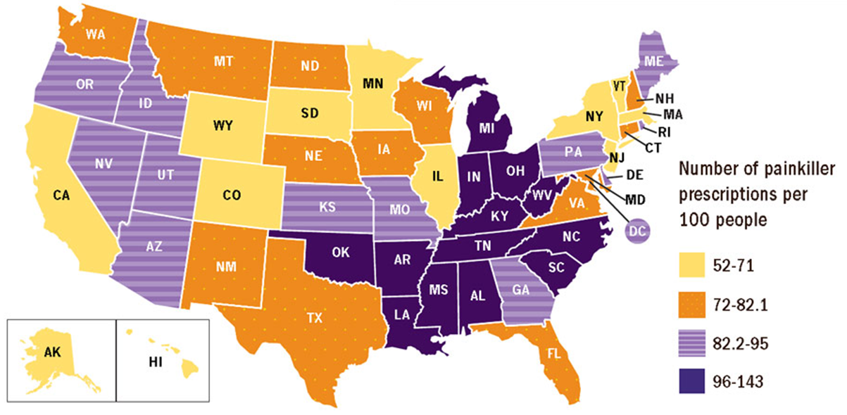
Indiana Statistics
Indiana providers wrote 109 painkiller Rxs per 100 residents during 2012 (only AR, LA, MS, OK, KY, WV, AR, and TN wrote more)
Illustration and data source: National Center for Injury Prevention and Control. (2014). Opioid painkiller prescribing infographic. Centers for Disease Control and Prevention, http://www.cdc.gov/vitalsigns/opioid-prescribing/infographic.html#map

Slide 22
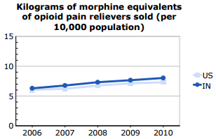
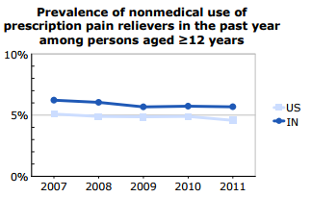
Indiana Statistics
Rx opioid sales and abuse in Indiana is higher than the U.S. overall
Illustration and data source: Centers for Disease Control and Prevention. (2014). Prevention status reports 2013: Prescription drug overdose – Indiana. Retrieved from http://www.cdc.gov/psr/prescriptiondrug/2013/in-pdo.pdf

Slide 23
Indiana Statistics
CDC quote –
“The sharp rise in opioid overdose deaths closely parallels an equally sharp increase in the prescribing of these drugs. Opioid pain reliever sales in the United States quadrupled from 1999 to 2010. Similarly, the substance abuse treatment admission rate for opioid abuse in 2010 was seven times higher than in 1999.”
Centers for Disease Control and Prevention. (2014). Prevention status reports 2013: Prescription drug overdose – Indiana. Retrieved from http://www.cdc.gov/psr/prescriptiondrug/2013/in-pdo.pdf

Slide 24
Marion County

Slide 25
Compared to national rates, prevalence of substance use among young adults in central Indiana is elevated
Percentage of 12-17 year olds who reported having used illicit drugs within the past month when surveyed during 2010-2012
9.6% (marijuana included)
4.0% (excluding marijuana)
Percentage of 18-25 year olds who reported having used illicit drugs within the past month when surveyed during 2010-2012
22.4% (marijuana included)
8.0% (excluding marijuana)
National Institute on Drug Abuse. (n.d.). National survey of drug use and health. Retrieved from http://www.drugabuse.gov/national-survey-drug-use-health
Substance Abuse and Mental Health Services Administration. (2012). Center for behavioral health statistics and quality national survey on drug use and health, 2010, 2011, and 2012. Retrieved from http://www.samhsa.gov/data/sites/default/files/substate2k12-AgeGroupTabs/NSDUHsubstateAgeGroupTabs2012.pdf

Slide 26
Marion County Statistics
Increasing opiate use is taxing Marion County public services
Marion County Public Health Department. (2014). The health of Marion County residents, ages 18-34: A sub-report of the community health assessment. Retrieved from http://health.mchd.com/wp-content/uploads/2015/02/D_18-34_CHA_YoungAdult-2014_FINAL.docx

Slide 27
Rise in heroin use strains Marion County crime lab
Rafael Sanchez
Oct 27, 2014
http://www.theindychannel.com/news/local-news/rise-in-heroin-use-strains-marion-county-first-responders

Slide 28
Juvenile judge: Indy is ‘drowning in heroin’
“The community [Indianapolis] is drowning in heroin. I've never seen anything like this. It's like someone dynamited the Hoover Dam.” … [Heroin users most often encountered in the Marion County Juvenile Court are], “White, middle-class parents with jobs.” - Honorable Marilyn Moores (MCJC Court Judge)
Kara Kenney
Oct 29, 2014
http://www.theindychannel.com/news/call-6-investigators/juvenile-judge-indy-is-drowning-in-heroin

Slide 29
Marion County Statistics
Abuse of Rx opiates is also a concern in Marion County
Of 18-34 year old 2012 MCPHD Community Health Assessment Survey respondents (N=746)
12.1% of 18-24 year olds reported having abused an Rx drug
5.9% of 25-34 year olds reported having abused an Rx drug
Addiction to Rx drug(s) was highest among 18-34 year old non-Hispanic White and non-Hispanic Other at greater than 4.25%
Addition to Rx drug(s) was reported in 2.1% of African Americans and 1.9% of Hispanic/Latinos
Marion County Public Health Department. (2014). The health of Marion County residents, ages 18-34: A sub-report of the community health assessment. Retrieved from http://health.mchd.com/wp-content/uploads/2015/02/D_18-34_CHA_YoungAdult-2014_FINAL.docx

Slide 30
Marion County Statistics
The number of fatal drug ODs among Marion County residents has steadily increased for more than a decade
223 deaths in 2014 accounted for 3.1% of all deaths among Marion County residents
Marion County Public Health Department. (2015). Integrated public health information system (IPHIS) and FINAL.DCa.
Centers for Disease Control and Prevention. (2013). Prescription drug overdose data & statistics: Guide to ICD-9-CM and ICD-10 codes related to poisoning and pain. Retrieved from http://www.cdc.gov/drugoverdose/pdf/pdo_guide_to_icd-9-cm_and_icd-10_codes-a.pdf
Drug overdose fatalities defined as ICD-10 underlying cause of death: X40-X44, X60-X64, X85, or Y10-Y14; and at least one contributing factor: T36-T50

Slide 31
Marion County Statistics
Crude OD mortality rate among Marion County residents increased more than seven-fold between 2000 and 2014, from 3.3 to 23.9 per 100,000 (RR=7.3; 95% CI: 5.0-10.9)
Marion County Public Health Department. (2015). Integrated public health information system (IPHIS) and FINAL.DCa.

Slide 32
Marion County Statistics
Age-adjusted OD mortality rate increased 73% between 2010 and 2014
Marion County Public Health Department. (2015). Integrated public health information system (IPHIS) and FINAL.DCa.
Age-adjusted rates computed using the direct method and the 2000 U.S. standard million population.

Slide 33
Marion County Statistics
In 2014, the OD mortality rate among males was about twice that of females (RR=1.96; 95% CI: 1.49-2.58)
Marion County Public Health Department. (2015). Integrated public health information system (IPHIS) and FINAL.DCa.

Slide 34
Marion County Statistics
Non-Hispanic Whites experience the highest OD mortality rate and is the only racial group in which a significant increase occurred since 2010 (r=0.9673; P=0.007)
Marion County Public Health Department. (2015). Integrated public health information system (IPHIS) and FINAL.DCa.

Slide 35
Marion County Statistics
By age, residents 35-64 have historically experienced the highest OD mortality rates in the county; however, the rate among 25-34 year olds surpassed that of 55-64 in 2014
Marion County Public Health Department. (2015). Integrated public health information system (IPHIS) and FINAL.DCa.

Slide 36
Marion County Statistics
During 2010-2014, significant increases in OD mortality rate were seen in residents aged 25-34 (r=0.8837; P=0.047), 35-44 (r=0.9924; P=0.001), and 55-64 (r=0.925; P=0.024)
Marion County Public Health Department. (2015). Integrated public health information system (IPHIS) and FINAL.DCa.

Slide 37
Marion County Statistics
As seen throughout the state, most providers report drug ODs as ‘Other/Unspecified’ Rx or narcotic
Marion County Public Health Department. (2015). Integrated public health information system (IPHIS) and FINAL.DCa.

Slide 38
Marion County Statistics
Of ODs with a reported drug type, both heroin and Rx opioids have increased significantly – Rx opioids in 2007 followed by heroin in 2008
Marion County Public Health Department. (2015). Integrated public health information system (IPHIS) and FINAL.DCa.

Slide 39
Marion County
If national findings for Rx opioids are applied locally for 2014, then 22,428 other Marion County residents are at risk of fatal Rx opioid OD, assuming that deaths from Rx opioids are not underreported – It is more likely that they are given the huge proportion of OD deaths reported as ‘Other/Unspecified’
28 fatal Rx opioid overdose
336 Rx opioid Tx admissions
700 Rx opioid emergency department visits
2,940 abusing or dependent on Rx opioids
18,452 non-medical Rx opioid users
National Center for Injury Prevention and Control. (2014). The prescription drug overdose epidemic. Centers for Disease Control and Prevention, http://www.nga.org/files/live/sites/NGA/files/pdf/2014/1409ReducingPrescriptionDrugAbuseDrugOverdoseEpidemic_Noonan.pdf

Slide 40
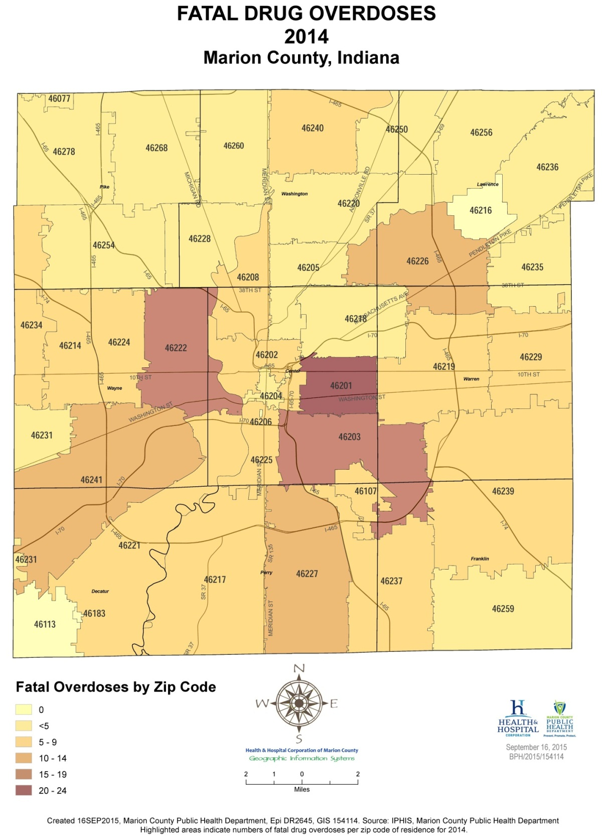
Fatal drug ODs in Marion County, by zip code, during 2014
Marion County Public Health Department. (2015). Integrated public health information system (IPHIS) and FINAL.DCa. Created 16SEP2015, Epi DR2645, GIS 154114.

Slide 41
Marion County Statistics
Thanks to naloxone and the excellent training of our first responders, not everyone who ODs becomes a mortality statistic
Indianapolis EMS has administered naloxone 1,128 times during 2015 YTD (as of 0900 on Dec. 7), averaging 3.3 runs per day
Excludes the 20% of runs taken by other ambulance services administrations by Indianapolis Metropolitan Police Department
Indianapolis EMS. (2015). I-EMS naloxone report: 2011-2015 (as of 0900 on 07-DEC-2015).

Slide 42
Marion County Statistics
Indianapolis EMS. (2015). I-EMS naloxone report: 2011-2015 (as of 0900 on 07-DEC-2015).

Slide 43
Marion County Statistics
I-EMS 2015 Monthly
Blue stars indicate new runs for the most recent month; red stars indicate cumulative previous months’ runs
I-EMS and WTFD 2015 thru Oct
Blue stars indicate I-EMS naloxone admins for the month of October; red stars indicate Jan-Sep 2015; green stars indicate Wayne Township Fire Department runs for Jan-Oct 2015
Incomplete data for Wayne, Decatur, Pike, City of Lawrence, and Beech Grove
Indianapolis EMS. (2015). I-EMS naloxone report: 2011-2015 (as of 0900 on 07-DEC-2015).

Slide 44
During this presentation, about three U.S. residents died of heroin or prescription painkiller overdose
Centers for Disease Control and Prevention. (2015). Today’s heroin epidemic: More people at risk, multiple drugs abused. Retrieved from http://www.cdc.gov/vitalsigns/heroin/index.html
National Center for Injury Prevention and Control. (2014). Opioid painkiller prescribing: Where you live makes a difference. Centers for Disease Control and Prevention, http://www.cdc.gov/vitalsigns/pdf/2014-07-vitalsigns.pdf

Slide 47
Tammie Nelson, MPH, CPH
Epidemiologist
Marion County Public Health Department
3901 Meadows Drive, H108
Indianapolis, IN 46205
Office: 317-221-3556
TNelson@MarionHealth.org

