Slide 1
Ryan White Part A & Minority AIDS Initiative Service Utilization in the Indianapolis Transitional Grant Area: FY 2017-2018
June 7, 2018
Sam Parmar, MPH
SParmar@MarionHealth.org

Slide 2
Objective
To provide the Ryan White Planning Council with information necessary for FY 2019-2020 priority setting and allocation

Slide 3
The Indianapolis Transitional Grant Area (TGA)

Slide 4
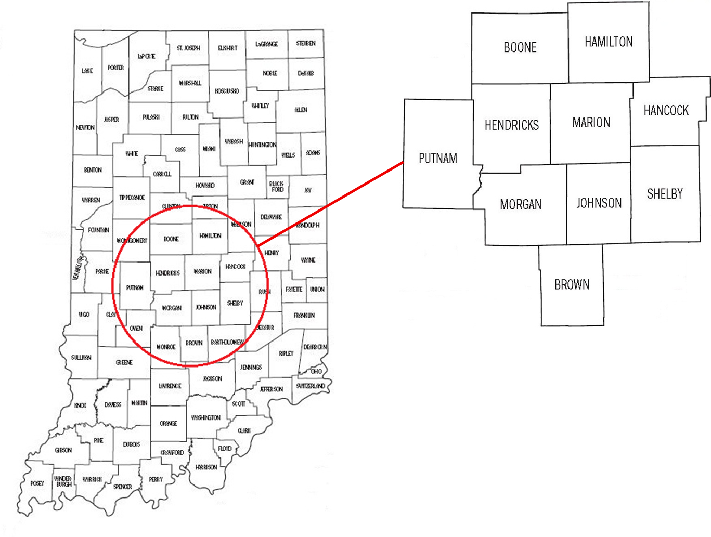
Indianapolis TGA Population
Ten Central Indiana counties with an estimated population of 1.89 million¹ (6% increase since 2010)² ³

Slide 5
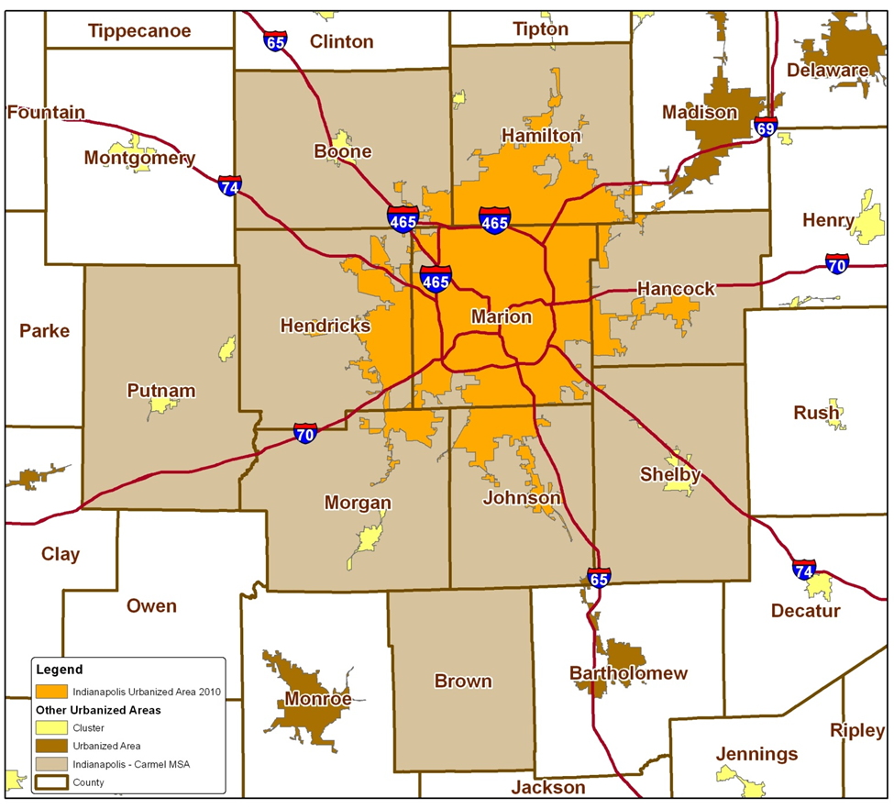
TGA Population Center
88% of the TGA’s population in orange⁴
46% reside inside Indianapolis city limits¹

Slide 6
Overview of Part A and Minority AIDS Initiative (MAI) Funding

Slide 7
Overview of Part A and MAI Funding
Part A Funding = Formula + Supplemental⁵
Formula funds are based on the number of people living with HIV/AIDS (PLWH/A) in the TGA
Supplemental funds are awarded competitively based on demonstrated need and other selective criteria
Includes core medical and support services designed to provide a continuum of care for PLWH/A
Core Medical
Must account for at least 75% of Part A funds allocated for services (without a waiver)
Support Services
Must be linked to the continuum of care and cannot exceed 25% of Part A funds allocated for services unless a waiver is obtained

Slide 8
Overview of Part A and MAI Funding
MAI Funding⁵
Funding based on distribution of PLWH/A among racial/ethnic minorities residing in the TGA
Supports services for minority populations
Data Sources
Utilization data collected using the Ryan White Information Services Enterprise (RISE) database⁶
Clinical and outcomes data collected using RISE, CAREWare, and the Enhanced HIV/AIDS Reporting System (eHARS) database⁷

Slide 9
All Parts Spending in the Indianapolis TGA

Slide 13
Part A and MAI Service Utilization

Slide 14
Part A/MAI Utilization: FY 2017-2018
During FY 2017-2018:
2,799 unique clients utilized 28,303 units of service excluding 8,492 EIS tests administered
Core Medical accounted for 63.1% of Part A/MAI service units and 72.6% of dollars spent at an average cost of $111 per unit
Support Services accounted for 37.0% of Part A/MAI service units and 27.4% of dollars spent at an average cost of $72 per unit

Slide 15
Part A/MAI Utilization: FY 2017-2018 vs. FY 2016-2017
The number of clients and services utilized increased considerably during FY 2017-2018
Number of clients increased 4.0% (2,799 v. 2,690)
Number of EIS tests increased 10.8% (8,492 v. 7,664)
Units of non-EIS service increased 1.2% (28,303 v. 27,952)
Cost per client decreased 1.2% ($1,338 v. $1,354)

Slide 16
Utilization of Core Medical Services

Slide 17
Utilization in FY 2017-2018 v. FY 2016-2017

Slide 18
Utilization in FY 2017-2018 v. FY 2016-2017

Slide 19
Utilization in FY 2017-2018 v. FY 2016-2017

Slide 20
Utilization in FY 2017-2018 v. FY 2016-2017

Slide 21
Early Intervention Services (EIS)
Accounted for 22.0% of Part A/MAI services utilized and 10.2% of dollars spent
Utilized by 8,090 clients, a increase of 6.9% from FY16 (N=7,568)
1.0 service unit per client
Averaged $47 per client, a decrease of 6% from FY16 ($50)

Slide 22
Medical Case Management (Including Treatment Adherence)
Accounted for 20.7% of Part A/MAI services utilized and 31.3% of dollars spent
Utilized by 2,703 clients, an increase of 21.5% from FY16 (N=2,225)
Averaged 3.0 service units per client, a decrease of 18.9% from FY16 (N=3.7)
Averaged $430.83 per client, a decrease of 13.3% from FY16 ($496.74)

Slide 23
Outpatient Ambulatory/Primary Medical Care
Accounted for 10% of Part A/MAI services utilized and 18% of dollars spent
Utilized by 635 clients, an increase of 19.6% from FY16 (N=531)
Averaged 6.1 service units per client, a decrease of 15.3% from FY16 (N=7.2)
Averaged $1,055.23 per client, a decrease of 14.5% from FY16 ($1,234.81)

Slide 24
Mental Health Services
Accounted for 5.2% of Part A/MAI services utilized and 8.4% of dollars spent
Utilized by 407 clients, a increase of 49.1% from FY16 (N=273)
Averaged 7.4 service units per client, an increase of 8.8% from FY16 (N= 6.8)
Averaged $763.77 per client, an decrease of 13.3% from FY16 ($880.53)

Slide 25
Oral Health Care
Accounted for 0.9% of Part A/MAI services utilized and 2.1% of dollars spent
Utilized by 110 clients, a increase of 7.8% from FY16 (N=102)
Averaged 3.0 service units per client, no change from FY16
Averaged $706.52 per client, an increase of 28.3% from FY16 ($550.81)

Slide 26
AIDS Pharmacy Assistance (Local)
Accounted for 0.03% of Part A/MAI services utilized and 0.3% of dollars spent
Utilized by 6 clients, a decrease of 93.8% from FY16 (N=97)
Averaged 2.2 service units per client, a decrease of 4.3% from FY16 (2.3)
Averaged $1,806.33 per client, a increase of 29.9% from FY16 ($1,390.79)

Slide 27
Health Insurance Premium & Cost Sharing Assistance
Accounted for 0.03% of Part A/MAI services utilized and 0.8% of dollars spent
Utilized by 9 clients, an decrease of 78.6% from FY16 (N=42)
Averaged 1.2 service units per client, a decrease of 84% from FY16 (N=7.5)
Averaged $3,325.33 per client, a decrease of 6.9% from FY16 ($3,570.93)

Slide 28
Substance Abuse Services - Outpatient
Accounted for 0.9% of Part A/MAI services utilized and 1.2% of dollars spent
Utilized by 33 clients, no change from FY16 (N=33)
Averaged 10.9 service units per client, an increase of 230% from FY16 (N=3.3)
Averaged $1,342.42 per client, a increase of 171.3% from FY16 ($494.79)

Slide 29
Nutrition Services
Accounted for 0.6% of Part A/MAI services utilized and 0.3% of dollars spent
Utilized by 115 clients, an increase of 43.8% from FY16 (N=80)
Averaged 2.1 service units per client, an increase of 23.5% from FY16 (N=1.7)
Averaged $94.35 per client, an decrease of 14.5% from FY16 ($110.31)

Slide 30
Utilization of Support Services

Slide 31
Utilization in FY 2017-2018 v. FY 2016-2017

Slide 32
Utilization in FY 2017-2018 v. FY 2016-2017

Slide 33
Utilization in FY 2017-2018 v. FY 2016-2017

Slide 34
Utilization in FY 2017-2018 v. FY 2016-2017

Slide 35
Utilization in FY 2017-2018 (new) v. FY 2016-2017

Slide 36
Utilization in FY 2017-2018 (new) v. FY 2016-2017

Slide 37
Non-Medical Case Management
Accounted for 21.5% of Part A/MAI services utilized and 17.5% of dollars spent
Utilized by 2,462 clients, an increase of 10.6% from FY16 (N=2,225)
Averaged 3.4 service units per client, an increase of 25.9% from FY16 (N=2.7)
Averaged $264.85 per client, an increase of 29.7% from FY16 ($204.22)

Slide 38
Health Education/Risk Reduction (HE/RR)
Accounted for 4.6% of Part A/MAI services utilized and 2.4% of dollars spent
Utilized by 585 clients, a increase of 15.4% from FY16 (N=507)
Averaged 3.0 service units per client – no change from FY16
Averaged $153.78 per client, a decrease of 7.2% from FY16 ($165.81)

Slide 39
Outreach Services
Accounted for 1.5% of Part A/MAI services utilized and 0.04% of dollars spent
Utilized by 36 clients, a decrease of 85.6% from FY16 (N=250)
Averaged 16.3 service units per client, an increase of 608.7% from FY16 (N=2.3)
Averaged $40.28 per client, a decrease of 54.4% from FY16 ($88.38)

Slide 40
Emergency Financial: Food
Accounted for 2.6% of Part A/MAI services utilized and 0.9% of dollars spent
Utilized by 432 clients, a increase of 6.4% from FY16 (N=406)
Averaged 2.3 service units per client, a increase of 4.5% from FY16 (2.2)
Averaged $75.84 per client, a increase of 2.6% from FY16 ($73.92)

Slide 41
Medical Transportation Services
Accounted for 3.0% of Part A/MAI services utilized and 1.4% of dollars spent
Utilized by 280 clients, an decrease of 20.2% from FY16 (N=351)
Averaged 4.1 service units per client, a decrease of 51.2% from FY16 (N=8.4)
Averaged $183.06 per client, an decrease of 19.4% from FY16 ($227.26)

Slide 42
Short Term Housing
Accounted for 0.5% of Part A/MAI services utilized and 2.5% of dollars spent
Utilized by 143 clients, a decrease of 10.6% from FY16 (N=160)
Averaged 1.3 service units per client, no change from FY16
Averaged $642.91 per client, an decrease of 7.1% from FY16 ($692.06)

Slide 43
Emergency Financial: Utilities
Accounted for 0.4% of Part A/MAI services utilized and 1.3% of dollars spent
Utilized by 122 clients, an decrease of 20.3% from FY16 (N=153)
Averaged 1.4 service units per client, an decrease of 6.7% from FY16 (N=1.5)
Averaged $401.05 per client, an increase of 27.2% from FY16 ($315.35)

Slide 44
Legal Services
Accounted for 0.04% of Part A/MAI services utilized and 0.1% of dollars spent
Utilized by 10 clients, an decrease of 86.1% from FY16 (N=72)
Averaged 1.5 service units per client, a decrease of 34.8% from FY16 (N=2.3)
Averaged $206.30 per client, a decrease of 16.8% from FY16 ($248.07)

Slide 45
Linguistic Services
Accounted for 0.7% of Part A/MAI services utilized and 0.5% of dollars spent
Utilized by 48 clients, an increase of 9.1% from FY16 (N=44)
Averaged 5.6 service units per client, a decrease of 13.8% from FY16 (N=6.5)
Averaged $365.40 per client, an decrease of 25.2% from FY16 ($488.34)

Slide 46
Emergency Pharmacy (new)
Accounted for 0.04% of Part A/MAI services utilized and 0.6% of dollars spent
Utilized by 13 clients
Averaged 1.2 service units per client
Averaged $1644.46 per client

Slide 47
Substance Abuse Services – Residential (new)
Accounted for 0.21% of Part A/MAI services utilized and 0.1% of dollars spent
Utilized by 5 clients
Averaged 16 service units per client
Averaged $406.00 per client

Slide 48
Food Bank/Home delivered Meals (new)
Accounted for 1.9% of Part A/MAI services utilized and 0.2% of dollars spent
Utilized by 31 clients
Averaged 23.7 service units per client
Averaged $272.81 per client

Slide 49
Part A/MAI Client Profile

Slide 50
Client Status and Time Enrolled
During FY 2017-2018, a total of 2,799 unique clients utilized Part A and/or MAI services, an increase of 4.0% over FY 2016-2017 (N=2,690)
Of clients served, 71.9% (N=2,013) have an active client status, a increase of 5.1% over FY 2016-2017 (66.8%)
Of unique clients served, 7.7% (N=216) applied for and accessed Ryan White services for the first time, a decrease 3.2% over FY 2016-2017 (10.9%)

Slide 51
Part A/MAI Clients by Enrollment Status

Slide 52
Part A/MAI Clients by Gender

Slide 53
Part A/MAI Clients by Current Age

Slide 54
Part A/MAI Clients by Race/Ethnicity

Slide 55
Part A/MAI Clients by HIV Status
Notes:
Need update

Slide 56
Part A/MAI Clients by Exposure Category

Slide 57
Part A/MAI Clients by Poverty Level
Notes:
Need update

Slide 58
Part A/MAI Clients by County of Residence
During FY 2017, 46.0% of PLWH/A in the TGA utilized Part A/MAI services (2,806 of 6,092) – up from 45.5%
50.6% of Marion County PLWH/A accessed services – up from 49.3%
21.9% of PLWH/A in the outlying counties accessed services – down from 23.8%
N missing = 7

Slide 59
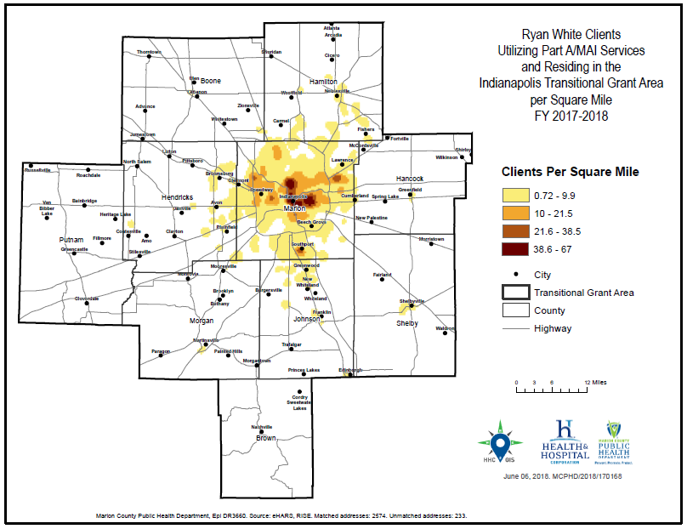
Notes:
Need update from gis

Slide 60
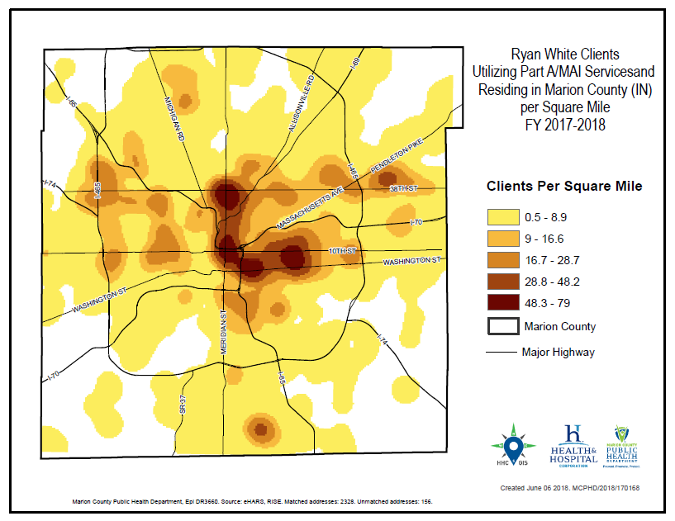
Notes:
Need update from gis

Slide 61
HIV Continuum of Care in the TGA

Slide 62
HIV Care Continuum Definitions
Linked to Care: People newly diagnosed with HIV during FY 2017 who received a CD4/viral load test within 90 days
Retained in Care: Residents living with HIV/AIDS with 2+ CD4/viral load tests performed at least 3 months apart in FY 2017
Antiretroviral Therapy: Residents living with HIV/AIDS who received a prescription for antiretroviral therapy in FY 2017
Viral Load Suppression: Residents living with HIV/AIDS with a FY 2017 viral load result <200 RNA copies/mL

Slide 63
Ryan White Clients v. Non-Client PLWH/A
* The National HIV/AIDS Strategy goal is 30 days until linkage to care. When using that benchmark, only 55.1% of RWSP clients and 57.9% of non-RWSP clients were linked to care.

Slide 66
Michael Butler
Director
Sam Parmar, MPH
Epidemiologist
Ryan White HIV Services Program
Health & Hospital Corporation
Marion County Public Health Department
http://RyanWhiteIndy.org

Slide 67
References
¹ U.S. Census Bureau and Marion County Public Health Department. (2017). Marion County Public Health Department estimates based on ARIMA projections calculated using U.S. Census Bureau data
² U.S. Census Bureau. (2002). Time series of Indiana intercensal population estimates by county: April 1, 1990 to April 1, 2000. Table CO-EST2001-12-18. Release date April 17, 2002.
³ U.S. Census Bureau. (2011). Intercensal estimates of the resident population for counties of Indiana: April 1, 2000 to July 1, 2010. Table CO-EST00INT-01-18.
⁴ Glenn, R. (2011). Demographics & trends: Indianapolis, Marion County & the Indianapolis region. Department of Metropolitan Development: City of Indianapolis.
⁵ Health Resources and Services Administration. (2014). About the Ryan White HIV/AIDS program – About Part A: Grants to emerging metropolitan & transitional grant areas. Washington D.C.: U.S. Department of Health and Human Services. Available at http://hab.hrsa.gov/abouthab/parta.html
⁶ Ryan White HIV Services Program. (2014). Ryan White Information Services Enterprise (RISE). Indianapolis: Marion County Public Health Department.
⁷ Centers for Disease Control and Prevention. (2014). Enhanced HIV/AIDS Reporting System (eHARS). Indianapolis: Indiana State Department of Health.
⁸ U.S. Department of Health & Human Services. (2015). 2015 poverty guidelines. Retrieved from https://aspe.hhs.gov/2015-poverty-guidelines.

