Slide 1
Ryan White Part A & Minority AIDS Initiative Service Utilization in the Indianapolis Transitional Grant Area: FY 2018-2019
June 6, 2019
Sam Parmar, MPH
SParmar@MarionHealth.org

Slide 2
Objective
To provide the Ryan White Planning Council with information necessary for FY 2020-2021 priority setting and allocation

Slide 3
The Indianapolis Transitional Grant Area (TGA)

Slide 4
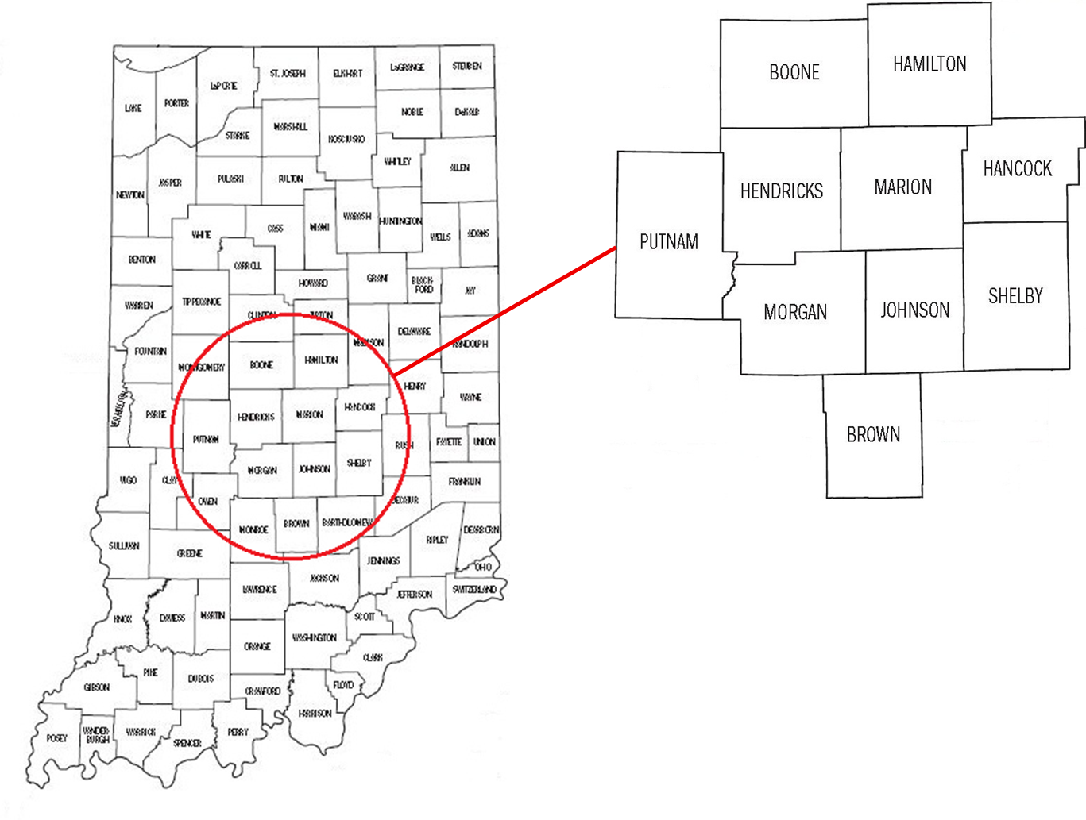
TGA Location & Population
Ten Central Indiana counties with a 2018 estimated population of 1.92 million¹ (9% increase since 2010)^{2, 3}
Notes:
1,760,856 to 1,920,076

Slide 5
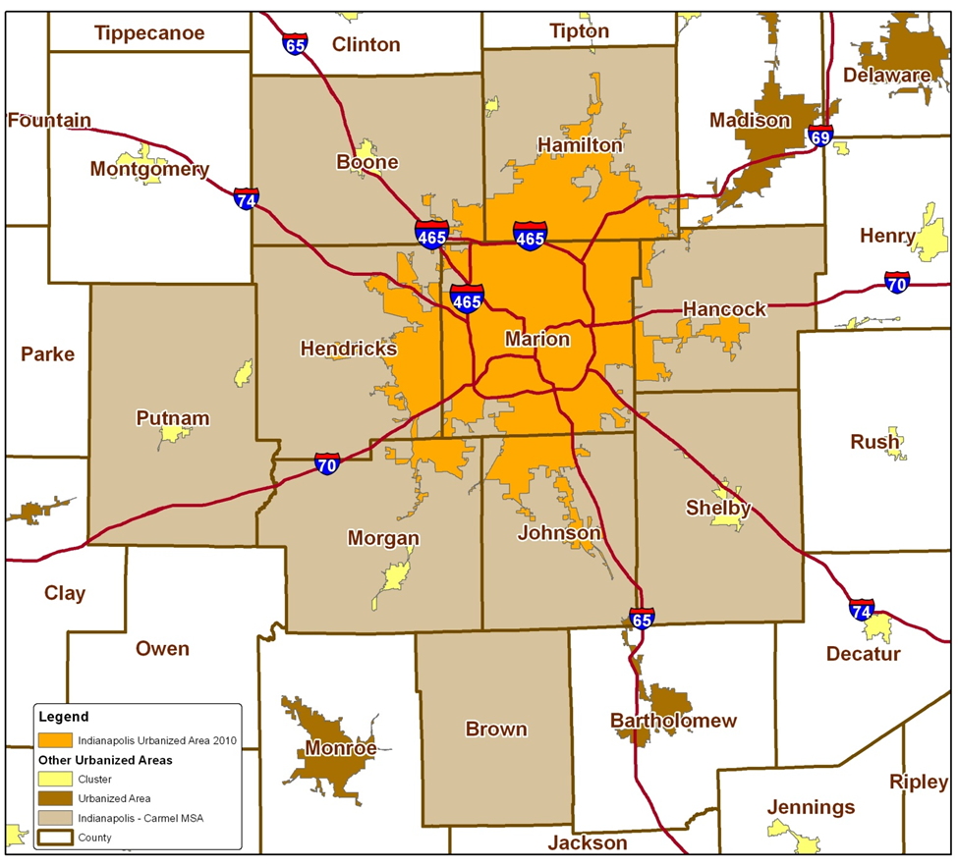
TGA Population Center
84% of the TGA’s population in orange⁴
49% reside inside Indianapolis city limits¹
Notes:
84% of TGA population is most recent estimate (1,604,134/1,920,076)
49% reside inside Indianapolis city limits (955,110/1,920,076)

Slide 6
Overview of Part A and Minority AIDS Initiative (MAI) Funding

Slide 7
Overview of Part A and MAI Funding
Part A Funding = Formula + Supplemental⁵
Formula funds are based on the number of people living with HIV/AIDS (PLWH/A) in the TGA
Supplemental funds are awarded competitively based on demonstrated need and other selective criteria
Includes core medical and support services designed to provide a continuum of care for PLWH/A
Core Medical
Must account for at least 75% of Part A funds allocated for services (without a waiver)
Support Services
Must be linked to the continuum of care and cannot exceed 25% of Part A funds allocated for services unless a waiver is obtained

Slide 8
Overview of Part A and MAI Funding
MAI Funding⁵
Funding based on distribution of PLWH/A among racial/ethnic minorities residing in the TGA
Supports services for minority populations
Data Sources
Utilization data collected using the Ryan White Information Services Enterprise (RISE) database⁶
Clinical and outcomes data collected using RISE, CAREWare, and the Enhanced HIV/AIDS Reporting System (eHARS) database⁷

Slide 9
All Parts Spending in the Indianapolis TGA

Slide 11
Notes:
Outpatient Ambulatory category above includes Outpatient Ambulatory - Vision

Slide 13
Part A/MAI Service Units/Clients Comparison: FY 2018-2019 vs. 2017-2018
Service Type | FY 2018-2019 |  | FY 2017-2018
 | # of Clients | # of Services | # of Clients | # of Services
EIS | 6,791 | 7,129 | 8,090 | 8,492
Medical Case Mgt | 2,344 | 7,813 | 2,703 | 7,996
Amb/Pri Medical Care | 423 | 1,611 | 635 | 3,849
Mental Health Care | 17 | 61 | 407 | 2,978
Oral Health Care | 80 | 139 | 110 | 318
Local AIDS Rx Assist. | 13 | 17 | 6 | 13
Health Insurance | 16 | 16 | 9 | 11
Substance Abuse - Outpatient | 1 | 1 | 33 | 360
Nutrition | 204 | 509 | 115 | 245
Non-Med Case Mgt | 2,157 | 9,619 | 2,462 | 8,276
HE/RR | 152 | 152 | 585 | 1,755
Emergency $ Food | 519 | 1,185 | 432 | 991
Medical Transport | 294 | 1,231 | 280 | 1,150
Outreach | 39 | 40 | 36 | 585
Short Term Housing | 133 | 156 | 143 | 185
Emergency $ Utilities | 94 | 132 | 122 | 168
Legal | 12 | 23 | 10 | 15
Linguistic | 44 | 156 | 48 | 267
Psycho- social | 0 | 0 | 0 | 0
Emergency Pharmacy | 21 | 22 | 13 | 15
Substance Abuse - Residential | 24 | 1142 | 5 | 80
Food bank/home-delivered meals | 53 | 6086 | 31 | 735
Summary | 2,715 | 60,417 | 2,799 | 36,795
Notes:
This slide has been added by request
Core services in red tone and supportive services in blue tone
MCM and NMCM # of service units revised since presentation

Slide 14
Part A and MAI Service Utilization

Slide 15
Part A/MAI Utilization: FY 2018-2019
During FY 2018-2019:
2,715 unique clients utilized 30,111 units of service excluding 7,129 EIS tests administered
Core Medical accounted for 46.4% of Part A/MAI service units and 67.8% of dollars spent at an average cost of $134.89 per unit
Support Services accounted for 53.5% of Part A/MAI service units and 32.1% of dollars spent at an average cost of $55.33 per unit
Notes:
This slide has been revised

Slide 16
Part A/MAI Utilization: FY 2018-2019 vs. FY 2017-2018
The number of clients and services utilized increased considerably during FY 2018-2019
Number of clients decreased 3.0% (2,715 v. 2,799)
Number of EIS tests decreased 16.1% (7,129 v. 8,492)
Units of non-EIS service increased 6.4% (30,111 v. 28,303)
Cost per client decreased 5.3% ($1,266 v. $1,338)
Notes:
Due to RISE system change and data quality issues, true change in non-EIS service units now believed to be 12.9%; 53,288 v. 47,192

Slide 17
Utilization of Core Medical Services

Slide 18
Utilization in FY 2018-2019 v. FY 2017-2018

Slide 19
Utilization in FY 2018-2019 v. FY 2017-2018
Notes:
Graphs updated to reflect correct MCM service units

Slide 20
Utilization in FY 2018-2019 v. FY 2017-2018

Slide 21
Utilization in FY 2018-2019 v. FY 2017-2018

Slide 22
Early Intervention Services (EIS)
Accounted for 19.1% of Part A/MAI services utilized and 13.4% of dollars spent
Utilized by 6,791 clients, a decrease of 16.1% from FY17 (N=8,090)
Average 1.0 service unit per client
Averaged $67 per client, an increase of 42% from FY17 ($47)
Notes:
Proportion of services utilized updated

Slide 23
Medical Case Management (Including Treatment Adherence)
Accounted for 21.0% of Part A/MAI services utilized and 35.5% of dollars spent
Utilized by 2,344 clients, an decrease of 13.3% from FY17 (N=2,703)
Averaged 3.33 service units per client, an increase of 11% from FY17 (N=3.0)
Averaged $520.2 per client, an increase of 20.7% from FY17 ($430.83)
Notes:
Proportion of services utilized updated and service units per client updated

Slide 24
Outpatient Ambulatory/Primary Medical Care
Accounted for 4.3% of Part A/MAI services utilized and 14.8% of dollars spent
Utilized by 423 clients, a decrease of 33.3% from FY17 (N=635)
Averaged 3.8 service units per client, a decrease of 38% from FY17 (N=6.1)
Averaged $1,200.17 per client, an increase of 13.7% from FY17 ($ 1,055.23)
Notes:
Proportion of services utilized updated

Slide 25
Mental Health Services
Accounted for 0.16% of Part A/MAI services utilized and 0.3% of dollars spent
Utilized by 17 clients, a decrease of 95.8% from FY17 (N=407)
Averaged 3.6 service units per client, a decrease of 51% from FY17 (N=7.4)
Averaged $579.94 per client, a decrease of 24.1% from FY17 ($ 763.77)
Notes:
Proportion of services utilized updated

Slide 26
Oral Health Care
Accounted for 0.37% of Part A/MAI services utilized and 1.6% of dollars spent
Utilized by 80 clients, a decrease of 27.3% from FY16 (N=110)
Averaged 1.7 service units per client, a decrease of 43% from FY17 (N=3.0)
Averaged $690.10 per client, a decrease of 2.3% from FY17 ($706.52)
Notes:
Proportion of services utilized updated

Slide 27
AIDS Pharmacy Assistance (Local)
Accounted for 0.05% of Part A/MAI services utilized and 1.3% of dollars spent
Utilized by 13 clients, a increase of 117% from FY17 (N=6)
Averaged 1.3 service units per client, a decrease of 40.9% from FY17 (N=2.2)
Averaged $3,454.23 per client, a increase of 91.2% from FY17 ($1,806.33)
Notes:
Proportion of services utilized updated

Slide 28
Health Insurance Premium & Cost Sharing Assistance
Accounted for 0.04% of Part A/MAI services utilized and 0.5% of dollars spent
Utilized by 16 clients, an decrease of 77.8% from FY17 (N=9)
Averaged 1.0 service units per client, a decrease of 16.7% from FY17 (N=1.2)
Averaged $993.19 per client, a decrease of 70.1% from FY17 ($3,325.33)
Notes:
Proportion of services utilized updated

Slide 29
Substance Abuse Services - Outpatient
Accounted for 0.003% of Part A/MAI services utilized and 0.004% of dollars spent
Utilized by 1 clients, a 97% decrease from FY17 (N=33)
Averaged 1 service units per client, a decrease of 90.8% from FY17 (N=10.9)
Averaged $138 per client, a decrease of 89.7% from FY17 ($1,342.42)
Notes:
Proportion of services utilized updated

Slide 30
Medical Nutrition Therapy
Accounted for 1.4% of Part A/MAI services utilized and 0.6% of dollars spent
Utilized by 204 clients, an increase of 77.4% from FY17 (N=115)
Averaged 2.5 service units per client, a 19% decrease from FY17 (N=2.1)
Averaged $98.7 per client, an increase of 4.6% from FY17 ($94.35)
Notes:
Proportion of services utilized updated

Slide 31
Utilization of Support Services

Slide 32
Utilization in FY 2018-2019 v. FY 2017-2018

Slide 33
Utilization in FY 2018-2019 v. FY 2017-2018
Notes:
Graphs updated to reflect correct NMCM service units

Slide 34
Utilization in FY 2018-2019 v. FY 2017-2018

Slide 35
Utilization in FY 2018-2019 v. FY 2017-2018

Slide 36
Utilization in FY 2018-2019 v. FY 2017-2018

Slide 37
Utilization in FY 2018-2019 v. FY 2017-2018

Slide 38
Non-Medical Case Management
Accounted for 25.8% of Part A/MAI services utilized and 20.3% of dollars spent
Utilized by 2,157 clients, a decrease of 12.4% from FY17 (N=2,462)
Averaged 4.5 service units per client, an increase of 32.3% from FY17 (N=3.4)
Averaged $347.5 per client, an increase of 31.2% from FY17 ($264.85)
Notes:
Proportion of services utilized updated and service units per client updated

Slide 39
Health Education/Risk Reduction (HE/RR)
Accounted for 0.41% of Part A/MAI services utilized and 1.7% of dollars spent
Utilized by 152 clients, a decrease of 74% from FY17 (N=585)
Averaged 1 service units per client, a 67% decrease from FY17 (N=3)
Averaged $393.19 per client, an increase of 156% from FY17 ($153.78)
Notes:
Proportion of services utilized updated

Slide 40
Outreach Services
Accounted for 0.11% of Part A/MAI services utilized and 0.03% of dollars spent
Utilized by 39 clients, an increase of 8.3% from FY17 (N=36)
Averaged 1.0 service units per client, a decrease of 93.8% from FY17 (N=16.3)
Averaged $24.05 per client, a decrease of 40.3% from FY17 ($40.28)
Notes:
Proportion of services utilized updated

Slide 41
Emergency Financial: Food
Accounted for 3.2% of Part A/MAI services utilized and 0.92% of dollars spent
Utilized by 519 clients, a increase of 20.1% from FY17 (N=432)
Averaged 2.3 service units per client, no change from FY17 (2.3)
Averaged $60.83 per client, a decrease of 19.8% from FY17 ($75.84)
Notes:
Proportion of services utilized updated

Slide 42
Medical Transportation Services
Accounted for 3.3% of Part A/MAI services utilized and 1.7% of dollars spent
Utilized by 294 clients, an increase of 5.0% from FY17 (N=280)
Averaged 4.2 service units per client, a decrease of 2.4% from FY17 (N=4.1)
Averaged $194.1 per client, an increase of 6.0% from FY17 ($183.06)
Notes:
Proportion of services utilized updated

Slide 43
Short Term Housing
Accounted for 0.42% of Part A/MAI services utilized and 2.5% of dollars spent
Utilized by 133 clients, a decrease of 7.0% from FY17 (N=143)
Averaged 1.2 service units per client, a 7.7% decrease from FY17 (N=1.3)
Averaged $637.42 per client, a decrease of 0.8% from FY17 ($642.91)
Notes:
Proportion of services utilized updated

Slide 44
Emergency Financial: Utilities
Accounted for 0.35% of Part A/MAI services utilized and 1.21% of dollars spent
Utilized by 94 clients, an decrease of 23.0% from FY17 (N=122)
Averaged 1.4 service units per client, no change from FY17 (N=1.4)
Averaged $443.91 per client, an increase of 10.7% from FY17 ($401.05)
Notes:
Proportion of services utilized updated

Slide 45
Legal Services
Accounted for 0.06% of Part A/MAI services utilized and 0.1% of dollars spent
Utilized by 12 clients, an increase of 20% from FY17 (N=10)
Averaged 1.9 service units per client, an increase of 26.7% from FY17 (N=1.5)
Averaged $381.25 per client, an increase of 84% from FY17 ($206.30)
Notes:
Proportion of services utilized updated

Slide 46
Linguistic Services
Accounted for 0.42% of Part A/MAI services utilized and 0.5% of dollars spent
Utilized by 44 clients, an decrease of 8.3% from FY17 (N=48)
Averaged 3.5 service units per client, a decrease of 37% from FY17 (N=5.6)
Averaged $422.61 per client, an increase of 15.6% from FY17 ($365.40)
Notes:
Proportion of services utilized updated

Slide 47
Emergency Financial: Pharmacy
Accounted for 0.06% of Part A/MAI services utilized and 1.2% of dollars spent
Utilized by 21 clients, an increase of 61.5% from FY17 (N=13)
Averaged 1.0 service units per client, a decrease of 16.7% from FY17 (N=1.2)
Averaged $1987.08 per client, an increase of 20.8% from FY17 ($1644.46)
Notes:
Proportion of services utilized updated

Slide 48
Substance Abuse Services – Residential
Accounted for 3.1% of Part A/MAI services utilized and 0.8% of dollars spent
Utilized by 24 clients, an increase of 380% from FY17 (N=5)
Averaged 16 service units per client, no change from FY17 (N=16)
Averaged $1,115.00 per client, an increase of 174% from FY17 ($406.00)
Notes:
Proportion of services utilized updated

Slide 49
Food Bank/Home delivered Meals
Accounted for 16.3% of Part A/MAI services utilized and 1.8% of dollars spent
Utilized by 53 clients, an increase of 71% from FY17 (N=31)
Averaged 114.8 service units per client, an increase of 384% from FY17 (N=23.7)
Averaged $1,162.26 per client, an increase of 326% from FY17 ($272.81)
Notes:
Proportion of services utilized updated

Slide 50
Part A/MAI Client Profile

Slide 51
Client Status and Time Enrolled
During FY 2018-2019, a total of 2,715 unique clients utilized Part A and/or MAI services, a decrease of 3.0% over FY 2017-2018 (N=2,799)
Of clients served, 61.7% (N=1,676) have an active client status, a decrease of 16.7% over FY 2017-2018 (71.9%)
Of unique clients served, 6.2% (N=167) applied for and accessed Ryan White services for the first time, nearly the same as FY 2017-2018 (6.0%, 168)

Slide 52
Part A/MAI Clients by Enrollment Status

Slide 53
Part A/MAI Clients by Gender

Slide 54
Part A/MAI Clients by Current Age

Slide 55
Part A/MAI Clients by Race/Ethnicity

Slide 56
Part A/MAI Clients by HIV Status
Notes:
Need update

Slide 57
Part A/MAI Clients by Exposure Category

Slide 58
Part A/MAI Clients by Poverty Level
Notes:
Need update

Slide 59
Part A/MAI Clients by County of Residence
During FY 2018, 44.1% of PLWH/A in the TGA utilized Part A/MAI services (2,806 of 6,155) – down from 46.0%
48.3% of Marion County PLWH/A accessed services – down from 50.6%
18.7% of PLWH/A in the outlying counties accessed services – down from 21.9%
N missing = 12

Slide 60
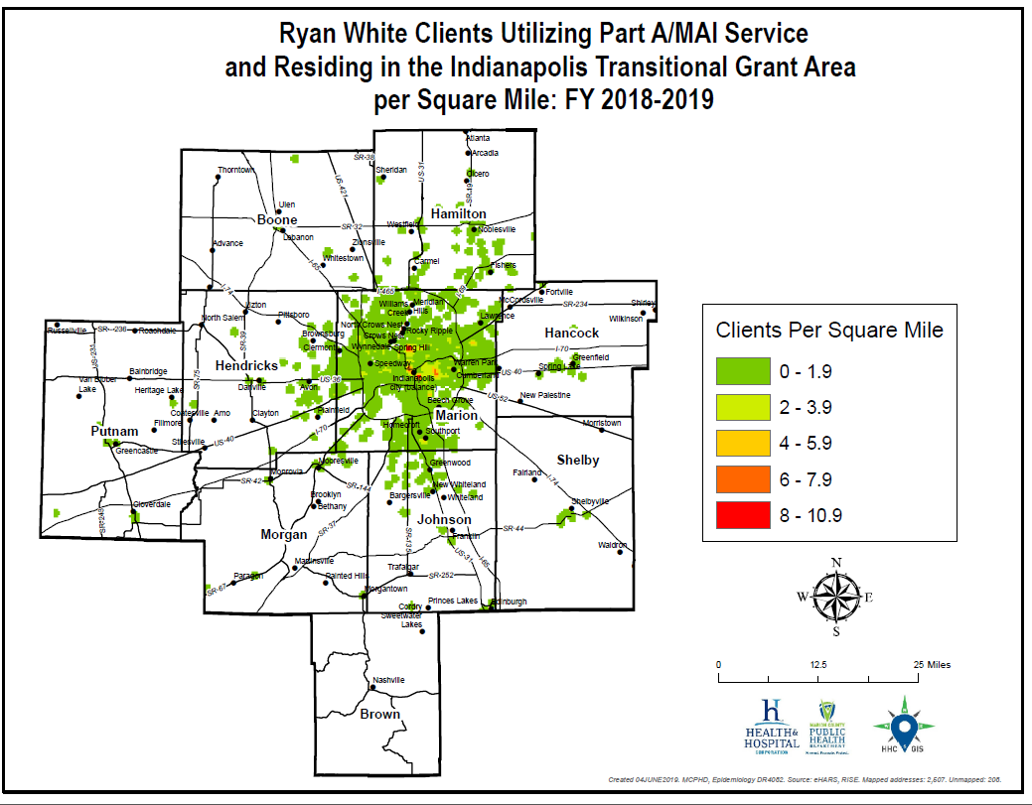
Notes:
MCPHD GIS: The output values represent the predicted amount of the phenomenon within each cell. Better to look the classes/colors in this graph qualitatively rather quantitatively. This is b/c some areas may have been emphasized due to surrounding cell values or due to points crossing multiple cells (being at an edges or intersections).

Slide 61
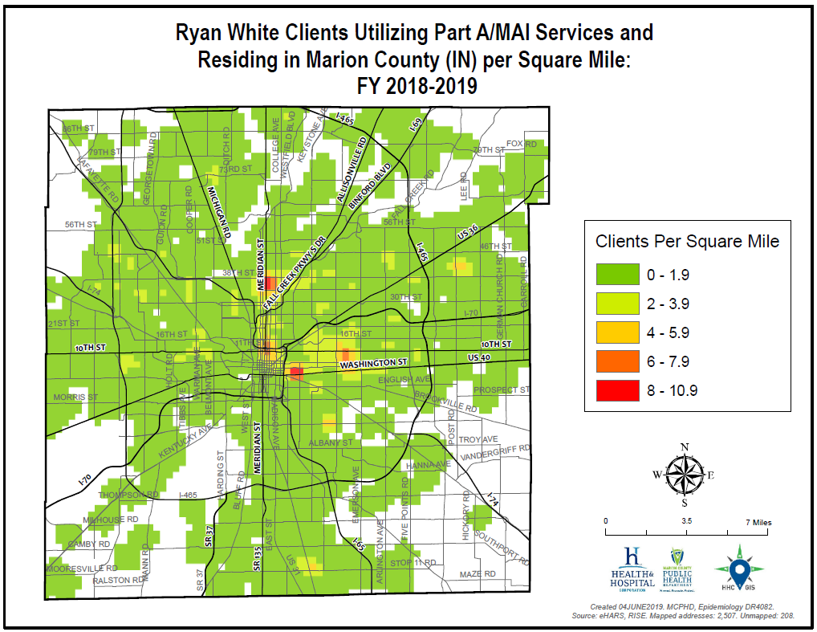
Notes:
MCPHD GIS: The output values represent the predicted amount of the phenomenon within each cell. Better to look the classes/colors in this graph qualitatively rather quantitatively. This is b/c some areas may have been emphasized due to surrounding cell values or due to points crossing multiple cells (being at an edges or intersections).

Slide 62
HIV Continuum of Care in the TGA

Slide 63
HIV Care Continuum Definitions
Linked to Care: People newly diagnosed with HIV during FY 2018 who received a CD4/viral load test within 90 days or 30 days (declared)
Retained in Care: Residents living with HIV/AIDS with 2+ CD4/viral load tests performed at least 3 months apart in FY 2018
Antiretroviral Therapy: Residents living with HIV/AIDS who received a prescription for antiretroviral therapy in FY 2018
Viral Load Suppression: Residents living with HIV/AIDS with a FY 2018 viral load result <200 RNA copies/mL

Slide 64
Ryan White Clients v. Non-Client PLWH/A

Slide 67
Michael Butler
Director
Sam Parmar, MPH
Epidemiologist
Ryan White HIV Services Program
Health & Hospital Corporation
Marion County Public Health Department
http://RyanWhiteIndy.org

Slide 68
References
¹ U.S. Census Bureau and Marion County Public Health Department. (2017). Marion County Public Health Department estimates based on ARIMA projections calculated using U.S. Census Bureau data
² U.S. Census Bureau. (2002). Time series of Indiana intercensal population estimates by county: April 1, 1990 to April 1, 2000. Table CO-EST2001-12-18. Release date April 17, 2002.
³ U.S. Census Bureau. (2011). Intercensal estimates of the resident population for counties of Indiana: April 1, 2000 to July 1, 2010. Table CO-EST00INT-01-18.
⁴ Glenn, R. (2011). Demographics & trends: Indianapolis, Marion County & the Indianapolis region. Department of Metropolitan Development: City of Indianapolis.
⁵ Health Resources and Services Administration. (2014). About the Ryan White HIV/AIDS program – About Part A: Grants to emerging metropolitan & transitional grant areas. Washington D.C.: U.S. Department of Health and Human Services. Available at http://hab.hrsa.gov/abouthab/parta.html
⁶ Ryan White HIV Services Program. (2014). Ryan White Information Services Enterprise (RISE). Indianapolis: Marion County Public Health Department.
⁷ Centers for Disease Control and Prevention. (2014). Enhanced HIV/AIDS Reporting System (eHARS). Indianapolis: Indiana State Department of Health.
⁸ U.S. Department of Health & Human Services. (2015). 2015 poverty guidelines. Retrieved from https://aspe.hhs.gov/2015-poverty-guidelines.

