Slide 1
Ryan White Part A & Minority AIDS Initiative Service Utilization in the Indianapolis Transitional Grant Area: FY 2020-2021
June 3, 2021
Michael Butler, Director
Mibutler@MarionHealth.org
Maguette Diop, MPH
MDiop@MarionHealth.org

Slide 2
Objective
To provide the Ryan White Planning Council with information necessary for FY 2022-2023 priority setting and allocation

Slide 3
The Indianapolis Transitional Grant Area (TGA)

Slide 4
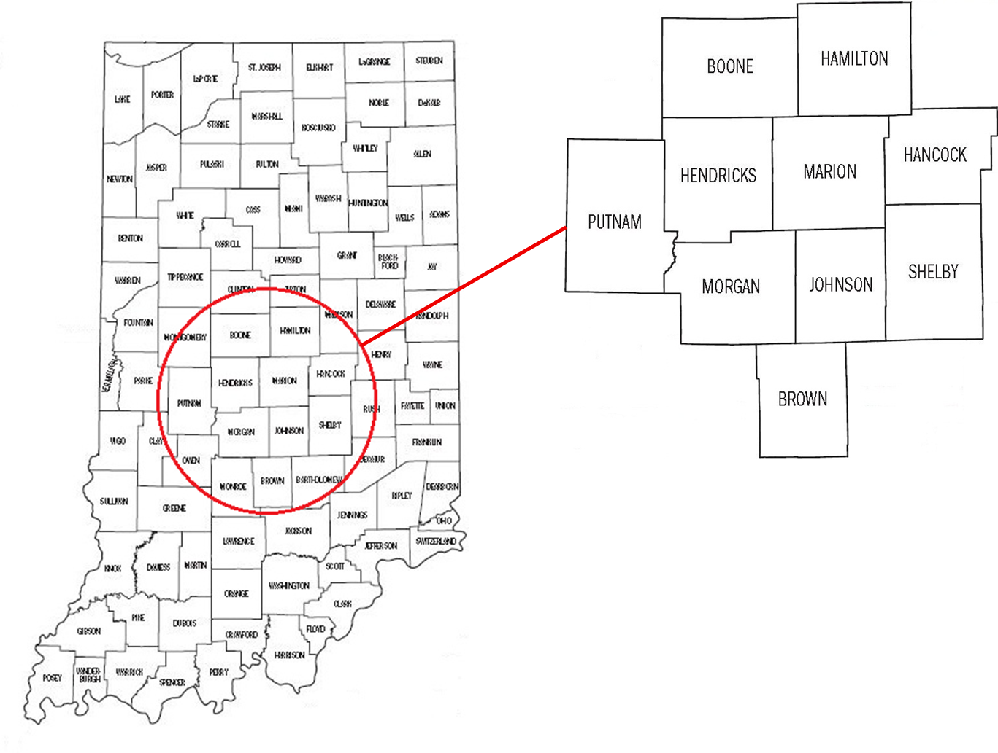
TGA Location & Population
Ten Central Indiana counties with a 2019 estimated population of 1.96 million¹ (10% increase since 2010)^{2, 3}

Slide 5
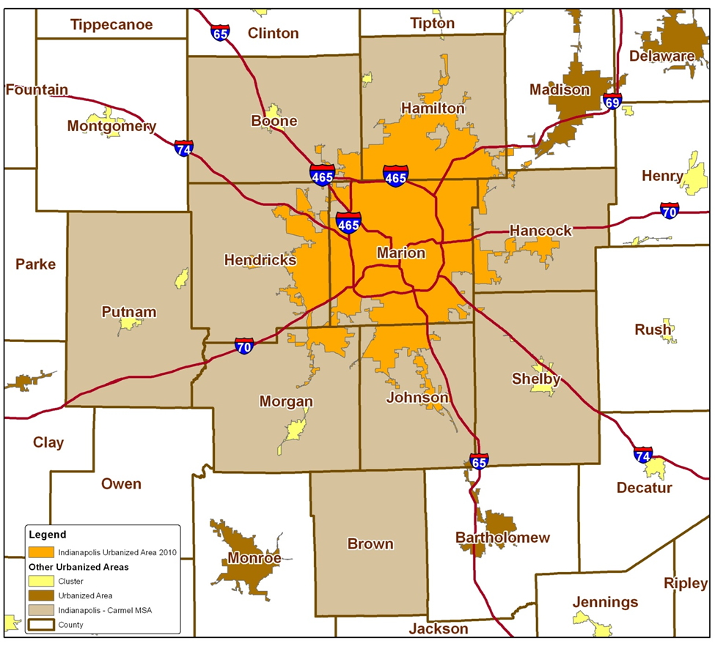
TGA Population Center
83% of the TGA’s population in orange⁴
49% reside inside Indianapolis city limits¹
Notes:
84% of TGA population is most recent estimate (1,604,134/1,920,076)
49% reside inside Indianapolis city limits (955,110/1,920,076)

Slide 6
Overview of Part A and Minority AIDS Initiative (MAI) Funding

Slide 7
Overview of Part A and MAI Funding
Part A Funding = Formula + Supplemental⁵
Formula funds are based on the number of people living with HIV/AIDS (PLWH/A) in the TGA
Supplemental funds are awarded competitively based on demonstrated need and other selective criteria
Includes core medical and support services designed to improve access and reduce disparities in health outcomes for PLWH/A
Core Medical
Must account for at least 75% of Part A funds allocated for services (without a waiver)
Support Services
Must be linked to the continuum of care and cannot exceed 25% of Part A funds allocated for services unless a waiver is obtained

Slide 8
Overview of Part A and MAI Funding
MAI Funding⁵
Funding based on distribution of PLWH/A among racial/ethnic minorities residing in the TGA
Supports services for minority populations
Data Sources
Utilization data collected using the Ryan White Information Services Enterprise (RISE) ⁶ database and CAREWare
Clinical and outcomes data collected using RISE, CAREWare, and the Enhanced HIV/AIDS Reporting System (eHARS) database⁷

Slide 9
All Parts Spending in the Indianapolis TGA

Slide 11
Notes:
Need for Part C
Outpatient Ambulatory category above includes Outpatient Ambulatory - Vision

Slide 13
Part A/MAI Service Units/Clients Comparison: FY 2020-2021 vs. 2019-2020
Service Type | FY 2020-2021 |  | FY 2019-2020
 | # of Clients | # of Services | # of Clients | # of Services
EIS | 9,555 | 11,023 | 7,399 | 8,103
Medical Case Mgt | 2,368 | 8,644 | 2,347 | 9,159
Out/Amb Health Services | 136 | 595 | 317 | 2,834
Mental Health Services | 3 | 7 | 1 | 2
Oral Health Care | 47 | 113 | 92 | 178
AIDS Rx Assist. (local) | 6 | 9 | 17 | 20
Health Insurance | 12 | 19 | 5 | 5
Substance Abuse - Outpatient | 0 | 0 | 0 | 0
Medical Nutrition Therapy | 196 | 1,083 | 215 | 1,608
Non-Med Case Mgt | 2,179 | 10,382 | 2,196 | 10,653
HE/RR | 218 | 218 | 356 | 356
Emergency $ Food | 630 | 1,792 | 545 | 1,402
Medical Transport | 323 | 1,400 | 319 | 3,058
Outreach Services | 144 | 182 | 90 | 98
Emergency $ Housing | 89 | 109 | 135 | 174
Emergency $ Utilities | 67 | 93 | 126 | 185
Legal | 0 | 0 | 28 | 124
Linguistic | 34 | 68 | 35 | 131
Psycho- social | 0 | 0 | 0 | 0
Emergency $ Pharmacy | 11 | 13 | 24 | 37
Substance Abuse - Residential | 9 | 840 | 16 | 1,193
Food bank/home-delivered meals | 0 | 0 | 0 | 0
Summary | 2,908 | 36,590 | 2,834 | 39,320
Notes:
This slide has been added by request
Core services in red tone and supportive services in blue tone

Slide 14
Part A and MAI Service Utilization

Slide 15
Part A/MAI Utilization: FY 2020-2021
During FY 2020-2021:
2,908 unique Ryan White enrolled clients (does not include individuals receiving testing or HE/RR services) utilized 25,349 units of service excluding 11,023 EIS tests administered, and 218 HE/RR services delivered)
Core Medical accounted for 58.7% of Part A/MAI service units and 64.4% of dollars spent at an average cost of $112.63 per unit
Support Services accounted for 41.3% of Part A/MAI service units and 35.6% of dollars spent at an average cost of $74.09 per unit

Slide 16
Part A/MAI Utilization: FY 2020-2021 vs. FY 2019-2020
The number of clients and EIS services utilized increased during FY 2020-2021
The number of non-EIS services utilized and the cost per client decreased during FY 2020-2021
Number of clients increased 2.6% (2,908 v. 2,834)
Number of EIS tests increased 36.0% (11,023 v. 8,103)
Units of non-EIS service decreased 18.1% (25,567 v. 31,217)
Cost per client decreased 2.5% ($1,293 v. $1,326)

Slide 17
Utilization of Core Medical Services

Slide 18
Utilization in FY 2020-2021 v. FY 2019-2020

Slide 19
Utilization in FY 2020-2021 v. FY 2019-2020
Notes:
Graphs updated to reflect correct MCM service units

Slide 20
Utilization in FY 2020-2021 v. FY 2019-2020

Slide 21
Utilization in FY 2020-2021 v. FY 2019-2020

Slide 22
Early Intervention Services (EIS)
Accounted for 30% of Part A/MAI services utilized and 24.1% of dollars spent
Utilized by 9,555 clients, an increase of 29.1% from FY19 (N=7,399)
Average 1.0 service unit per client
Averaged $95 per client, a decrease of 3.1% from FY19 ($98)
Notes:
Proportion of services utilized updated

Slide 23
Medical Case Management (Including Treatment Adherence)
Accounted for 24% of Part A/MAI services utilized and 33% of dollars spent
Utilized by 2,368 clients, an increase of 0.9% from FY19 (N=2,347)
Averaged 3.7 service units per client, a decrease of 5% from FY19 (N=3.9)
Averaged $529.4 per client, an increase of 11.8% from FY19 ($473.4)
Notes:
Proportion of services utilized updated and service units per client updated

Slide 24
Outpatient /Ambulatory Health Services
Accounted for 1.6% of Part A/MAI services utilized and 3.5% of dollars spent
Utilized by 136 clients, a decrease of 57.1% from FY19 (N=317)
Averaged 4.4 service units per client, a decrease of 50.6% from FY19 (N=8.9)
Averaged $969.05 per client, a decrease of 43.2% from FY19 ($1,707.03)
Notes:
Proportion of services utilized updated

Slide 25
Mental Health Services
Accounted for 0.02% of Part A/MAI services utilized and 0.03% of dollars spent
Utilized by 3 clients, an increase of 200% from FY19 (N=1)
Averaged 2 service units per client, the same as for FY19 (N=2)
Averaged $430.33 per client, an increase of 11% from FY19 ($388)
Notes:
Proportion of services utilized updated

Slide 26
Oral Health Care
Accounted for 0.31% of Part A/MAI services utilized and 0.7% of dollars spent
Utilized by 47 clients, a decrease of 48.9% from FY19 (N=92)
Averaged 2.4 service units per client, an increase of 26% from FY19 (N=1.9)
Averaged $558 per client, a decrease of 15% from FY19 ($656.8)
Notes:
Proportion of services utilized updated

Slide 27
AIDS Pharmacy Assistance (Local)
Accounted for 0.02% of Part A/MAI services utilized and 0.6% of dollars spent
Utilized by 6 clients, a decrease of 64.7% from FY19 (N=17)
Averaged 1.5 service units per client, a decrease of 16.7% from FY19 (N=1.8)
Averaged $3,682 per client, a decrease of 9.9% from FY19 ($4,088.3)
Notes:
Proportion of services utilized updated

Slide 28
Health Insurance Premium & Cost Sharing Assistance
Accounted for 0.05% of Part A/MAI services utilized and 1.2% of dollars spent
Utilized by 12 clients, an increase of 140% from FY19 (N=5)
Averaged 1.6 service units per client, an increase of 60% of from FY19 (N=1)
Averaged $3,810.25 per client, an increase of 83.4% from FY19 ($2,077.2)
Notes:
Proportion of services utilized updated

Slide 29
Medical Nutrition Therapy
Accounted for 3% of Part A/MAI services utilized and 0.9% of dollars spent
Utilized by 196 clients, a decrease of 8.8% from FY19 (N=215)
Averaged 5.5 service units per client, a 26.7% decrease from FY19 (N=7.5)
Averaged $171.6 per client, a decrease of 14.4% from FY19 ($200.4)
Notes:
Proportion of services utilized updated

Slide 30
Utilization of Support Services

Slide 31
Utilization in FY 2020-2021 v. FY 2019-2020

Slide 32
Utilization in FY 2020-2021 v. FY 2019-2020
Notes:
Graphs updated to reflect correct NMCM service units

Slide 33
Utilization in FY 2020-2021 v. FY 2019-2020

Slide 34
Utilization in FY 2020-2021 v. FY 2019-2020

Slide 35
Utilization in FY 2020-2021 v. FY 2019-2020

Slide 36
Utilization in FY 2020-2021 v. FY 2019-2020

Slide 37
Non-Medical Case Management
Accounted for 28.4% of Part A/MAI services utilized and 21.9% of dollars spent
Utilized by 2,179 clients, a decrease of 0.8% from FY19 (N=2,196)
Averaged 4.8 service units per client, a decrease of 2% from FY19 (N=4.9)
Averaged $377.5 per client, an increase of 6.2% from FY19 ($355.6)
Notes:
Proportion of services utilized updated and service units per client updated

Slide 38
Health Education/Risk Reduction (HE/RR)
Accounted for 0.6% of Part A/MAI services utilized and 3.5% of dollars spent
Utilized by 218 clients, a decrease of 38.8% from FY19 (N=356)
Averaged 1 service unit per client, no change from FY19 (N=1)
Averaged $604.2 per client, an increase of 134% from FY19 ($258.2)
Notes:
Proportion of services utilized updated

Slide 39
Emergency Financial: Food
Accounted for 4.9% of Part A/MAI services utilized and 1.3% of dollars spent
Utilized by 630 clients, an increase of 15.6% from FY19 (N=545)
Averaged 2.8 service units per client, an increase of 7.7% from FY19 (2.6)
Averaged $75.2 per client, a decrease of 16.2% from FY19 ($89.7)
Notes:
Proportion of services utilized updated

Slide 40
Medical Transportation Services
Accounted for 3.8% of Part A/MAI services utilized and 0.4% of dollars spent
Utilized by 323 clients, an increase of 1.3% from FY19 (N=319)
Averaged 4.3 service units per client, a decrease of 55.2% from FY19 (N=9.6)
Averaged $48 per client, a decrease of 26.4% from FY19($65.2)
Notes:
Proportion of services utilized updated

Slide 41
Outreach Services
Accounted for 0.5% of Part A/MAI services utilized and 0.2% of dollars spent
Utilized by 144 clients, an increase of 60% from FY19 (N=90)
Averaged 1.3 service units per client, an increase of 18.2% from FY19 (N=1.1)
Averaged $58.1 per client, an increase of 53.7% from FY19 ($37.8)
Notes:
Proportion of services utilized updated

Slide 42
Emergency Financial Housing
Accounted for 0.3% of Part A/MAI services utilized and 1.2% of dollars spent
Utilized by 89 clients, a decrease of 34.1% from FY19 (N=135)
Averaged 1.2 service units per client, a 7.7% decrease from FY19 (N=1.3)
Averaged $510.8 per client, a decrease of 40% from FY19 ($850.7)
Notes:
Proportion of services utilized updated

Slide 43
Emergency Financial: Utilities
Accounted for 0.25% of Part A/MAI services utilized and 0.5% of dollars spent
Utilized by 67 clients, a decrease of 46.8% from FY19 (N=126)
Averaged 1.4 service units per client, 6.7% decrease from FY19 (N=1.5)
Averaged $289.5 per client, a decrease of 32.8% from FY19 ($431)
Notes:
Proportion of services utilized updated

Slide 44
Legal Services
Accounted for 0% of Part A/MAI services utilized and 0% of dollars spent
Utilized by 0 client, a decrease of 100% from FY19 (N=28)
Averaged 0 service unit per client, a decrease of 100% from FY19 (N=4.4)
Averaged $0 per client, a decrease of 100% from FY19 ($729.2)
Notes:
Proportion of services utilized updated

Slide 45
Linguistic Services
Accounted for 0.2% of Part A/MAI services utilized and 0.1% of dollars spent
Utilized by 34 clients, a decrease of 2.9% from FY19 (N=35)
Averaged 2 service units per client, a decrease of 45.9% from FY19 (N=3.7)
Averaged $114.7 per client, a decrease of 66% from FY19 ($337)
Notes:
Proportion of services utilized updated

Slide 46
Emergency Financial: Pharmacy
Accounted for 0.04% of Part A/MAI services utilized and 0.1% of dollars spent
Utilized by 11 clients, a decrease of 54.2% from FY19 (N=24)
Averaged 1.2 service units per client, a decrease of 20% from FY19 (N=1.5)
Averaged $373.7 per client, a decrease of 43.8% from FY19 ($665.4)
Notes:
Proportion of services utilized updated

Slide 47
Substance Abuse Services – Residential
Accounted for 2.3% of Part A/MAI services utilized and 0.5% of dollars spent
Utilized by 9 clients, a decrease of 43.8% from FY19 (N=16)
Averaged 93 service units per client, 24% increase from FY19 (N=75)
Averaged $2,243 per client, an increase of 25.6% from FY19 ($1,786)
Notes:
Proportion of services utilized updated

Slide 48
Part A/MAI Client Profile

Slide 49
Client Status and Time Enrolled
During FY 2020-2021, a total of 2,908 unique clients utilized Part A and/or MAI services, an increase of 2.6% over FY 2019-2020 (N=2,834)
Of unique clients served, 5.8% (N=168) applied for and accessed Ryan White services for the first time, the same as for FY 2019-2020 (5.9%,N=168)
Notes:
How many have an active client status?

Slide 50
Part A/MAI Clients by Gender

Slide 51
Part A/MAI Clients by Current Age

Slide 52
Part A/MAI Clients by Race/Ethnicity

Slide 53
Part A/MAI Clients by County of Residence
During FY 2020, 49.1% of PLWH/A in the TGA utilized Part A/MAI services (2,908 of 5,917)
51.7% of Marion County PLWH/A accessed services
28.3% of PLWH/A in the outlying counties accessed services
N missing = 59
Notes:
Migrating to new data t

Slide 56
Michael Butler
Director
Maguette Diop, MPH
Epidemiologist
Ryan White HIV Services Program
Health & Hospital Corporation
Marion County Public Health Department
http://RyanWhiteIndy.org

Slide 57
References
¹ U.S. Census Bureau and Marion County Public Health Department. (2017). Marion County Public Health Department estimates based on ARIMA projections calculated using U.S. Census Bureau data
² U.S. Census Bureau. (2002). Time series of Indiana intercensal population estimates by county: April 1, 1990 to April 1, 2000. Table CO-EST2001-12-18. Release date April 17, 2002.
³ U.S. Census Bureau. (2011). Intercensal estimates of the resident population for counties of Indiana: April 1, 2000 to July 1, 2010. Table CO-EST00INT-01-18.
⁴ Glenn, R. (2011). Demographics & trends: Indianapolis, Marion County & the Indianapolis region. Department of Metropolitan Development: City of Indianapolis.
⁵ Health Resources and Services Administration. (2014). About the Ryan White HIV/AIDS program – About Part A: Grants to emerging metropolitan & transitional grant areas. Washington D.C.: U.S. Department of Health and Human Services. Available at http://hab.hrsa.gov/abouthab/parta.html
⁶ Ryan White HIV Services Program. (2014). Ryan White Information Services Enterprise (RISE). Indianapolis: Marion County Public Health Department.
⁷ Centers for Disease Control and Prevention. (2014). Enhanced HIV/AIDS Reporting System (eHARS). Indianapolis: Indiana State Department of Health.
⁸ U.S. Department of Health & Human Services. (2015). 2015 poverty guidelines. Retrieved from https://aspe.hhs.gov/2015-poverty-guidelines.

