Slide 1
Epidemiology of HIV in the Indianapolis Transitional Grant Area: 2021
May 05, 2022
Maguette Diop, MD-MPH
MDiop@MarionHealth.org

Slide 2
Objectives
To identify trends in HIV incidence, prevalence, mortality, and health outcomes within the TGA
To provide the Ryan White Planning Council with information necessary for priority setting and allocation
To provide Planning Council subcommittees with relevant information

Slide 3
Epidemiology

Slide 4
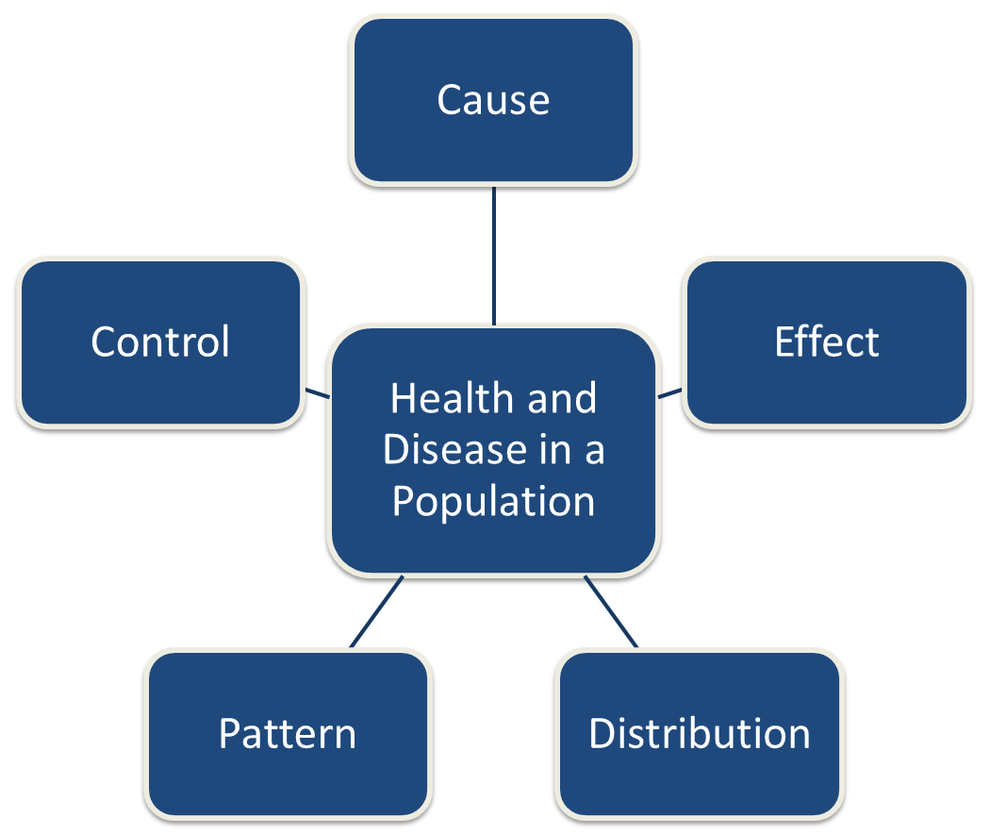
Epidemiology – The study of:

Slide 5
Epidemiology - Terminology
Incidence
New diagnoses– Annual rate of new diagnoses per 100,000 of those at risk
Prevalence
Existing diagnoses – The number of previously diagnosed and newly diagnosed people per 100,000 (e.g., number of TGA residents living with HIV on 01/01/2021 who were still living in the TGA on 12/31/2021)
Mortality
Deaths due to a specific cause – Annual rate of deaths per 100,000
Rate Ratio
Comparison of rates between two or more groups

Slide 6
Gender Classification
Male: persons assigned “male” sex at birth and current gender identity is “male.”
Female: persons assigned “female” sex at birth and current gender identity is “female.”
Transgender woman: persons assigned “male” sex at birth and current gender identity is “female.”
Transgender man: persons assigned “female” sex at birth and current gender identity is “male.”
Unknown

Slide 7
The Indianapolis Transitional Grant Area
(TGA)

Slide 8
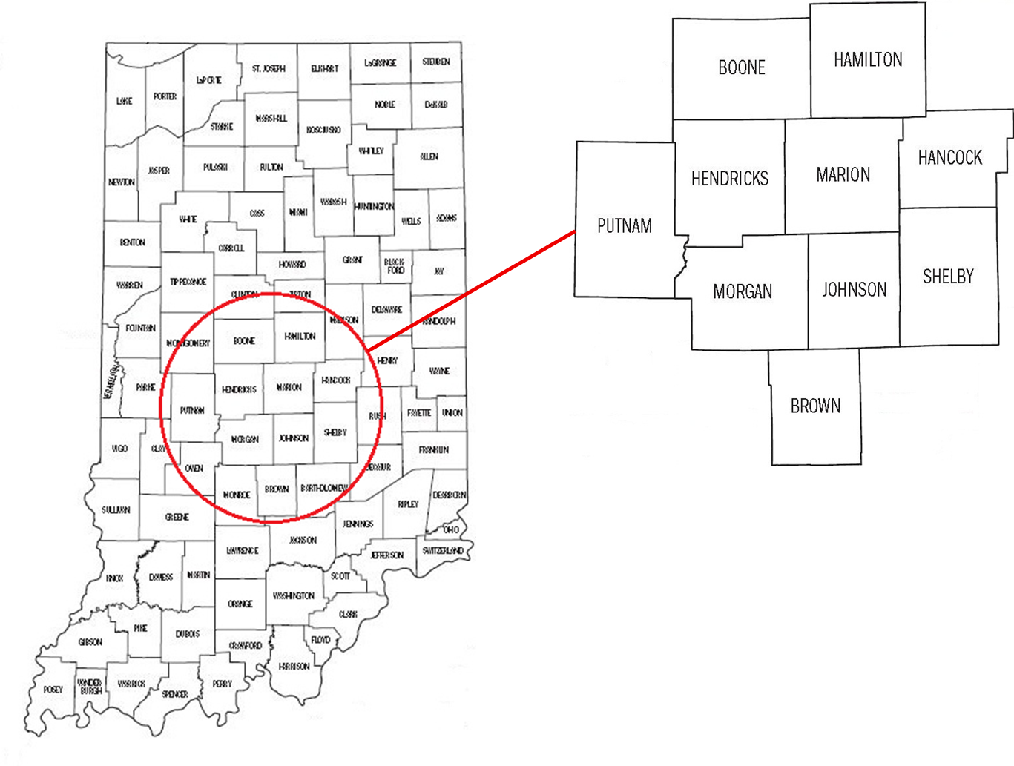
TGA Location & Population
Ten Central Indiana counties with a 2021 estimated population of 1.97 million¹ (12.4% increase since 2010)^{2, 3}
Notes:
1,761,042 to 1,979,981

Slide 9
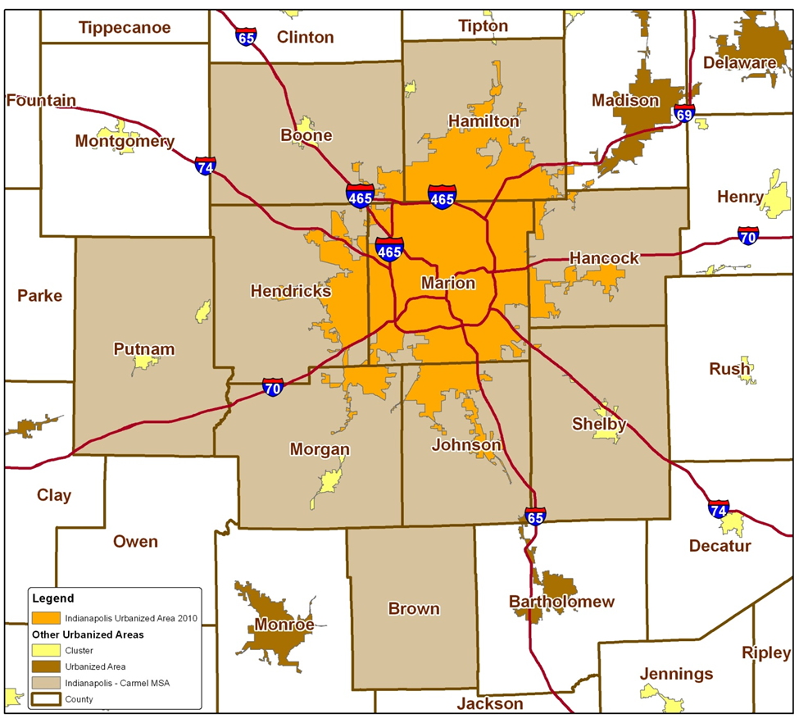
TGA Population Center
82% of the TGA’s population in orange⁴
49% reside inside Indianapolis city limits¹
Notes:
82% of TGA population is most recent estimate (1,623,354/1,979,981)
49% reside inside Indianapolis city limits (969,462/1,979,981)

Slide 10
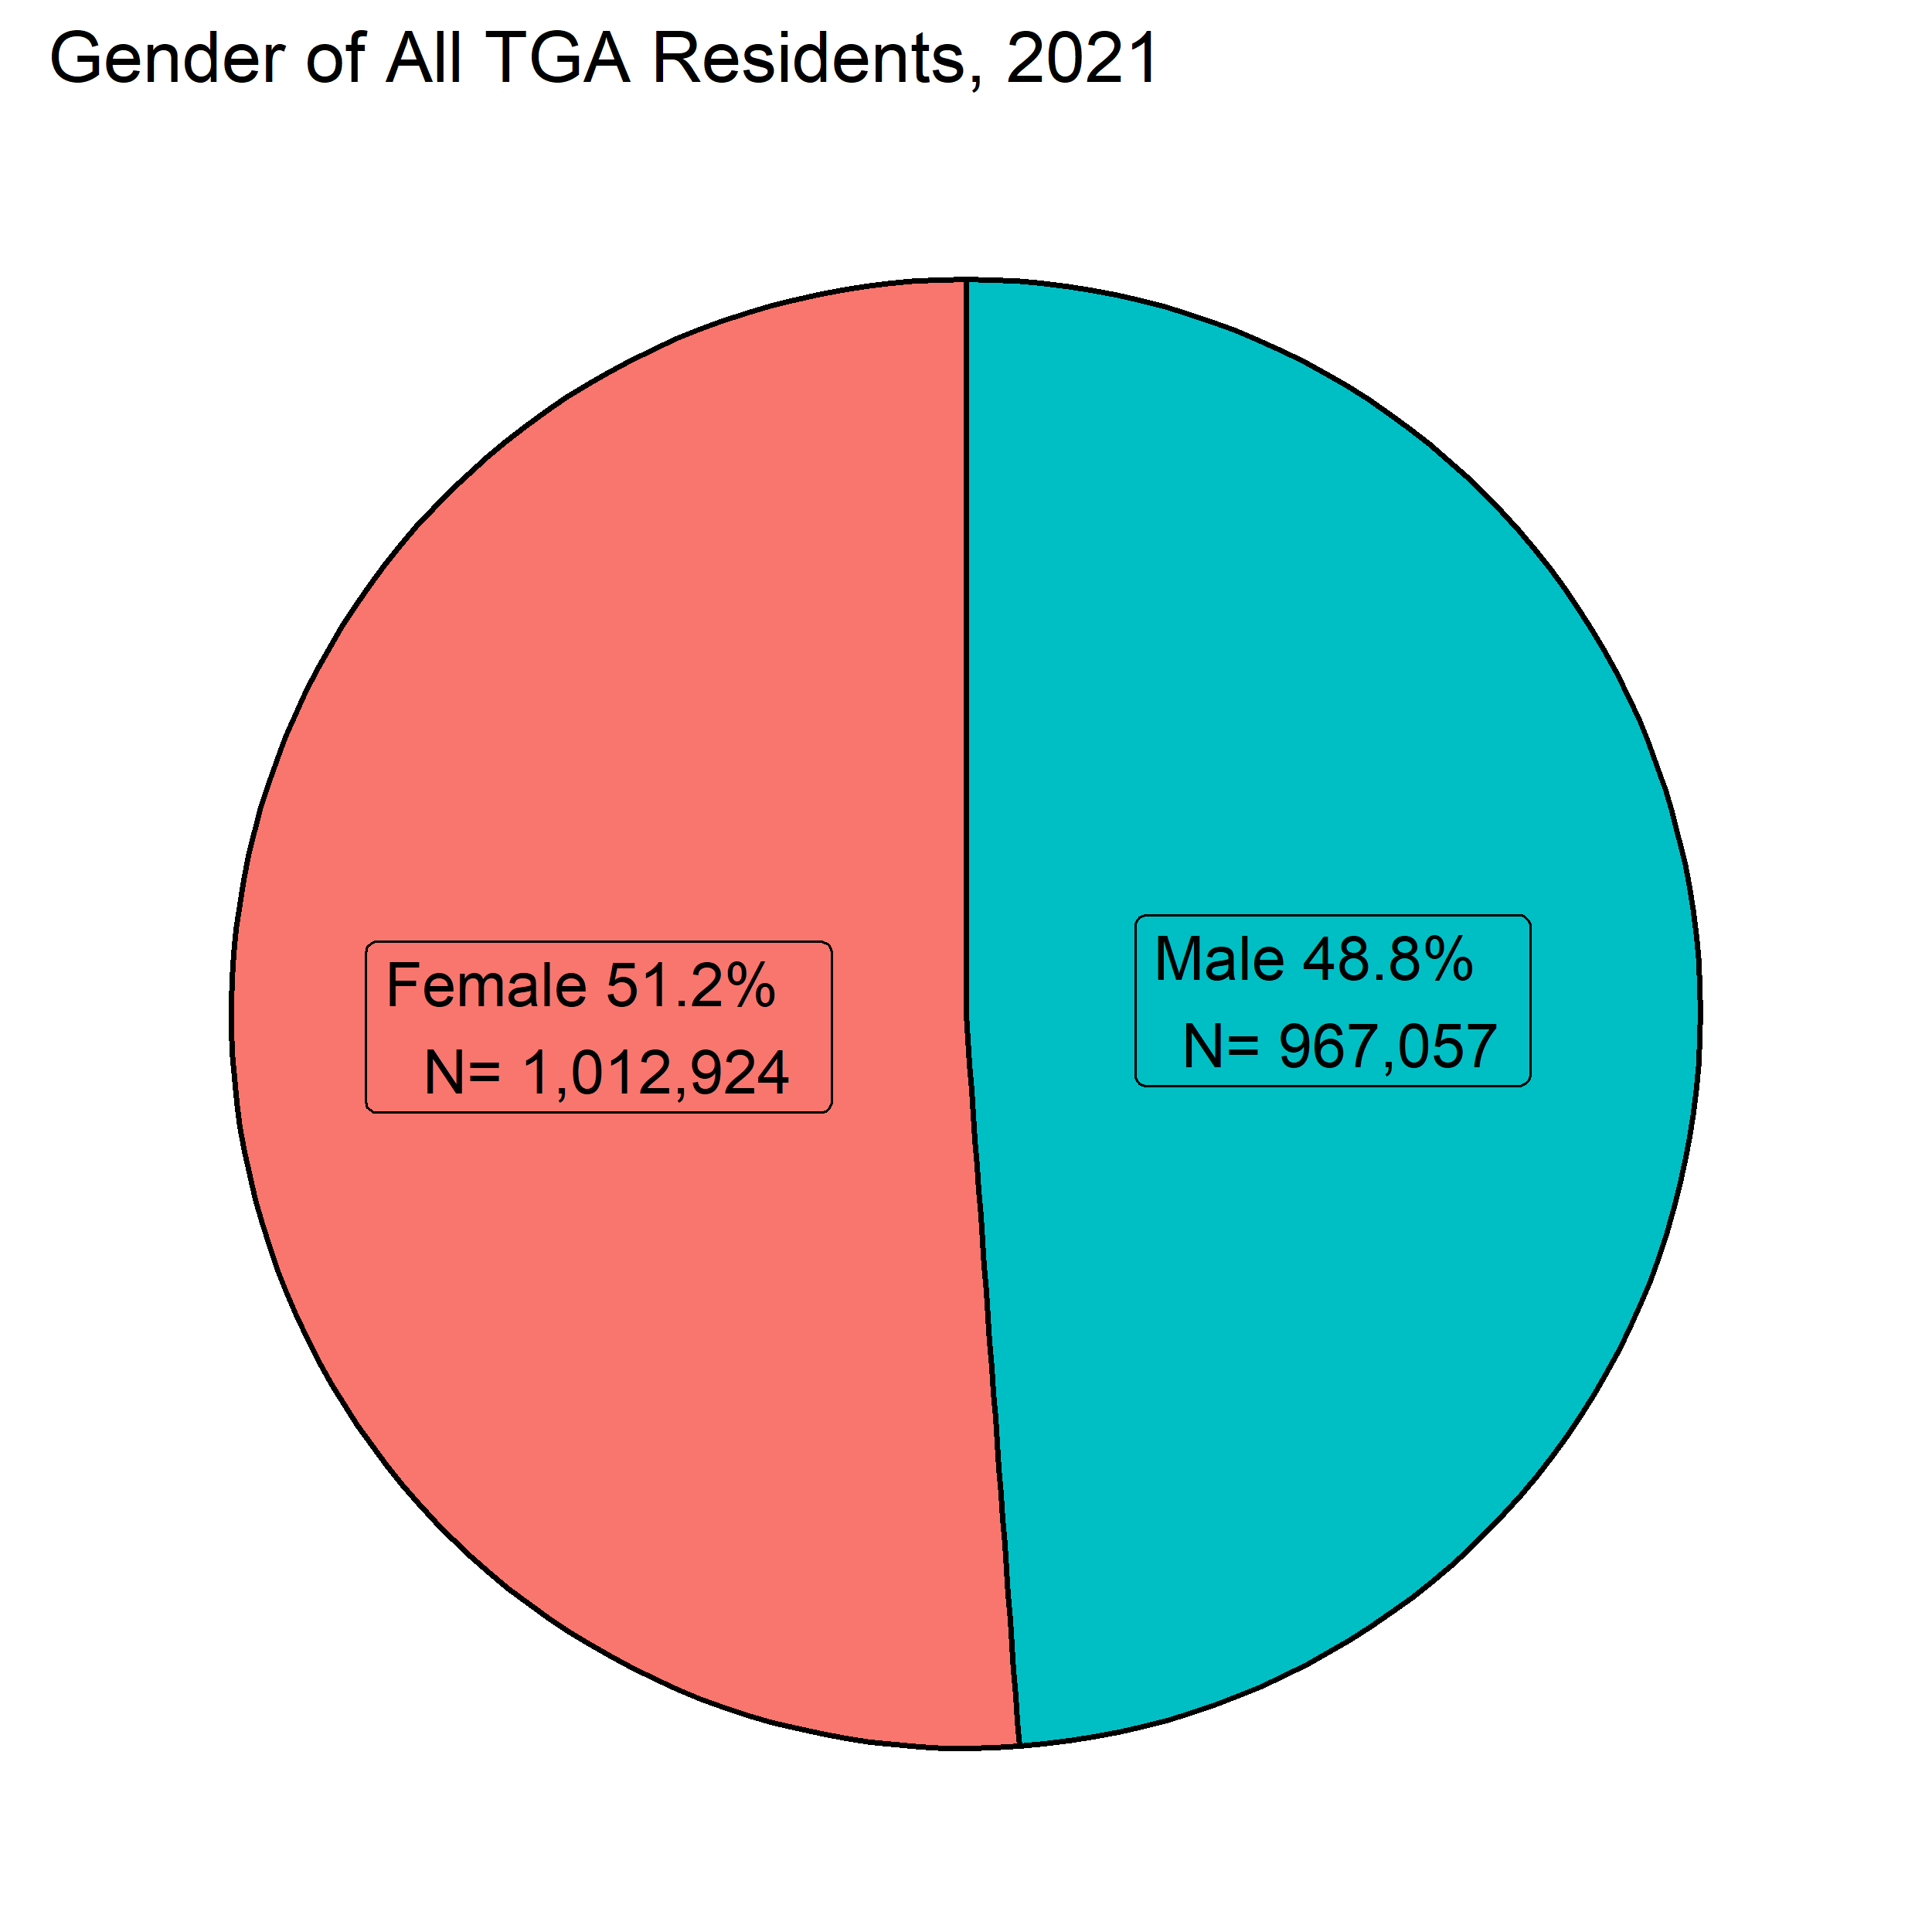
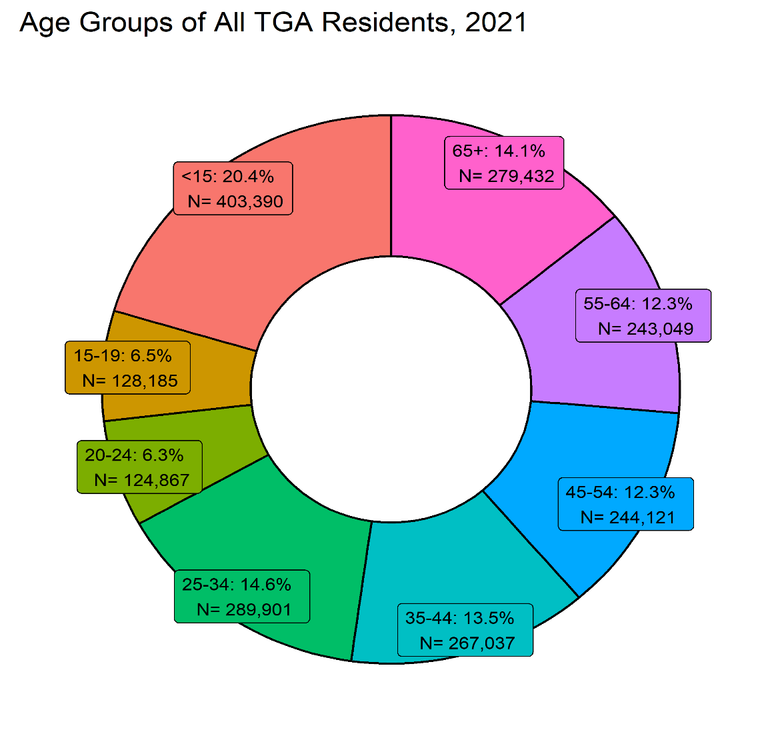
TGA Demographics

Slide 11
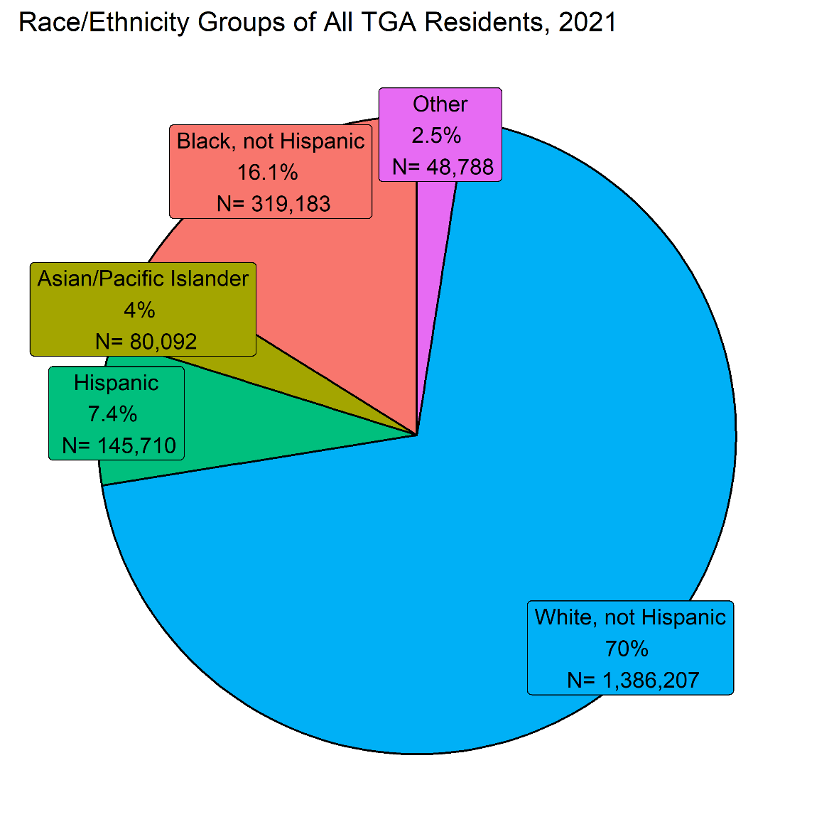
TGA Demographics
The population of Marion County is more diverse than that of the TGA overall, with 29% African American, 11% Hispanic, and nearly 4% each of Asian/PI and 3% Other

Slide 12
HIV/AIDS Incidence

Slide 13
HIV/AIDS Incidence
New Diagnoses | No. | Rate [95% CI*] | 2020 Rate [95% CI*] | U.S. Rate** (2019) ⁵
HIV† | 279 | 14.1[12.5-15.9] | 10.2 [8.8-11.7] | 13.2
AIDS | 123 | 6.2 [5.2-7.4] | 5.2 [4.2-6.3] | 5.2
*95% confidence interval **Includes the TGA † New HIV dx and HIV at AIDS dx
In 2021, HIV incidence increased by 40.2% compared to 2020 (199) and by 3% compared to 2019 (271) in the TGA.
AIDS incidence increased by 20.6% compared to 2020 (102) and by 48.2% compared to 2019 (83) in the TGA.
Notes:
Most recent available year-end US HIV Rate is for 2019 updated, as of 05/2021:
https://www.cdc.gov/hiv/pdf/library/reports/surveillance/cdc-hiv-surveillance-report-2018-updated-vol-32.pdf
Most recent available year-end US AIDS Rate is for 2018 preliminary, as of 04/30/2019:
https://www.cdc.gov/hiv/pdf/library/reports/surveillance/cdc-hiv-surveillance-report-2018-vol-30.pdf

Slide 14
HIV/AIDS Incidence
HIV Diagnoses and Population Estimates in the Indianapolis TGA: 2010-2021

Slide 15
HIV/AIDS Incidence
HIV Diagnoses by Time to AIDS in the Indianapolis TGA: 2010-2021
*Conversion within 91-365 Days masked due to low case counts

Slide 16
HIV Incidence by County
County | No. | % of HIV in TGA | Rate [95% CI*] | RR [95% CI*]: to Others
Marion | 231 | 82.8% | 23.8 [20.9-27.1] | 5.3 [3.3-8.3]
Hamilton | 19 | 6.8% | 5.4 [3.3-8.5]⁺ | 1.2[0.6-2.2]
Hendricks | 9 | 3.2% | 5.1[2.3-9.7] ⁺ | 1.1[0.5-2.5]
Others | 20 | 7.2% | 4.5 [2.8-7] ⁺ | 1.0
* 95% confidence interval ^{+ Unstable rate}
Marion County HIV incidence was at about 5 times that of TGA counties outside of Marion, Hamilton and Johnson

Slide 17
HIV Incidence by County

Slide 18
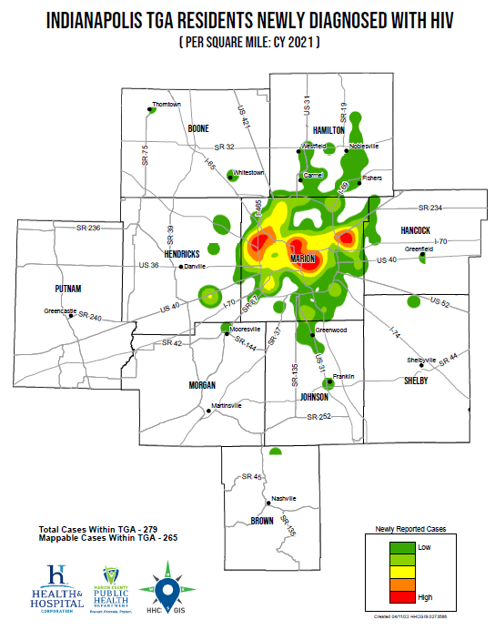
Notes:
MCPHD GIS: The output values represent the predicted amount of the phenomenon within each cell. Better to look at the classes/colors in this graph qualitatively rather quantitatively. This is b/c some areas may have been emphasized due to surrounding cell values or due to points crossing multiple cells (being at an edges or intersections).

Slide 19
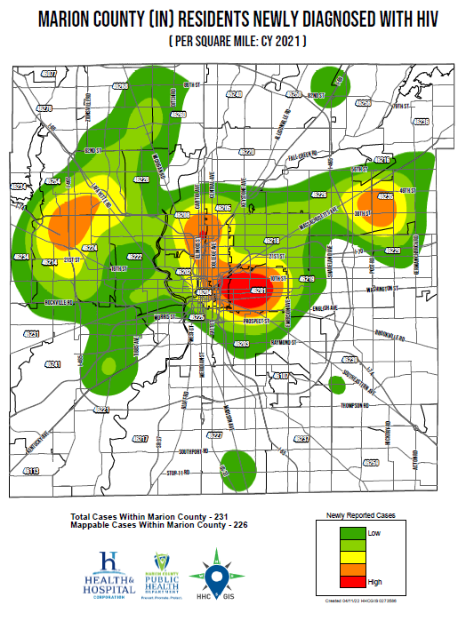

Slide 20
HIV Incidence by Gender
Gender | No. | % of HIV in TGA | Rate [95% CI*] | RR [95% CI*]: to Female
Female | 58 | 20.8% | 5.7[4.3-7.4] | 1.0
Male | 213 | 76.3% | 22 [19.2-25.2] | 3.8[2.9-5.1]
Transgender Unknown | 7 < 5 | 2.5% - | - | -
*95% confidence interval
Men were diagnosed with HIV at a rate of about 4 times that of women

Slide 21
HIV Incidence by Gender

Slide 22
HIV/AIDS Incidence
HIV Diagnoses by Sex at Birth in the Indianapolis TGA: 2010-2021

Slide 23
HIV Incidence by Race/Ethnicity
Race/ Ethnicity | No. | % of HIV in TGA | Rate [95% CI*] | RR [95% CI*]: to White
Asian/PI | 7 | 2.5 | NS | NS
Black | 136 | 48.8% | 42.6[35.8-50.4] | 6.7[5.1-8.8]
Hispanic | 43 | 15.4% | 29.5[21.4-39.7] ⁺ | 4.6[3.2-6.7]
Other | 5 | 1.8% | NS | NS
White | 88 | 31.5% | 6.3[5.1-7.8] | 1.0
*95% confidence interval ^{+ = Unstable Rate} NS = Does not meet MCPHD standards for statistical significance
African Americans and residents of Hispanic ethnicity continue to experience increased risk of HIV infection

Slide 24
HIV Incidence by Race/Ethnicity

Slide 25
HIV Incidence by Age
Age (Yrs.) | No. | % of HIV in TGA | Rate [95% CI*]
<15 | <5 | - | NS
15-19 | 8 | 2.87% | 6.2[2.7-12.3] ⁺
20-24 | 49 | 17.6% | 39.2[29-51.9]
25-34 | 122 | 43.7% | 42.1[35.5-50.2]
35-44 | 50 | 17.9% | 18.7[13.9-24.7]
45-54 | 33 | 11.8% | 13.5 [9.3-19] ⁺
55-64 | 16 | 5.7% | 6.6[3.8-10.7] ⁺
65+ | - | - | NS
*95% confidence interval ^{+= Unstable Rate} NS = Does not meet MCPHD standards for statistical significance
Young adults 20-34 continue to be at most risk of HIV, with rates at least double those of other age groups

Slide 26
HIV Incidence by Age

Slide 27
HIV Incidence by Exposure Category
Exposure | No. | % of HIV in TGA | Rate [95% CI*] | RR [95% CI*]: to Heterosexual
MSM^ | 127 | 45.5% | 221.2 [184.4-263.1] | 114.9[79.7-165.7]
IDU^ | 19 | 6.8% | 60 [36.1-93.6] ⁺ | 31.2 [17.9-54.2]
Heterosex. | 37 | 13.3% | 1.9[1.4-2.7] ⁺ | 1.0
Not Rptd. | 96 | 34.4% | 4.8[3.9-5.9] | NA
^MSM=Male-to-male sexual contact (denominator estimated)^{5, 6}and IDU=Injection drug use(denominator estimated)³⁰ Rows may total more than actual incidence due to report of multiple categories *95% confidence interval ^{+ = Unstable Rate}
MSM continue to bear the greatest burden of HIV

Slide 28
HIV Incidence by Exposure Category

Slide 29
HIV Incidence by U.S. Nativity Status
Nativity Status | No. | % of HIV in TGA | Rate [95% CI*] | RR [95% CI*]: to Native Born
Foreign Born** | 21 | 7.5% | 14.2[8.8-21.7] ⁺ | 4.4[2.7-7.3]
Native Born | 59 | 21.2% | 3.2 [2.5-4.2] | 1.0
Unk/Miss | 199 | 71.3% | - | -
*95% confidence interval, ** TGA foreign born population denominator based on census tract data^{1 + = Unstable Rate}
Foreign-born residents of the TGA account for an estimated 7.5% of the TGA population and experienced HIV incidence about 4x that of native-born residents
Notes:
The top 3 for HIV Incidence among Foreign-born were Nigeria, Myanmar (Burma), and Venezuela.

Slide 30
HIV Incidence by U.S. Nativity Status

Slide 31
HIV Mortality and Death

Slide 32
HIV Mortality and All Deaths of PLWH/A
Area | No. | Rate [95% CI*] | 2020 Rate [95% CI*] | U.S. Rate^{**7}
Mortality (Marion Only) | 10 | NS | NS | 1.7(2017)
Deaths (TGA) | 51 | 2.6[1.9-3.4] | 2.8[2.1-3.6] | 5.7(2019)
*95% confidence interval; NS = Does not meet MCPHD standards for statistical significance
The mortality rate of PLWH/A in 2021 is close to the 2020.
Notes:
Most recent U.S. data for cause of death related to HIV here: https://www. https://www.cdc.gov/nchs/data/nvsr/nvsr69/nvsr69-13-508.pdf
Most recent All cause HIV mortality here: https://www.cdc.gov/hiv/pdf/library/reports/surveillance/cdc-hiv-surveillance-report-2018-updated-vol-32.pdf

Slide 33
Death of PLWH/A (Any Cause)
Deaths of Indianapolis TGA Residents Living with HIV/AIDS, Regardless of Cause of Death, by Year: 2000-2021

Slide 34
HIV Mortality
Deaths of Marion County (IN) Residents with HIV as the Underlying Cause of Death, by Year: 2000-2021

Slide 35
Deaths by County
County | No. | % of HIV in TGA | Rate [95% CI*]
Marion | 43 | 84.3% | 4.4 [3.2-6.0] ⁺
Johnson | < 5 | - | -
Others | < 5 | - | -
* 95% confidence interval ^{+ = Unstable Rate}
Marion County had the highest number of death

Slide 36
Deaths by Gender
Gender | No. | % of HIV in TGA | Rate [95% CI*] | RR [95% CI*]: to Female
Female | 11 | 21.6% | 1.1 [0.5-1.9] ⁺ | 1.0
Male | 39 | 76.5% | 4.0 [2.9-5.5] ⁺ | 3.7[1.9-2.9]
Transgender | < 5 | -
*95% confidence interval ^{+ = Unstable Rate}
Men were about 4 times likely to die compared to Women

Slide 37
Death Rate by Gender, 2021

Slide 38
Deaths by Race/Ethnicity
Race/ Ethnicity | No. | % of HIV in TGA | Rate [95% CI*] | RR [95% CI*]: to White
Asian/PI | - | - | NS | NS
Black | 20 | 39.2% | 6.3[3.8-9.7] ⁺ | 3.0[1.7-5.3]
Hispanic | - | - | NS | NS
Other | < 5 | - | NS | NS
White | 29 | 56.9% | 2.1[1.4-3.0] ⁺ | 1.0
*95% confidence interval NS = Does not meet MCPHD standards for statistical significance ^{+ = Unstable Rate}
African Americans were 3 times more likely to die compared o their White counterparts

Slide 39
Death Rate by Race/Ethnicity

Slide 40
Deaths by Age
Age (Yrs.) | No. | % | Rate [95% CI*]
<15 | - | - | NS
15-19 | - | - | NS
20-24 | < 5 | - | NS
25-34 | 7 | 13.7% | 2.4[1.0-5.0] ⁺
35-44 | < 5 | - | [-]
45-54 | 6 | 11.8% | 2.5[0.9-5.3] ⁺
55-64 | 26 | 51.0% | 10.7[7.0-15.7] ⁺
65+ | 7 | 13.7% | 2.6[1.9-3.4] ⁺
*95% confidence interval NS = Does not meet MCPHD standards for statistical significance ^{+ = Unstable Rate}
Adults aged 55-64 experienced the highest death rate

Slide 41
Death Rate by Age

Slide 42
Deaths by Exposure/Risk
Exposure | No. | % of HIV in TGA | Rate [95% CI*] | RR [95% CI*]: to Heterosexual
MSM^ | 23 | 45.1% | 40.1[25.4-60.1] ⁺ | 64.2[32-129]
Heterosex. | 12 | 23.5% | 0.6[0.3-1.1] ⁺ | 1.0
IDU^ | 10 | 19.6% | 31.6[15.1-58] ⁺ | 50.6[21.9-117.1]
Perinatal | < 5 | - | NS | NS
Other | - | - | NS | NS
Not Rptd. | 5 | 9.8% | 0.3[0.1-0.6] ⁺ | NS
^MSM=Male-to-male sexual contact (denominator estimated)⁵ ⁶ and IDU=Injection drug use (denominator estimated)³⁰ Rows may total more than actual incidence due to report of multiple categories *95% confidence interval ^{+ = Unstable Rate}
MSM and IDU had the highest death rate

Slide 43
Death Rate by Exposure Status

Slide 44
Deaths by U.S. Nativity Status
Nativity Status | No. | % of HIV in TGA | Rate [95% CI*] | RR [95% CI*]: to Native Born
Foreign Born** | < 5 | - | [-] | [-]
Native Born | 47 | 92.2% | 2.6[1.9-3.4] | 1.0
Unk/Miss | < 5 | 5.9% | - | -
*95% confidence interval, ** TGA foreign born population denominator based on census tract data¹
Native Born had a death rate of 2.6
Notes:
The top 3 for HIV Incidence among Foreign-born were Nigeria, Myanmar (Burma), and Venezuela.

Slide 45
HIV Prevalence

Slide 46
Estimated Number of Undiagnosed PLWH/A
HIV/AIDS Prevalence | 6,174
HIV Prevalence | 3,317
AIDS Prevalence | 2,857
Undiagnosed/Unaware | 923
Estimated Total PLWH/A | 7,097
Current estimated proportion of PLWH/A while undiagnosed/unaware is 13% of known prevalence²⁷

Slide 47
Prevalence of Diagnosed HIV/AIDS
Status | No. | Rate [95% CI*] | U.S. Rate (2017)⁵
HIV | 3,317 | 167.5[161.9-173.3] | 147.3
AIDS | 2,857 | 144.3[139.1-149.7] | 161.4
Total | 6,174 | 311.8[304.1-319.7] | 308.7
*95% confidence interval
No significant change in HIV and AIDS prevalence from 2020 to 2021
Notes:
HIV above represents HIV, non-AIDS.
2017 (year-end) for total PLWHA
https://www.cdc.gov/hiv/pdf/library/reports/surveillance/cdc-hiv-surveillance-report-2018-vol-30.pdf

Slide 48
HIV/AIDS Prevalence by County
County | No. | % of HIV/AIDS in TGA | Rate [95% CI*] | RR [95% CI*]: to Brown
Marion | 5,228 | 84.7% | 539.3[524.8-554] | 9.1 [4.7-17.4]
Hamilton | 279 | 4.5% | 79.5[70.4-89.4] | NS
Hendricks | 201 | 3.3% | 113.9[98.7-130.7] | 1.9[1.0-3.7]
Johnson | 172 | 2.8% | 105.6[90.4-122.6] | NS
Morgan | 65 | 1.1% | 91.6[70.7-116.7] | NS
Hancock | 62 | 1.0% | 76.6[58.7-98.2] | NS
Boone | 60 | 1.0% | 85[64.8-109.4] | NS
Putnam | 57 | 0.9% | 152.1 [115.3-197.1] | 2.6 [1.3- 5.2]
Shelby | 41 | 0.7% | 91.1[65.4-123.6] ⁺ | NS
Brown | 9 | 0.2% | 59.5[27.2-113] ⁺ | 1.0
*95% confidence interval ^{+ = Unstable Rate}

Slide 49
HIV/AIDS Prevalence by County

Slide 50
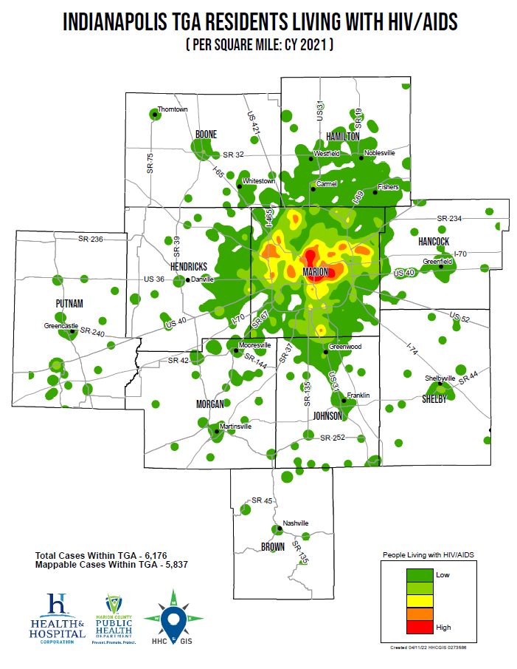

Slide 51
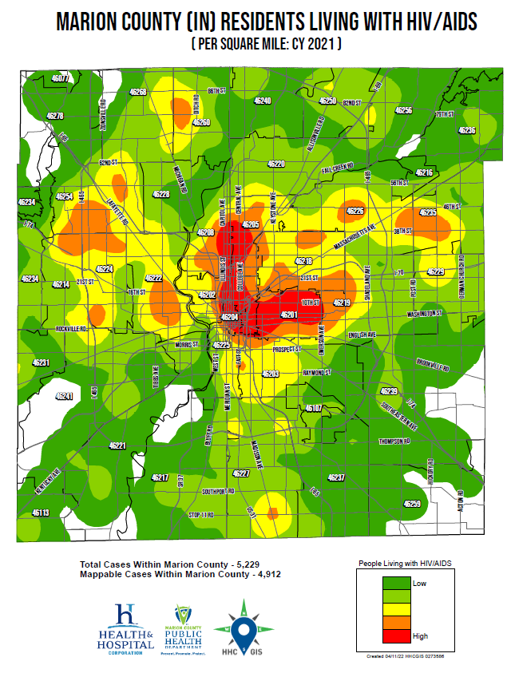

Slide 52
HIV/AIDS Prevalence by Gender
Gender | No. | % of HIV/AIDS in TGA | Rate [95% CI*] | RR [95% CI*]: to Female
Female | 1,330 | 21.5% | 131.3[124.3-138.5] | 1.0
Male | 4,745 | 76.9% | 490.7[476.9-504.8] | 3.7 [3.5-4.0]
MtF | 82 | 1.3% | UNK | UNK
FtM | 16 | 0.3% | UNK | UNK
Unk/Mis | <5 | - | - | -
*95% confidence interval
HIV prevalence among the TGA’s men was about 4 times that found among women

Slide 53
HIV/AIDS Prevalence by Gender

Slide 54
HIV/AIDS Prevalence by Race/Ethnicity
Race/ Ethnicity | No. | % of HIV/AIDSin TGA | Rate [95% CI*] | RR [95% CI*]: to White
Black | 2,936 | 47.6% | 919.8[887.2-953.4] | 5.7 [5.4-6.0]
Other | 215 | 3.5% | 440.7[383.8-503.5] | 2.7[2.4-3.1]
Hispanic | 600 | 9.7% | 411.8[379.5-446] | 2.5 [2.3-2.8]
Asian/PI | 169 | 2.7% | 211[180.4-245.3] | 1.3 [1.1-1.5]
White | 2,254 | 36.5% | 162.6[156-169.4] | 1.0
*95% confidence interval
HIV prevalence continues to be higher among racial/ethnic minorities than among Caucasians in the TGA

Slide 55
HIV/AIDS Prevalence by Race/Ethnicity

Slide 56
HIV/AIDS Prevalence by Current Age
Age (Yrs.) | No. | % of HIV/AIDS in TGA | Rate [95% CI*]
<15 | 28 | 0.5% | 6.9[4.6-10] ⁺
15-19 | 35 | 0.6% | 27.3[19-38] ⁺
20-24 | 188 | 3.1% | 150.6[129.8-173.7]
25-34 | 1,228 | 19.9% | 423.6[400.3-447.9]
35-44 | 1,351 | 21.9% | 505.9[479.4-533.5]
45-54 | 1,430 | 23.2% | 585.8[556-616.7]
55-64 | 1,396 | 22.6% | 574.4[544.8-605.1]
65+ | 518 | 8.4% | 185.4[169.8-202]
*95% confidence interval ^{+ = Unstable Rate}
Adults over 45 Yrs. of age account for more than 54% of the TGA’s PLWH/A

Slide 57
HIV/AIDS Prevalence by Current Age

Slide 58
HIV/AIDS Prevalence by Exposure/Risk
Exposure | No. | % of HIV/AIDS in TGA | Rate [95% CI*] per 100,000 or per 100(%) | RR [95% CI*]: to Heterosexual
MSM^ | 3,326 | 53.9% | 5.8%[5.6%-%6.0] | 79.2[74.4-84.3]
Heterosex. | 1,406 | 22.8% | 0.07%[0.069%-0.077%] | 1.0
IDU^ | 542 | 8.8% | 1.7% [1.57%-1.86%] | 23.4[21.2-25.8]
Perinatal | 80 | 1.3% | - | -
Other | 9 | 0.2% | NS | NS
Not Rptd. | 811 | 13.1% | 0.041%[0.038%-0.044%] | 0.56[0.51-0.61]
^MSM=Male-to-male sexual contact (denominator estimated)⁵ ⁶ and IDU=Injection drug use (denominator estimated)³⁰ Rows may total more than actual incidence due to report of multiple categories *95% confidence interval
Based on CDC estimates, as many as 34% of HIV-positive MSM are unaware of their status.⁸

Slide 59
HIV/AIDS Prevalence by Exposure/Risk

Slide 60
HIV/AIDS Prevalence by U.S. Nativity Status
 |  | Nativity Status | No. | % of HIV/AIDS in the TGA | Rate [95%CI*] | RR [95% CI*]: to Native Born
 |  | Foreign Born | 921 | 14.9% | 623.4[583.9-664.8] | 2.6[2.4-2.7]
 |  | Native Born | 4,451 | 72.1% | 243.3[236.3-250.6] | 1.0
 |  | Other | 7 | 0.1% | -
 |  | Unk/Miss | 795 | 12.9% | -
*95% confidence interval
HIV prevalence among foreign-born TGA residents is about three times that of native-born residents

Slide 61
HIV/AIDS Prevalence by U.S. Nativity Status

Slide 62
HIV/AIDS Prevalence by Birth Region
Birth Region | No. | % of HIV/AIDS in TGA
Northern America | 4,451 | 72.1%
Latin America and Caribbean | 382 | 5.7%
Africa | 320 | 5.3%
Asia | 157 | 2.6%
Europe | 24 | 0.3%
Unknown | 840 | 9.3%
United States, Latin America and Africa are the top 3 Birth Regions for PLWHA in our TGA
Notes:
Northern America group here includes USA, Canada, Greenland, etc. It does not include Mexico and Central American countries which are included in Latin America and Caribbean group.
The top 3 countries in Latin America and the Caribbean with the highest prevalence of HIV/AIDS were : Mexico (178), Honduras (32), and Haiti (22).
The top 3 African Countries with the highest prevalence of HIV/AIDS were: Nigeria (75), Zimbabwe (64), and Kenya (30).

Slide 63
Co-occurring conditions

Slide 64
COVID-19
Information and data on COVID-19 are rapidly evolving
It is still unknown if people with HIV are at a greater risk of acquiring COVID-19 or may develop adverse clinical outcomes
Some studies done in the United States and Europe showed no significant differences in the clinical outcomes of COVID-19 between HIV positive and HIV negative patients. ^{33,34,35}
Some other studies done in the United States, the United Kingdom, and South Africa showed worse COVID-19 outcomes for patients with HIV including high COVID-19 mortality rates. ^{36,37,38,39}
In 2021, among PLWH/A in the TGA, 335 (5.4%; 95% CI: 4.9%-6.0%) were diagnosed with COVID-19 in Marion County and 7 died of COVID-19
People with HIV should follow the CDC guidelines to prevent COVID -19 including wearing masks, social distancing, avoiding crowded area, proper hand hygiene, vaccination, and booster shots

Slide 65
Foreign-Born
With a risk of about 3 times that of native-born residents, foreign-born residents of the TGA accounted for over 1 in 10 newly diagnosed with HIV during 2021
Similarly, over 1 in 10 PLWH/A in the TGA are foreign-born, experiencing a prevalence that is about three times as high as among the native-born
Special considerations
Linguistic services
Health insurance
Social support structure
Cultural stigma/beliefs
Fear

Slide 66
Aging
Better therapies → Longer lives
Over 54% of PLWH/A in the TGA are 45+ years of age
Special considerations⁹
Weakened immune system
Increased risk of adverse events and drug interactions
Stigma and depression due to illness, or loss of family and friends
Increased risk for cardiovascular disease, bone loss, and certain cancers

Slide 67
Homelessness
Among PLWH/A, between 300 and 400 were homeless or insecurely housed at some point during 2021^{10,11,12}
Research suggests that 10%-16% of all PLWH/A in some communities are homeless at any given time¹³
Special considerations
Case finding
Public assistance
Permanent housing
Priority of medical care
Photo credit: Jeremy Swain, Ending Homelessness in London
Notes:
Most recent estimate for Indianapolis based on HOPWA report for 2019.

Slide 68
Recent Incarceration
10% of the TGA’s PLWH/A have a history of incarceration
Special considerations
Employment and housing
Retention in care throughout and after the transition
Substance abuse
Trouble navigating the health care system
Notes:
Current estimate = 10.4%

Slide 69
Mental Health & Substance Abuse
According to many studies, PLWH have a higher rate of mental health disorders than the general population with approximately 36% suffering from major depression, and 15.8% from generalized anxiety disorder ⁴¹
50% of PLWH/A are estimated to have current or history of drugs or alcohol disorders. ⁴³
Special considerations
Non-adherence to treatment regimens
Immunosuppression

Slide 70
Food Insecurity
Nearly 50% of PLWH/A are thought to struggle with food insecurity
Food insecurity is a risk factor for mortality among people on HAART, especially those who are underweight¹⁶
Food insecurity associated with prevalent HIV, STI, and illicit drug use among men in the US ¹⁶
Notes:
HAART=Highly Active Antiretroviral Therapy

Slide 71
Smoking
Smoking is one of the leading cause of morbidity and mortality in HIV positive people ⁴⁴
The National Cancer Institute estimate that between 34 to 47% of PLWH/A smoke ⁴⁵
People with HIV and smokers are at increased risk of developing the following: ⁴⁴
Lung cancer, head and neck cancers, cervical and anal cancers , and other cancers
Heart diseases and stroke
Chronic obstructive pulmonary disease (COPD)
Serious HIV related infections, including bacterial pneumonia
HIV positive smokers have also lower response to HIV treatment and are at increased risk of developing life-threatening conditions that can lead to AIDS
People with HIV who smoke should be advised to quit smoking as soon as possible and to avoid secondhand smoke

Slide 72
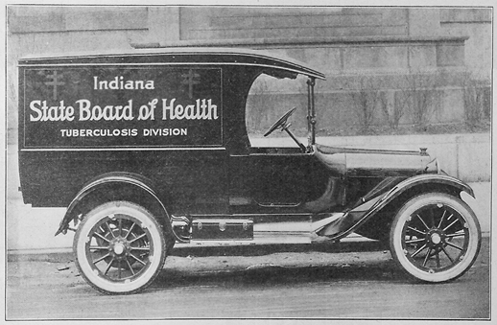
Mycobacterium tuberculosis (TB)
For 2018, 43 TGA residents were diagnosed with active TB, three were HIV-positive. For 2019, 49 TGA residents were diagnosed with active TB, five were HIV-positive. For 2020, 43 TGA residents were diagnosed with active TB, three were HIV-positive. For 2021, 62 TGA residents were diagnosed with active TB, three were HIV-positive.
6%-10% of active TB diagnoses are among PLWH/A¹⁷
Conversion from latent to active TB is 10 times more likely in PLWH/A (7%-10% risk each year)¹⁸
Everyone newly HIV diagnosed should be tested for TB right away, and PLWH/A and at risk for TB should be tested annually.¹⁹
Special considerations
Screening
Diagnostic
HIV-TB synergy
Treatment complications

Slide 73
Viral Hepatitis
Approximately 617 PLWH/A are thought to be co-infected with hepatitis B based on the 10% estimate of the National Institute of Health²⁰
Approximately 1,297 PLWH/A are thought to be co-infected with hepatitis C based on the 21% estimate of the National Institute of Health²¹
Current guidelines call for HCV screening in all PLWH/A (annually for those at increased risk)²³

Slide 74
Chlamydia
12,120 chlamydia diagnoses were reported in the TGA during 2020, at least 104 among PLWH/A²⁴
The chlamydia rate among PLWH/A was 1,758 per 100,000 [95% CI: 1,438.3-2,125.7], a rate 3-4 times higher than that of HIV-negative residents.
Chlamydia co-infection among PLWH/A is thought to be grossly underestimated – PLEASE screen, diagnose and treat PLWH/A and their partner(s) for chlamydia

Slide 75
Gonorrhea
5,368 gonorrhea diagnoses were reported in the TGA during 2020, at least 206 among PLWH/A²⁴
The gonorrhea rate among PLWH/A was 3,481 per 100,000 [95% CI: 3,029-3,980.5], a rate 15-19 times higher than that of HIV-negative residents
Gonorrhea co-infection among PLWH/A is thought to be grossly underestimated – PLEASE screen, diagnose and treat PLWH/A and their partner(s) for gonorrhea.

Slide 76
Early Syphilis
594 early syphilis (primary, secondary, and early latent) diagnoses were reported in the TGA during 2020, at least 233 among PLWH/A²⁴
The rate of early syphilis among PLWH/A was 3,938 per 100,000 [95% CI: 3,456.6-4,465], a rate at about 279 times higher [95% CI: 254.2-328.3] than that of HIV-negative residents.
HIV co-infection among new syphilis cases is very common– PLEASE screen, diagnose and treat PLWH/A and their partner(s) for syphilis.

Slide 77
More on Sexually-Transmitted Infections
HIV and STIs are commonly co-morbid conditions
Special concerns
STDs can increase the likelihood of contracting HIV
As providers to residents with the highest risk, you can:
Include routine screening as a function of HIV primary care
Perform risk analyses – Assess risk behaviors of your patients
Perform risk reduction - Alert your patients to the risks of STDs, especially when comorbid to HIV/AIDS, and offer periodic STD testing for each of your patients
Treat - Diagnose and treat patients and their partner(s)
Report – Provide thorough and accurate case reporting for better modeling of risk factors

Slide 78
Measures of HIV Health Outcomes

Slide 79
HIV Treatment Cascade (AKA: Continuum of Care
Developed by Dr. Edward Gardner and colleagues²⁵ in March 2011
Model for use in identifying unmet needs, as well as discovery of where, across the continuum of care, clients are lost to follow-up
“Improving control of HIV begins with enhanced detection and linkage to care” – Gardner, et al., 2011 ²⁵
“HIV screening without linkage to care “confers little or no benefit to the patient” – Branson, et al., 2006 ²⁶

Slide 80
Benefits of Improving Linkage Into and Retention in Care
Delayed linkage and poor engagement in care are associated with:²⁵ ²⁶
Delayed/no receipt of anti-retroviral therapy (ART)
Quicker progression to AIDS
Drug resistance
Increased morbidity (hospitalizations, opportunistic infections, emergency department visits, etc.)
Increased mortality
Increased risk of HIV transmission

Slide 81
National HIV/AIDS Progress Indicators ¹⁴
95% of HIV-positive residents aware of their status
95% of those newly diagnosed linked to care within 30 days
95% retained in care
95% suppressed viral load

Slide 82
HIV Care Continuum Definitions
Linked to Care: People newly diagnosed with HIV during CY 2021 who received a CD4/viral load test within 30 days
Receipt of Care: Residents living with HIV/AIDS with 1+ CD4 or viral load tests performed during CY 2021.
Retained in Care: Residents living with HIV/AIDS with 2+ CD4/viral load tests performed at least 3 months apart in CY 2021
Antiretroviral Therapy: Residents living with HIV/AIDS who received a prescription for antiretroviral therapy in CY 2021
Viral Load Suppression: Residents living with HIV/AIDS with a CY 2021 viral load result <200 RNA copies/mL

Slide 83
HIV Care Continuum of the TGA
80.8% (N=4990/6174)
Linkage to care within 30 days shown above
Note: There was 88.9% linkage to care within 90 days
Notes:
Linkage to care within 30 days shown above
Note: There was 88.9% linkage to care within 90 days

Slide 84
HIV Care Continuum in the TGA, 2021 (Linkage to Care)
Among the 198 people linked to Care within 30 days in 2021:
By County: 82.3% were from Marion County
By Gender: 77.3 % were Male
By Race/Ethnicity: 46.5 % were Black not-Hispanic and 31.3 % were White not- Hispanic
By Age Groups: 42.4% were aged between 25-34 years old
By Exposure Status: 47.5% were MSM
By Nativity Status: 68.7 % were of unknown Nativity status

Slide 85
HIV Care Continuum in the TGA, 2021 (Receipt of Care)
Among the 4990 people that received care during CY 2021:
By County: 84.2% were from Marion County
By Gender: 76.7 % were Male
By Race/Ethnicity: 46.4 % were Black not-Hispanic and 37.9 % were White not- Hispanic
By Age Groups: People aged 45-54 and 55-64 represented both 23.1%
By Exposure Status: 56% were MSM
By Nativity Status: 73.1 % were of unknown Nativity status

Slide 86
HIV Care Continuum in the TGA, 2021 (Retention in Care)
Among the 3315 people that were retained in Care during CY 2021:
By County: 84.9% were from Marion County
By Gender: 76.7 % were Male
By Race/Ethnicity: 46.5 % were Black not-Hispanic and 36.2 % were White not- Hispanic
By Age Groups: People aged 55-64 represented 24.1%
By Exposure Status: 54.9% were MSM
By Nativity Status: 72.6 % were of unknown Nativity status

Slide 87
HIV Care Continuum in the TGA, 2021 (Viral suppression)
Among the 4340 people that were virally suppressed during CY 2021:
By County: 83.9% were from Marion County
By Gender: 77.1 % were Male
By Race/Ethnicity: 44.2 % were Black not-Hispanic and 39.6 % were White not- Hispanic
By Age Groups: People aged 55-64 represented 24.7%
By Exposure Status: 56.9% were MSM
By Nativity Status: 73.8 % were of unknown Nativity status

Slide 88
HIV Care Continuum in the TGA by County, 2021

Slide 89
HIV Care Continuum in the TGA by Gender, 2021

Slide 90
HIV Care Continuum in the TGA by Race/Ethnicity, 2021

Slide 91
HIV Care Continuum in the TGA by Age

Slide 92
HIV Care Continuum in the TGA by Exposure Category

Slide 93
HIV Care Continuum in the TGA by Nativity Status

Slide 94
HIV Care Continuum in the TGA within each County, 2021
Johnson County had the greatest percentage of linkage to Care (85.7%)
Hendricks County had the lowest percent of receipt of Care (77.1%)
Shelby County had the lowest percent of retained in Care (46.3%)
Hendricks County had the lowest percent of viral load suppression (66.2%)

Slide 95
HIV Care Continuum in the TGA within each Gender, 2021
Female had the lowest percentage of linkage to Care (67.2%)
Female had the lowest percent of receipt of Care (80.6%) which is also close to male (80.7%)
Male had the lowest percent of retained in Care (53.6%) which was also close to female (53.8%)
Female had the lowest percent of viral load suppression (69.2%)

Slide 96
HIV Care Continuum in the TGA within each Race/Ethnicity, 2021
Black, not-Hispanic had the lowest percentage of linkage to Care (67.6%)
Hispanic had the lowest percent of receipt of Care (76.5%)
Black, not-Hispanic had the lowest percent of retained in Care (52.5%)
Black, not-Hispanic had the lowest percent of viral load suppression (65.4%)

Slide 97
HIV Care Continuum in the TGA within each age group, 2021
People aged 45-54 had the lowest percentage of linkage to Care (63.6%)
People aged 25-34 had the lowest percent of receipt of Care (78.4%)
People aged 25-34 had the lowest percent of retained in Care (49.5%)
People aged 25-34 had the lowest percent of viral load suppression (61.2%)

Slide 98
HIV Care Continuum in the TGA within each Exposure Category, 2021
IDU had the lowest percentage of linkage to Care (57.9%)
Perinatal exposure had the highest percent of receipt of Care (86.3%)
Perinatal exposure had the highest percent of retained in Care (68.8%)
Perinatal exposure had a percent of viral load suppression of 77.5%

Slide 99
HIV Care Continuum in the TGA within each Nativity Status, 2021
People of unknown Nativity Status had the lowest percentage of linkage to Care (68.3%)
Foreign Born had the lowest percent of receipt of Care (75%)
People of unknown Nativity Status had the lowest percent of retained in Care (47.9%)
People of unknown Nativity Status had the lowest percent of viral load suppression (63.5%)

Slide 100
HIV Care Continuum in the TGA within each County, 2021

Slide 101
HIV Care Continuum in the TGA within each Gender, 2021

Slide 102
HIV Care Continuum in the TGA within each Race/Ethnicity, 2021

Slide 103
HIV Care Continuum in the TGA within each age groups

Slide 104
HIV Care Continuum in the TGA within each Exposure Category

Slide 105
HIV Care Continuum in the TGA within each Nativity Status

Slide 106
Ryan White Clients v. Non-Client PLWH/A
*Linkage to care within 90 days was 96.9% for RWSP clients and 82.2 % for non-RWSP clients.

Slide 107
Community Viral Load
Geometric means were used for comparisons of viral load
Geometric means are always smaller than arithmetic means because the effect of very large values is diminished
Geometric means are more stable from year to year
All results are based on the last reported viral load test during 2021 for all residents with ≥1 viral load test
Results were standardized such that:
Results reported as 0 or <20 were set to half the lower limit of detection possible for the assay used according to CDC recommendations²⁸

Slide 108
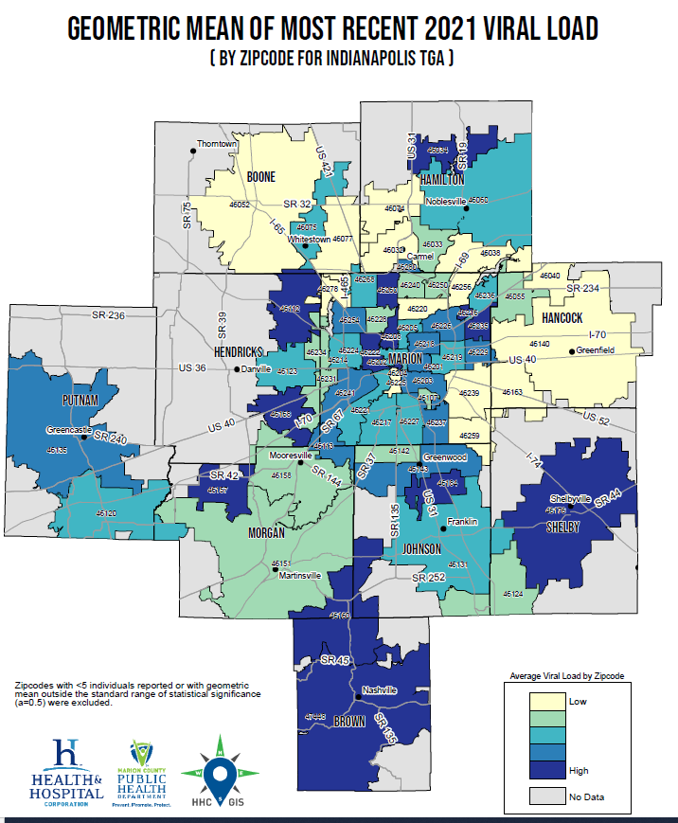

Slide 109
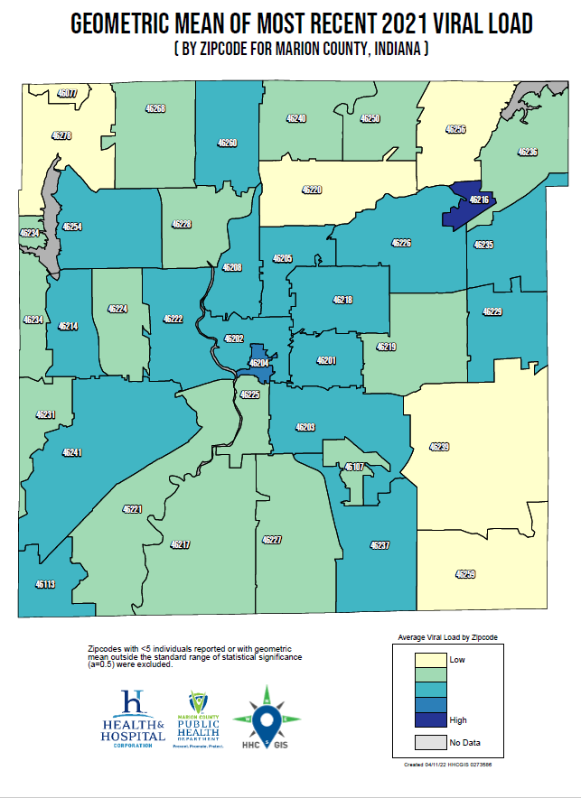

Slide 110
Community Viral Load by Gender
Number and percent with suppressed viral load (<200 copies/mL) at last CY 2021 test, by gender
Gender | N | % at <200 copies/mL** | Geometric Mean Viral Load | 95% Confidence Interval (GM)
Male | 3810 | 70.3 | 51 | 47-55
Female | 1064 | 69.1 | 53 | 46-61
MtF Transgender | 76 | 73.5 | * | 42-142
FtM Transgender | 14 | 75 | * | 16-177
*Point estimate suppressed due to wide confidence interval **Percentage includes unknown/missing viral loads in denominator

Slide 111
Community Viral Load by Race/Ethnicity
Number and percent with suppressed viral load (<200 copies/mL) at last CY 2021 test, by race/ethnicity
Race/Ethnicity | N | % at <200 copies/mL** | Geometric Mean Viral Load | 95% Confidence Interval (GM)
White | 1,890 | 75.9 | 41 | 37-44
Black | 2,296 | 65.2 | 65 | 59-72
Hispanic | 458 | 69 | 47 | 39-58
Asian/PI | 146 | 82.2 | 33 | 26-43
Other | 175 | 69.1 | 64 | 44-93
*Point estimate suppressed due to wide confidence interval **Percentage includes unknown/missing viral loads in denominator

Slide 112
Community Viral Load by Age
Number and percent with suppressed viral load (<200 copies/mL) at last CY 2021 test, by current age (Yrs.)
Current Age (Yrs.) | N | % at <200 copies/mL** | Geometric Mean Viral Load | 95% Confidence Interval (GM)
<15 | 27 | 92.9 | * | 15-62
15-19 | 29 | 62.9 | * | 38-374
20-24 | 154 | 62.2 | * | 64-153
25-34 | 948 | 61.2 | * | 75-107
35-44 | 1074 | 67.9 | 64 | 55-75
45-54 | 1142 | 72.5 | 43 | 39-49
55-64 | 1146 | 76.8 | 34 | 31-37
65+ | 412 | 76.8 | 29 | 26-34
Unk/Miss | 33 | 45.1 | * | 64-1038
*Point estimate suppressed due to wide confidence interval **Percentage includes unknown/missing viral loads in denominator

Slide 113
Community Viral Load by County
Number and percent with suppressed viral load (<200 copies/mL) at last CY 2021 test, by county of residence
County of Residence | N | % at <200 copies/mL** | Geometric Mean Viral Load | 95% Confidence Interval (GM)
Boone | 53 | 80 | * | 23-67
Brown | 8 | 77.8 | * | 10-364
Hamilton | 236 | 78.1 | 35 | 28-43
Hancock | 50 | 75.8 | * | 22-63
Hendricks | 153 | 66.2 | * | 37-73
Johnson | 140 | 72.7 | * | 33-62
Marion | 4153 | 69.6 | 53 | 49-56
Morgan | 59 | 80 | * | 30-89
Putnam | 44 | 68.4 | * | 31-132
Shelby | 36 | 73.2 | 30 | 29-199
*Point estimate suppressed due to wide confidence interval **Percentage includes unknown/missing viral loads in denominator

Slide 114
Community Viral Load by RWSP Status
Number and percent with suppressed viral load (<200 copies/mL) at last CY 2021 test, by Ryan White HIV Services Program enrollment status
RWSP Enrollment Status: CY 2021 | N | % at <200 copies/mL** | Geometric Mean Viral Load | 95% Confidence Interval (GM)
Not Enrolled | 2759 | 62.5 | 50.1 | 46-55
Enrolled | 2206 | 82.7 | 54 | 49-59
* Point estimate suppressed due to wide confidence interval
**Percentage includes unknown/missing viral loads in denominator

Slide 115
Undetectable = Untransmittable (U=U)
“Getting and keeping an undetectable viral load* is the best thing people with HIV can do to stay healthy” ³²⁻³³
CDC: Risk of HIV Transmission With Undetectable Viral Load by Transmission Category ³²
Transmission Category | Risk for People Who Keep an Undetectable Viral Load
Sex (oral, anal, or vaginal) | Effectively no risk
Pregnancy, labor, and delivery | 1% or less†
Sharing syringes or other drug injection equipment | Unknown, but likely reduced risk
Breastfeeding | Substantially reduces but does not eliminate risk. Current recommendation in the United States is that mothers with HIV should not breastfeed their infants.
Notes:
https://www.cdc.gov/hiv/risk/art/index.html
https://www.cdc.gov/hiv/pdf/risk/art/cdc-hiv-tasp-101.pdf
† The risk of transmitting HIV to the baby can be 1% or less if the mother takes HIV medicine daily as prescribed throughout pregnancy, labor, and delivery and gives HIV medicine to her baby for 4-6 weeks after giving birth.

Slide 116
Pre-Exposure Prophylaxis (PrEP)
PrEP is a prevention option for people at risk of HIV exposure to prevent getting HIV by taking one pill a day
Prep can lower the risk of getting HIV from sex by 99 % and by 74% for IDUs if taken consistently ⁴⁰
PrEP is covered by most insurance companies
Possible situations for taking PrEP⁴² :
HIV negative and any of the following:
have sexual partner with HIV (especially if the partner has an unknown or undetectable VL)
had anal or vaginal sex in the past 6 months and you have not consistently used condoms
have been diagnosed with an STD in the past 6 months
have an injection partner with HIV
share needles, syringes, or other equipment to inject drugs

Slide 117
Post-Exposure Prophylaxis (PEP)
PEP is the use of an emergency medicine to prevent HIV after a recent possible exposure.
PEP should be started within 72 hours after possible exposure
PEP is taken daily for 28 days
Possible exposures can be the following:
During sex (for example, if the condom broke),
Through sharing needles, syringes, or other equipment to inject drugs (for example, cookers), or
If you’ve been sexually assaulted.

Slide 118
Vision for the National HIV/AIDS Strategy
“The United States will be a place where new HIV infections are prevented, every person knows their status, and every person with HIV has high-quality care and treatment, lives free from stigma and discrimination, and can achieve their full potential for health and well-being across the lifespan. This vision includes all people, regardless of age, sex, gender identity, sexual orientation, race, ethnicity, religion, disability, geographic location, or socioeconomic circumstance.” ¹⁴

Slide 121
Maguette Diop, MPH
Epidemiologist
Health & Hospital Corporation
Marion County Public Health Department
3901 Meadows Drive, H116
Indianapolis, IN 46205
Office: 317-221-3556
Fax: 317-221-4404
MDiop@MarionHealth.org

Slide 122
References
¹ U.S. Census Bureau and Marion County Public Health Department. (2021). Marion County Public Health Department estimates based on ARIMA projections calculated using U.S. Census Bureau data.
² U.S. Census Bureau. (2002). Time series of Indiana intercensal population estimates by county: April 1, 1990 to April 1, 2000. Table CO-EST2001-12-18. Release date April 17, 2002.
³ U.S. Census Bureau. (2020). Annual Estimates of the Resident for Counties in Indiana: April 1, 2010 to July 1, 2019. Table CO-EST2019-ANNRES-18.
⁴ Glenn, R. (2011). Demographics & trends: Indianapolis, Marion County & the Indianapolis region. Department of Metropolitan Development: City of Indianapolis and U.S. Census Bureau. (2020). American Community Survey 5-year estimates. Retrieved from Census Reporter page for Indianapolis, IN Urbanized Area: https://censusreporter.org/profiles/40000US41212-indianapolis-in-urbanized-area/
⁵ Centers for Disease Control and Prevention. (2019). HIV surveillance report, 2018 Vol. 30. Retrieved from https://www.cdc.gov/hiv/pdf/library/reports/surveillance/cdc-hiv-surveillance-report-2018-vol-30.pdf and
Centers for Disease Control and Prevention. (2020). HIV surveillance report, 2018 (Updated) Vol. 31. Retrieved from https://www.cdc.gov/hiv/pdf/library/reports/surveillance/cdc-hiv-surveillance-report-2018-updated-vol-31.pdf
⁶ Purcell et al. (2012). Estimating the population size of MSM in the U.S. to obtain HIV and syphilis rates. Open AIDS Journal; 6(S1: M6) 98-107.
⁷Centers for Disease Control and Prevention. (2020). Deaths: Final data for 2018. National Vital Statistics Report, 69(13). Retrieved from https://www. https://www.cdc.gov/nchs/data/nvsr/nvsr69/nvsr69-13-508.pdf and https://www.cdc.gov/hiv/pdf/library/reports/surveillance/cdc-hiv-surveillance-report-2018-updated-vol-31.pdf
⁸ Centers for Disease Control and Prevention. (2016). HIV Testing in the United States: Fact sheet. Retrieved from https://www.cdc.gov/nchhstp/newsroom/docs/factsheets/hiv-testing-us-508.pdf
⁹ Centers for Disease Control and Prevention. (2020). HIV Among People Aged 50 and Older. Retrieved from https://www.cdc.gov/hiv/group/age/olderamericans/index.html
¹⁰ Indiana University Public Policy Institute. (2015). 2015 Point-in-time count: Many families in Indianapolis not able to find shelter. Retrieved from http://www.chipindy.org/wp-content/uploads/2013/07/HomelessCount_2015_
Web.pdf

Slide 123
References
¹¹ U.S. Department of Housing and Urban Development. (2019). HOPWA performance profile - Formula grantee: City of Indianapolis. Retrieved from https://files.hudexchange.info/reports/published/HOPWA_Perf_GranteeForm_00_AAAA-IN_IN_2020.pdf
¹² Health & Hospital Corporation. (2017). Ryan White information services enterprise (RISE). Indianapolis: Ryan White HIV Services Program, Marion County Public Health Department.
¹³ Shubert, G. (2012). Mobilizing knowledge: Housing is HIV prevention and care. Available from https://shnny.org/uploads/Housing_is_HIV_Prevention_and_Health_Care.pdf
¹⁴ U.S. Department of Health and Human Services.(2021). HIV National Strategic Plan for the United States: 2022–2025. Washington, DC and The White House Office of National AIDS Policy. (2010). National HIV/AIDS strategy for the United States. Retrieved from https://hivgov-prod-v3.s3.amazonaws.com/s3fs-public/NHAS-2022-2025.pdf and https://www.hiv.va.gov/patient/daily/mental/single-page.asp
¹⁵ Marion County Public Health Department. (2014). Community health assessment of Marion County: 2014. Retrieved from http://www.hhcorp.org/hhc/index.php/newsroom/2014-press-releases/645-marion-county-releases-2014-community-health-assessment
¹⁶ Weiser, S. D., Fernandes, K. A., Brandson, E. K., Lima, V. D., Anema, A., Bangsberg, D. R., . . . Hogg, R. S. (2009). The association between food insecurity and mortality among HIV-infected individuals on HAART. J Acquir Immune Defic Syndr, 52(3): 342-349. doi: 10.1097/QAI.0b013e3181b627c2. Retrieved from http://www.ncbi.nlm.nih.gov/pmc/articles/PMC3740738/ and Palar, K., Laraia, B., Tsai, A. C., Johnson, M., & Weiser, S. D. (2016). Food insecurity is associated with HIV, sexually transmitted infections and drug use among men in the United States. AIDS (London, England), 30(9), 1457–1465. http://doi.org/10.1097/QAD.0000000000001095
¹⁷ Centers for Disease Control and Prevention. (2013). Staying healthy with HIV/AIDS: Potential related health problems: Tuberculosis. Retrieved from https://www.aids.gov/hiv-aids-basics/staying-healthy-with-hiv-aids/potential-related-health-problems/tuberculosis/
¹⁸ Centers for Disease Control and Prevention. (2020). Latent tuberculosis infection: A guide for primary health care providers. Retrieved from https://www.cdc.gov/tb/publications/ltbi/pdf/LTBIbooklet508.pdf

Slide 124
References
¹⁹ Centers for Disease Control and Prevention. (2016). HIV and tuberculosis. Retrieved from http://www.cdc.gov/hiv/pdf/library/factsheets/hiv-tb.pdf
²⁰ National Institute of Health (NIH). (2021). HIV and Hepatitis B. Retrieved from https://hivinfo.nih.gov/understanding-hiv/fact-sheets/hiv-and-hepatitis-b
²¹ National Institute of Health (NIH). (2021). HIV and Hepatitis C. Retrieved from https://hivinfo.nih.gov/understanding-hiv/fact-sheets/hiv-and-hepatitis-c
²² Centers for Disease Control and Prevention. (2014). HIV and viral hepatitis. Retrieved from http://www.cdc.gov/hiv/pdf/library_factsheets_hiv_and_viral_hepatitis.pdf
²³ U.S. Department of Health & Human Services. (2021). Guidelines for the use of antiretroviral agents in HIV-1-infected adults and adolescents: Considerations for antiretroviral use in patients with coinfections. Retrieved from https://clinicalinfo.hiv.gov/sites/default/files/guidelines/archive/AdultandAdolescentGL_2021_08_16.pdf
²⁴ Indiana State Department of Health. (2020). National Electronic Disease Surveillance System Base System (NBS).
²⁵ Gardner, E.M., McLees, M.P., Steiner, J.F., del Rio, C., and Burman, W.J. (2011). The spectrum of engagement in HIV care and its relevance to test-and-treat strategies for prevention of HIV infection. Clin Infect Dis. 2011;52(6): 793-800. doi: 10.1093/cid/ciq243
²⁶ Branson, B.M., Handsfield, H.H., Lampe, M.A., Janssen, R.S., Taylor, A.W., Lyss, S.B., and Clark, J.E. (2006). Revised recommendations for HIV testing of adults, adolescents, and pregnant women in health-care settings. Centers for Disease Control and Prevention: Atlanta. MMWR. 2006; 55(RR14): 1-17. Retrieved from http://www.cdc.gov/mmwr/preview/mmwrhtml/rr5514a1.htm
²⁷ Centers for Disease Control and Prevention. (2016). Monitoring selected national HIV prevention and care objectives by using HIV surveillance data - United States and 6 dependent areas - 2014. HIV Surveillance Supplemental Report, 21(4). Retrieved from https://www.cdc.gov/hiv/pdf/library/reports/surveillance/cdc-hiv-surveillance-supplemental-report-vol-21-4.pdf
²⁸ Centers for Disease Control and Prevention. (2011). Guidance on community viral load: A family of measures, definitions, and method for calculation. Retrieved from https://stacks.cdc.gov/view/cdc/28147

Slide 125
References
²⁹ Thompson, M. A., Mugavero, M. J., Amico, K. R., Cargill, V. A., Chang, L. W., Gross, R., . . . Nachega, J. B. (2012). Guidelines for improving entry into and retention in care and antiretroviral adherence for persons with HIV: Evidence-based recommendations from an international association of physicians in AIDS care panel. Ann Intern Med. 2012;156(11): 817-833. doi: 10.7326/0003-4819-156-11-201206050-00419
³⁰ Kooreman& Greene. (2016). Injection drug us in Indiana: A major risk factor for HIV transmission.
https://www.healthpolicy.iupui.edu/PubsPDFs/Injection%20Drug%20Use%20in%20Indiana.pdf
³¹ CDC. (2019). HIV treatment Can Prevent Sexual Transmission. https://www.cdc.gov/hiv/pdf/risk/art/cdc-hiv-tasp-101.pdf
³² CDC. (2021). HIV Treatment as Prevention. https://www.cdc.gov/hiv/risk/art/index.html
³³Byrd KM, Beckwith CG, Garland JM, et al. SARS-CoV-2 and HIV coinfection: clinical experience from Rhode Island, United States. J Int AIDS Soc. 2020;23(7):e25573. Available at: https://www.ncbi.nlm.nih.gov/pubmed/32657527.
³⁴ Park LS, Rentsch CT, Sigel K, et al. COVID-19 in the largest U.S. HIV cohort. Presented at: 23rd International AIDS Conference; 2020. Virtual. Available at: https://www.natap.org/2020/IAC/IAC_115.htm.
³⁵ Shalev N, Scherer M, LaSota ED, et al. Clinical characteristics and outcomes in people living with human immunodeficiency virus hospitalized for coronavirus disease 2019. Clin Infect Dis. 2020;71(16):2294-2297. Available at: https://www.ncbi.nlm.nih.gov/pubmed/32472138.
³⁶ Bertagnolio S, Thwin SS, Silva R, et al. Clinical characteristics and prognostic factors in people living with HIV hospitalized with COVID-19: findings from the WHO Global Clinical Platform. Presented at: International AIDS Society; 2021. Virtual. Available at: https://theprogramme.ias2021.org/Abstract/Abstract/2498.
³⁷ Sun J, Patel RC, Zheng Q, et al. COVID-19 disease severity among people with HIV infection or solid organ transplant in the United States: a nationally representative, multicenter, observational cohort study. medRxiv. 2021. Available at: https://www.ncbi.nlm.nih.gov/pmc/articles/PMC8328066.
³⁸ Western Cape Department of Health in collaboration with the National Institute for Communicable Diseases South Africa. Risk factors for coronavirus disease 2019 (COVID-19) death in a population cohort study from the Western Cape Province, South Africa. Clin Infect Dis. 2021;73(7):e2005-e2015. Available at: https://www.ncbi.nlm.nih.gov/pubmed/32860699.
³⁹ Bhaskaran K, Rentsch CT, MacKenna B, et al. HIV infection and COVID-19 death: a population-based cohort analysis of U.K. primary care data and linked national death registrations within the OpenSAFELY platform. Lancet HIV. 2021;8(1):e24-e32. Available at: https://www.ncbi.nlm.nih.gov/pubmed/33316211.

Slide 126
References
⁴⁰ Centers for Disease Control and Prevention. (2021). Pre-Exposure Prophylaxis (PreP). Retrieved from https://www.cdc.gov/hiv/risk/prep/index.html
⁴¹ Remien, Robert H; Stirratt, Michael J. Nguyen; et al. Mental health and HIV/AIDS the need for an integrated response. 2019. Available at https://journals.lww.com/aidsonline/fulltext/2019/07150/mental_health_and_hiv_aids__the_need_for_an.1.aspx
⁴² Centers for Disease Control and Prevention. (2021). Is PrEP right for me?. Retrieved from https://www.cdc.gov/hiv/basics/prep/prep-decision.html
⁴³ Durvasula, R; Miller, T. Substance abuse treatment in persons with HIV/AIDS: challenges in managing triple diagnosis. 2014. Avaialble at https://pubmed.ncbi.nlm.nih.gov/24274175/
⁴⁴ HIV.gov. How Does Smoking Affect People with HIV? (2020). Available at https://www.hiv.gov/hiv-basics/staying-in-hiv-care/other-related-health-issues/smoking
⁴⁵ National Cancer Institute. Division of Cancer Control and population Sciences. Tobacco and HIV. (2020). Available at
https://cancercontrol.cancer.gov/brp/tcrb/tobacco-hiv

